Slide 1
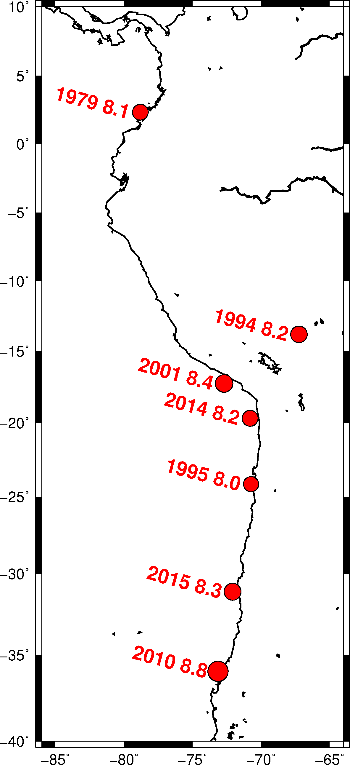
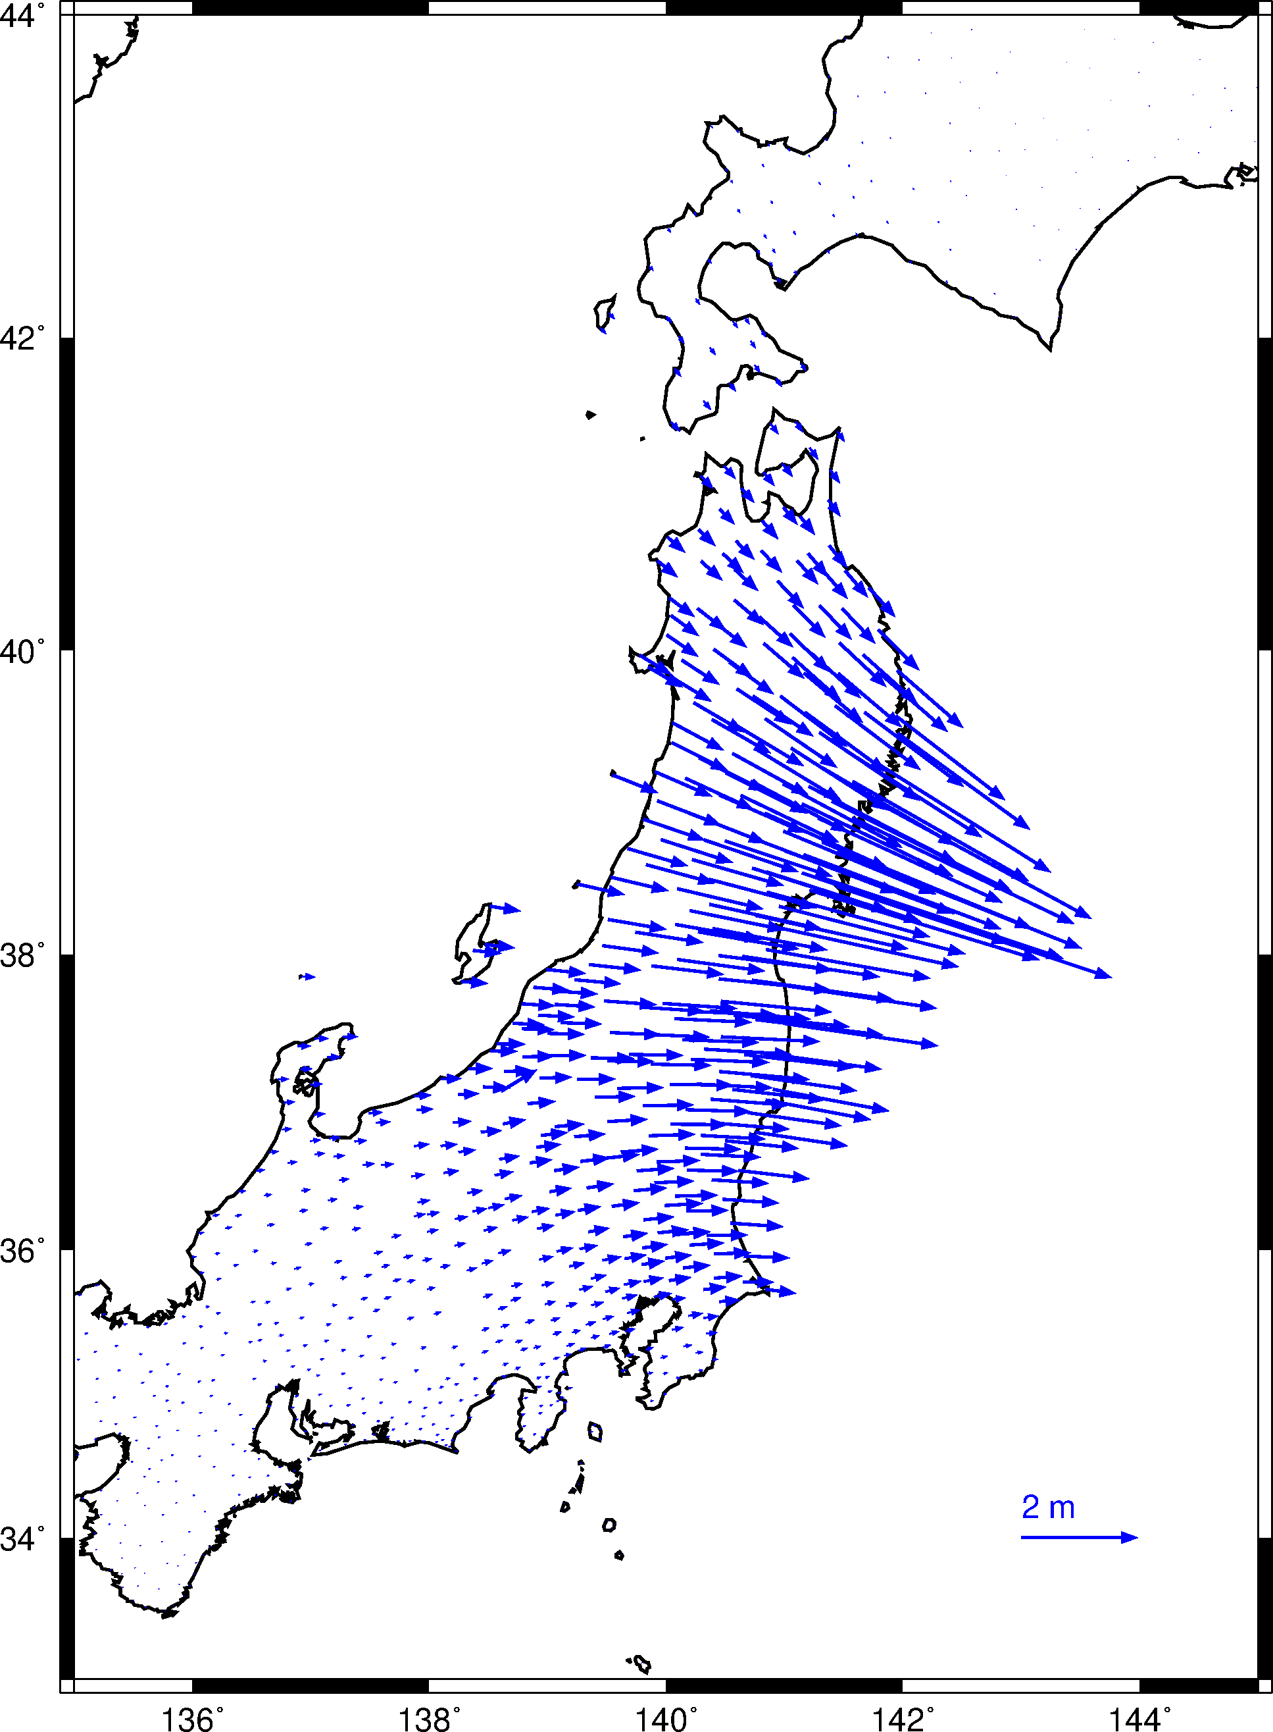
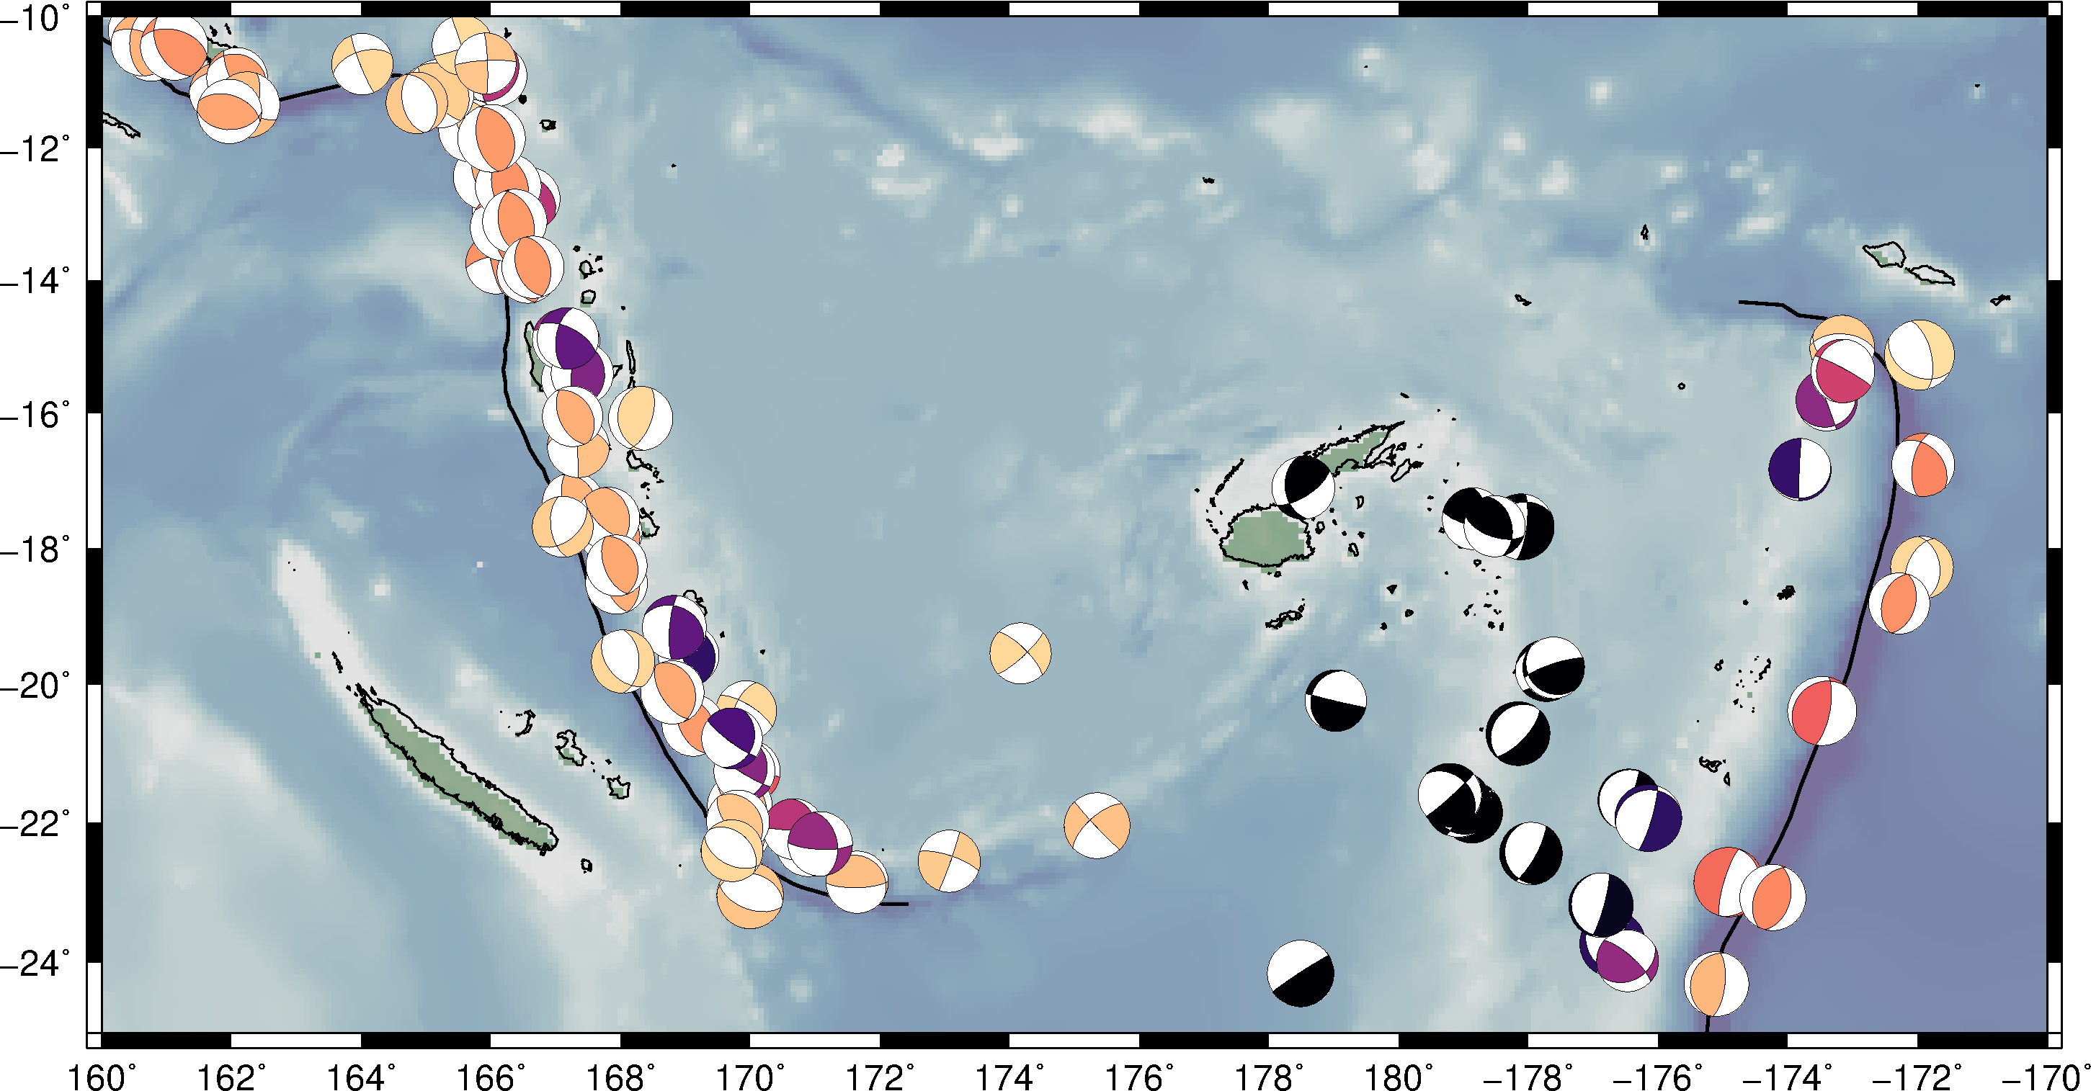
Introduction to GMT (Part 3)
Matt Herman
Last updated:

Slide 2
Tutorial Objectives
Learn the following new GMT commands
pstext
psxy -Sv
psmeca
Note: This tutorial assumes knowledge from Parts 1 and 2. If you are a new user, you may want to go back and complete these first!
Look at the awk tutorial too!

Slide 3
Outline of Tutorial Activities
pstext: add user-defined text
psxy -Sv: plot vectors
psmeca: plot earthquake focal mechanisms

Slide 4
Adding Text
In many figures, it is useful to include labels to provide additional context
We already learned how to add axis annotations with psbasemap and scale annotations/labels with psscale
In Tutorial 1, we plotted earthquakes as point data. Now we will label events by year and magnitude.

Slide 5
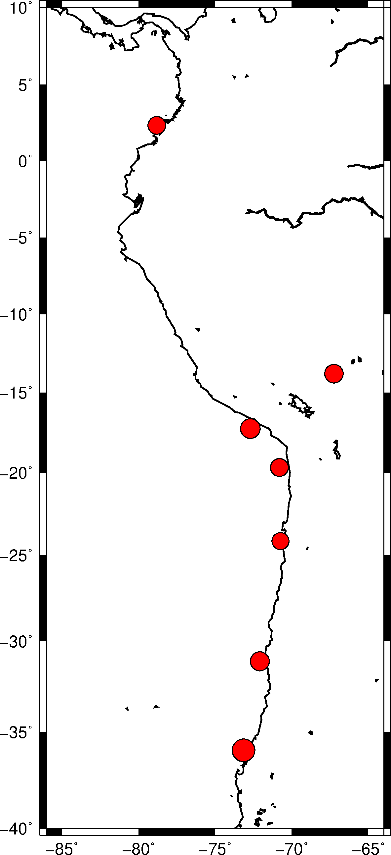
Introduction to pstext
gmt pscoast -JM3.4i –R-86/-64/-40/10 -W1p -Dl -K > samerica.ps
awk '{print $2,$3,$5*$5*$5/3000}' gcmt.dat |\
gmt psxy -JM3.4i –R-86/-64/-40/10 -W0.5p -Sci -Gred -K -O >> samerica.ps
gmt psbasemap -JM3.4i –R-86/-64/-40/10 -Bxa5 -Bya5 -BWeSn -K -O >> samerica.ps
Start with the set of commands listed above to produce the figure at right. We have covered all of these previously (including in the awk tutorial), so this should be a recap.
The earthquake data come from the Global Centroid Moment Tensor catalog (https://globalcmt.org), an excellent source to find the parameters of large earthquakes.
gcmt.dat:
1979-12-12T07:59:03 281.190 2.320 19.7 8.12
1994-06-09T00:33:16 292.750 -13.820 647.1 8.25
1995-07-30T05:11:23 289.260 -24.170 28.7 8.02
2001-06-23T20:33:14 287.290 -17.280 29.6 8.41
2010-02-27T06:34:15 286.850 -35.980 23.2 8.81
2014-04-01T23:46:47 289.190 -19.700 21.6 8.15
2015-09-16T22:54:32 287.910 -31.130 17.4 8.31

Slide 6
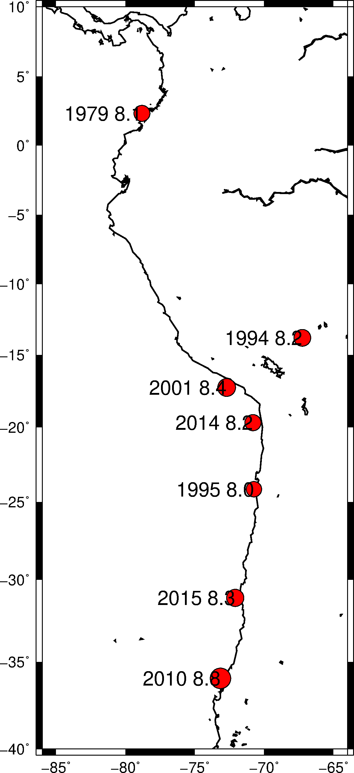
Introduction to pstext
gmt pstext label.dat -JM3.4i –R-86/-64/-40/10 -F+f+j \
-K -O >> samerica.ps
gmt pstext
To add text in your figure, use the pstext command. This is mainly for labels within the boundaries of the map; other commands are better for adding annotations and labels to axes, scale bars, etc.
Like psxy, the input starts with x and y coordinates, then the text details follow.
label.dat:
281.190 2.320 16,0 RM 1979 8.1
292.750 -13.820 16,0 RM 1994 8.2
289.260 -24.170 16,0 RM 1995 8.0
287.290 -17.280 16,0 RM 2001 8.4
286.850 -35.980 16,0 RM 2010 8.8
289.190 -19.700 16,0 RM 2014 8.2
287.910 -31.130 16,0 RM 2015 8.3

Slide 7
Introduction to pstext
The -F option defines the format of the input text parameters
gmt pstext label.dat -JM3.4i –R-86/-64/-40/10 -F+f+j \
-K -O >> samerica.ps
-F+f+j
The most important option in this instance of pstext is the -F flag. This defines how to read the input text parameters after the x-y coordinates. Here, +f is for the font, and +j is for the justification. The font is specified by the format <size>,<font>,<color>, so 16,0 means 16 point font, font number 0 (Helvetica), and default color (black). RM indicates right-middle justified.
label.dat:
281.190 2.320 16,0 RM 1979 8.1
292.750 -13.820 16,0 RM 1994 8.2
289.260 -24.170 16,0 RM 1995 8.0
287.290 -17.280 16,0 RM 2001 8.4
286.850 -35.980 16,0 RM 2010 8.8
289.190 -19.700 16,0 RM 2014 8.2
287.910 -31.130 16,0 RM 2015 8.3

Slide 8
Introduction to pstext
gmt pstext label.dat -JM3.4i –R-86/-64/-40/10 -F+f+j \
-K -O >> samerica.ps
Any text after the formatting columns is plotted on the map. In this case, we want to indicate the year that the earthquake occurred and its magnitude.
label.dat:
281.190 2.320 16,0 RM 1979 8.1
292.750 -13.820 16,0 RM 1994 8.2
289.260 -24.170 16,0 RM 1995 8.0
287.290 -17.280 16,0 RM 2001 8.4
286.850 -35.980 16,0 RM 2010 8.8
289.190 -19.700 16,0 RM 2014 8.2
287.910 -31.130 16,0 RM 2015 8.3

Slide 9
Introduction to pstext
gmt pstext label.dat -JM3.4i –R-86/-64/-40/10 -F+f+j \
-D-0.12i/0i -K -O >> samerica.ps
Shift text with -D
-D-0.12i/0i
In the previous map, the text overlapped the symbol, which makes the magnitude decimal value hard to read. To shift text from its input coordinate, use the -D option. The first value is the x-shift, the second value is the y-shift.
Now we can read all of the text more clearly.
label.dat:
281.190 2.320 16,0 RM 1979 8.1
292.750 -13.820 16,0 RM 1994 8.2
289.260 -24.170 16,0 RM 1995 8.0
287.290 -17.280 16,0 RM 2001 8.4
286.850 -35.980 16,0 RM 2010 8.8
289.190 -19.700 16,0 RM 2014 8.2
287.910 -31.130 16,0 RM 2015 8.3

Slide 10
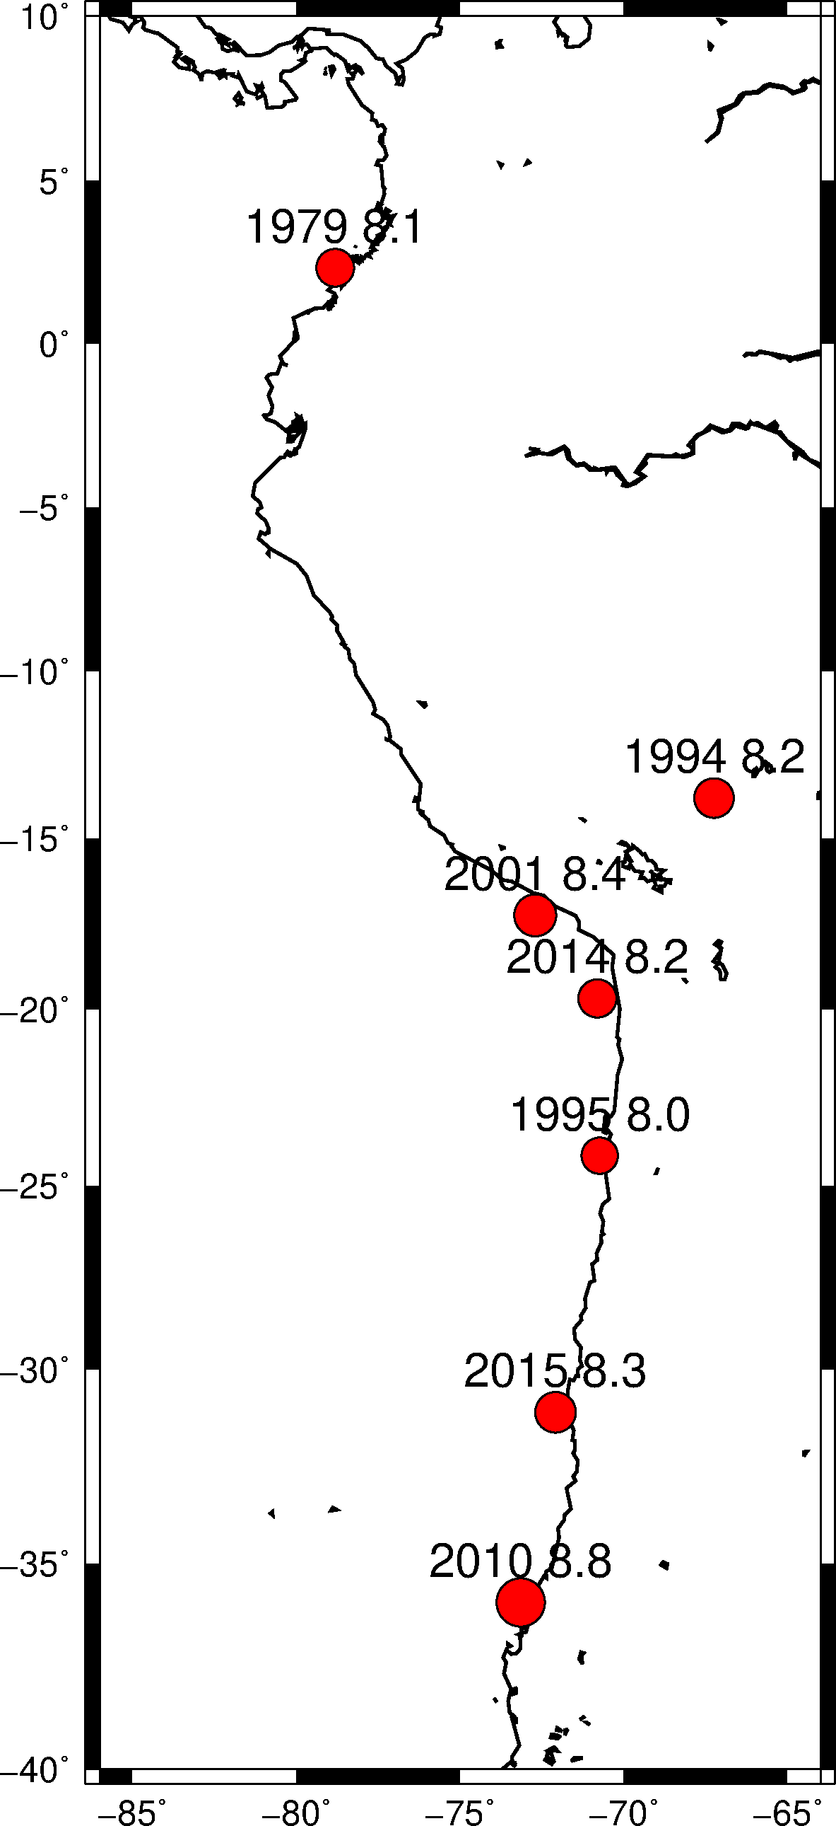
Introduction to pstext
gmt pstext label.dat -JM3.4i –R-86/-64/-40/10 -F+f+j \
-D0i/0.12i -K -O >> samerica.ps
Shift up instead of left
Adjust the justification column and the -D option to put the text in different locations. In this map, the text is CB for center-bottom justified. Then we move the text up above the symbol. The details of text positioning will depend on your specific figure, and you may need to experiment to find what looks best.
label.dat:
281.190 2.320 16,0 CB 1979 8.1
292.750 -13.820 16,0 CB 1994 8.2
289.260 -24.170 16,0 CB 1995 8.0
287.290 -17.280 16,0 CB 2001 8.4
286.850 -35.980 16,0 CB 2010 8.8
289.190 -19.700 16,0 CB 2014 8.2
287.910 -31.130 16,0 CB 2015 8.3

Slide 11
Introduction to pstext
Specify angle with +a
gmt pstext label.dat -JM3.4i –R-86/-64/-40/10 -F+f+j+a \
-D-0.12i/0i -K -O >> samerica.ps
The formatting is very flexible, like most things in GMT. As an example, here we added a rotation angle (measured counter-clockwise from the x-axis) to the text with the +a option added to -F. The angle must then be defined in the input file (or it can be defined for all inputs right after +a; then you do not need the column in the input file!). We also made the text bold and colored red by changing the font to 2 and adding the color specifier red.
label.dat:
281.190 2.320 16,2,red RM -15 1979 8.1
292.750 -13.820 16,2,red RM -15 1994 8.2
289.260 -24.170 16,2,red RM -15 1995 8.0
287.290 -17.280 16,2,red RM -15 2001 8.4
286.850 -35.980 16,2,red RM -15 2010 8.8
289.190 -19.700 16,2,red RM -15 2014 8.2
287.910 -31.130 16,2,red RM -15 2015 8.3

Slide 12
Adding Vectors
Vector data are common in Earth Science
Vectors can be plotted using psxy with a specific flag: -Sv (or -SV)
In Tutorial 2, we interpolated the surface displacement magnitude associated with the 2011 Mw 9.0 Japan earthquake. Now we will plot these displacements as vectors.

Slide 13
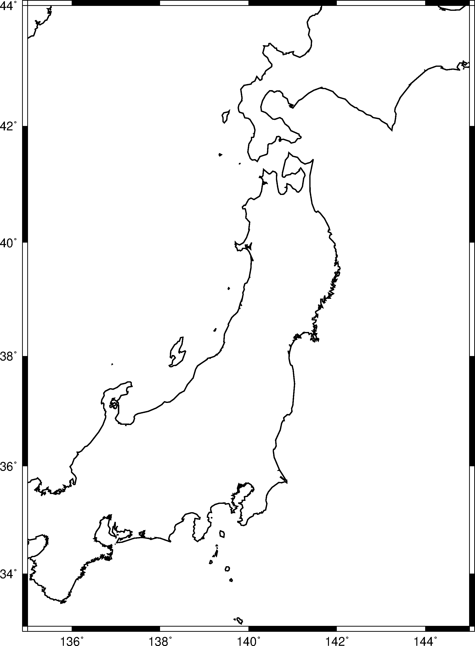
Introduction to psxy -Sv
gmt pscoast -JM6i -R135/145/33/44 -W1p -A0/0/1 -Di -K > japan2011.ps
gmt psbasemap -JM6i -R135/145/33/44 -Bxa2 -Bya2 -BWeSn -K -O >> japan2011.ps
We again start with a basic map, this time of Japan. I specified intermediate coastline resolution with the -Di flag.
-A0/0/1
Sometimes I want specific parts of the coastline. The -A option gives this control. The first number indicates the minimum area (in km²) to plot. I want all the details here. The next numbers indicate the minimum and maximum “hierarchical levels” to plot. From the GMT Cookbook: “Level=1 represents ocean/land boundaries, 2 is land/lakes borders, 3 is lakes/islands-in-lakes, and 4 is islands-in-lakes/ponds-in-islands-in-lakes”. I just want the ocean-land boundary here.

Slide 14
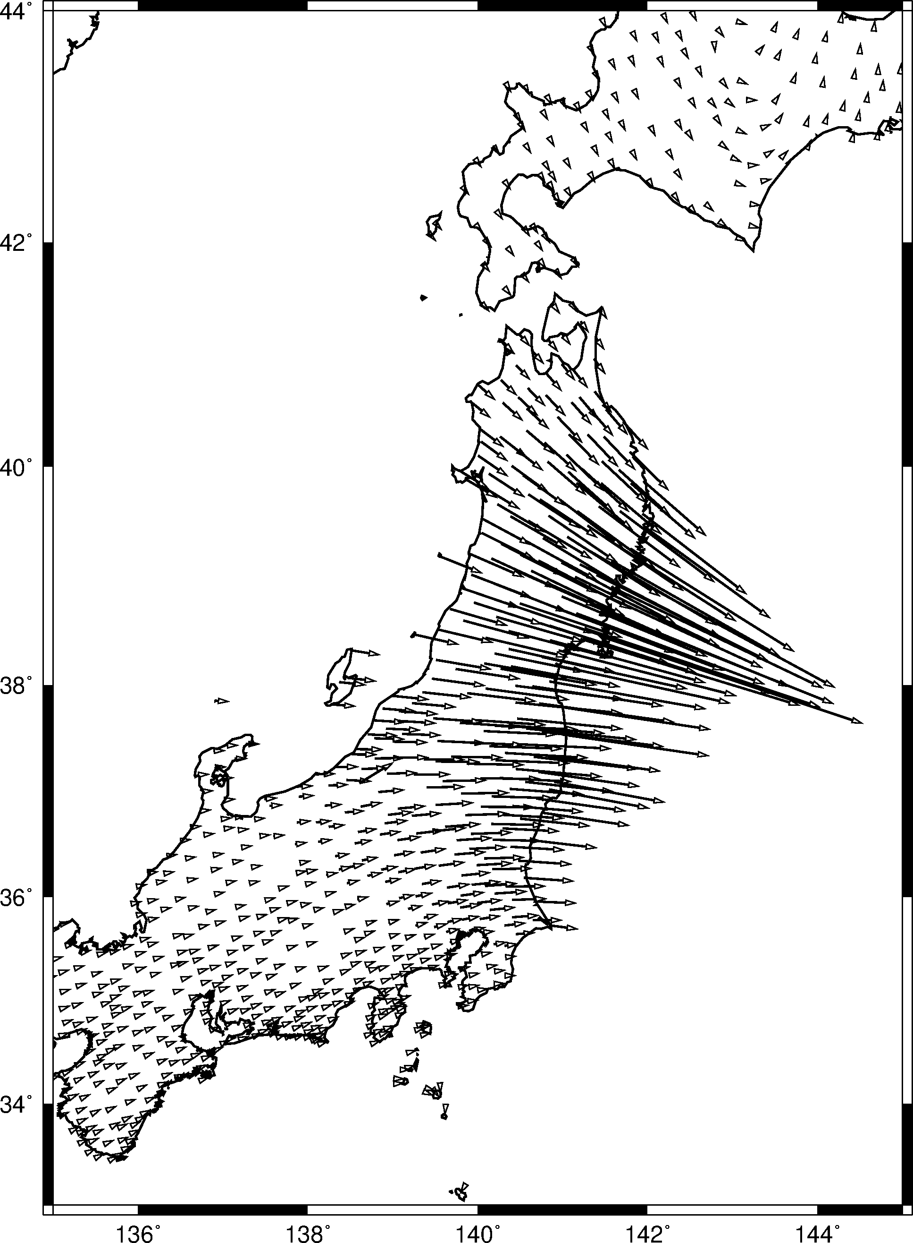
Introduction to psxy -Sv
gmt psxy tohoku2011.dat -JM6i -R135/145/33/44 -SV6p+jb+e -W1p \
-K -O >> japan2011.ps
psxy ... -SV6p+jb+e
We now add the co-seismic displacements measured after the 2011 earthquake at GPS stations throughout Japan. You can find the displacements in the file tohoku2011.dat (data from the Japan Geospatial Information Authority; link on the tutorial website).
The file format is similar to the format we used for psxy in the first tutorial. The first two columns indicate the longitude and latitude. The third column is the vector angle and the fourth column is the vector magnitude.
tohoku2011.dat:
141.861 44.0521 155.4740 0.0183895
133.734 35.0030 71.6785 0.0408278
141.007 37.5337 98.2782 2.6494300
139.142 35.2686 72.7149 0.1226310
139.849 39.8911 120.6330 0.6804290
140.447 39.0544 113.8440 1.6063900
: : : :

Slide 15
Introduction to psxy -Sv
gmt psxy tohoku2011.dat -JM6i -R135/145/33/44 -SV6p+jb+e -W1p \
-K -O >> japan2011.ps
psxy ... -SV6p+jb+e
Next, we will add the co-seismic displacement vectors measured after the 2011 earthquake at GPS stations throughout Japan. You can find the displacements in the file tohoku2011.dat (link available on the tutorial website).
The file format is similar to the format we used for psxy in the first tutorial. The first two columns indicate the longitude and latitude. The third column is the vector angle and the fourth column is the vector magnitude.
tohoku2011.dat:
141.861 44.0521 155.4740 0.0183895
133.734 35.0030 71.6785 0.0408278
141.007 37.5337 98.2782 2.6494300
139.142 35.2686 72.7149 0.1226310
139.849 39.8911 120.6330 0.6804290
140.447 39.0544 113.8440 1.6063900
: : : :
Longitude and latitude

Slide 16
Introduction to psxy -Sv
gmt psxy tohoku2011.dat -JM6i -R135/145/33/44 -SV6p+jb+e -W1p \
-K -O >> japan2011.ps
psxy ... -SV6p+jb+e
Next, we will add the co-seismic displacement vectors measured after the 2011 earthquake at GPS stations throughout Japan. You can find the displacements in the file tohoku2011.dat (link available on the tutorial website).
The file format is similar to the format we used for psxy in the first tutorial. The first two columns indicate the longitude and latitude. The third column is the vector angle and the fourth column is the vector magnitude.
tohoku2011.dat:
141.861 44.0521 155.4740 0.0183895
133.734 35.0030 71.6785 0.0408278
141.007 37.5337 98.2782 2.6494300
139.142 35.2686 72.7149 0.1226310
139.849 39.8911 120.6330 0.6804290
140.447 39.0544 113.8440 1.6063900
: : : :
Azimuth (degrees CW from north)

Slide 17
Introduction to psxy -Sv
gmt psxy tohoku2011.dat -JM6i -R135/145/33/44 -SV6p+jb+e -W1p \
-K -O >> japan2011.ps
psxy ... -SV6p+jb+e
Next, we will add the co-seismic displacement vectors measured after the 2011 earthquake at GPS stations throughout Japan. You can find the displacements in the file tohoku2011.dat (link available on the tutorial website).
The file format is similar to the format we used for psxy in the first tutorial. The first two columns indicate the longitude and latitude. The third column is the vector angle and the fourth column is the vector magnitude.
tohoku2011.dat:
141.861 44.0521 155.4740 0.0183895
133.734 35.0030 71.6785 0.0408278
141.007 37.5337 98.2782 2.6494300
139.142 35.2686 72.7149 0.1226310
139.849 39.8911 120.6330 0.6804290
140.447 39.0544 113.8440 1.6063900
: : : :
Displacement magnitude (meters)

Slide 18
Introduction to psxy -Sv
The -SV option defines the vector appearance
gmt psxy tohoku2011.dat -JM6i -R135/145/33/44 -SV6p+jb+e -W1p \
-K -O >> japan2011.ps
-SV6p+jb+e
The -SV flag specifies the vector parameters. The first number (6p) is the length of the vector head. +jb indicates justifying the vector at the beginning. In other words, the tail end will be placed at the specified coordinate. Finally, +e tells GMT to plot the vector head at the end. Without this, you will simply get a line with no arrow at the end!

Slide 19
Introduction to psxy -Sv
gmt psxy tohoku2011.dat -JM6i -R135/145/33/44 -SV6p+jb+e -W1p \
-K -O >> japan2011.ps
psxy ... -SV6p+jb+e
There are a couple things to be careful about here:
Since the vector orientations are defined as a geographic azimuth, clockwise from north, we need to use -SV (capital V). If the vectors are defined counter-clockwise from the x-axis, then we would use -Sv (lowercase v). Double check your azimuth definitions and this flag!
The input displacement magnitudes are in meters, but GMT will read the values and plot the vectors in the default units (usually centimeters). If your vectors have large or small values, you will need to re-scale them. We will cover that next.

Slide 20
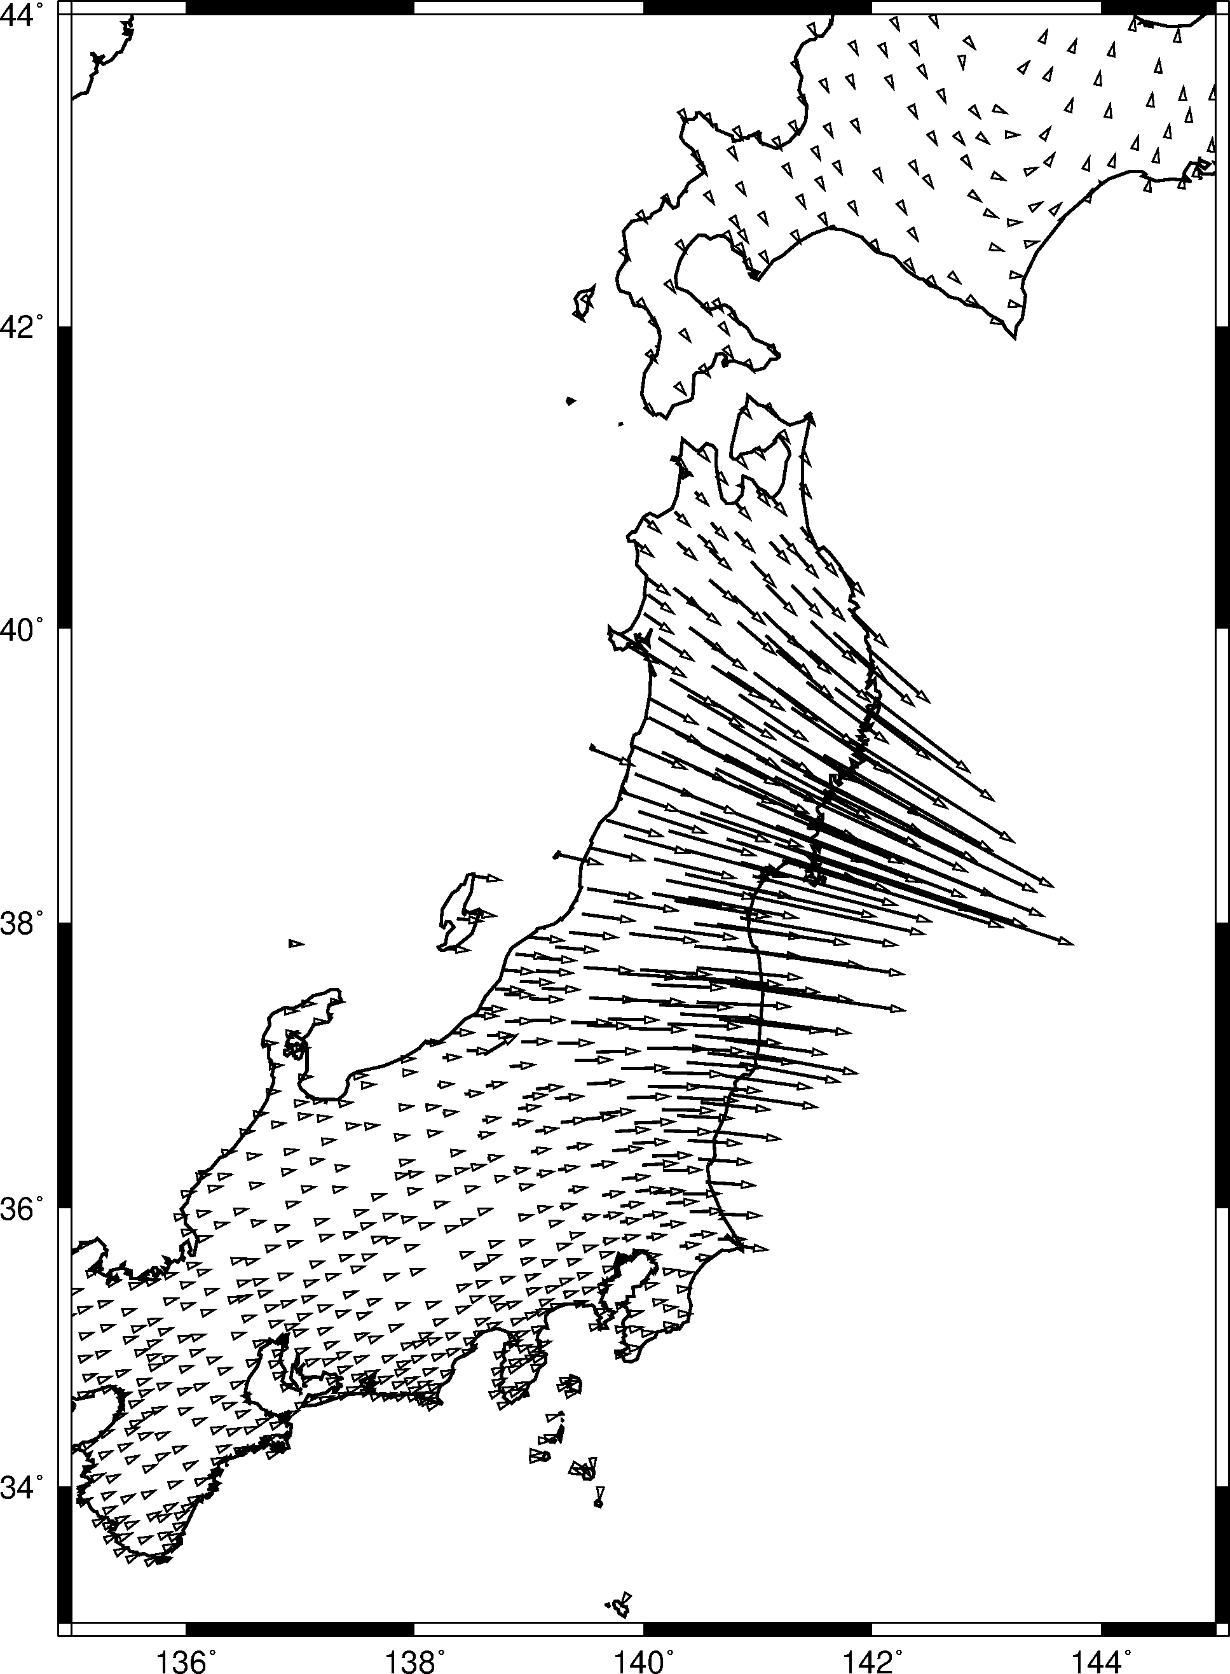
Introduction to psxy -Sv
awk '{print $1,$2,$3,$4*0.75}' tohoku2011.dat |\
gmt psxy -JM6i -R135/145/33/44 -SV6p+jb+e -W1p -K -O >> japan2011.ps
awk '{print $1,$2,$3,$4*0.75}’
tohoku2011.dat
To reduce the size of the arrows on the map, we use awk. This command takes the file tohoku2011.dat and prints the first column, second column, third column, and the fourth column (displacement magnitude) multiplied by 0.75. We “pipe” the awk output (|) to be the input for the psxy command.

Slide 21
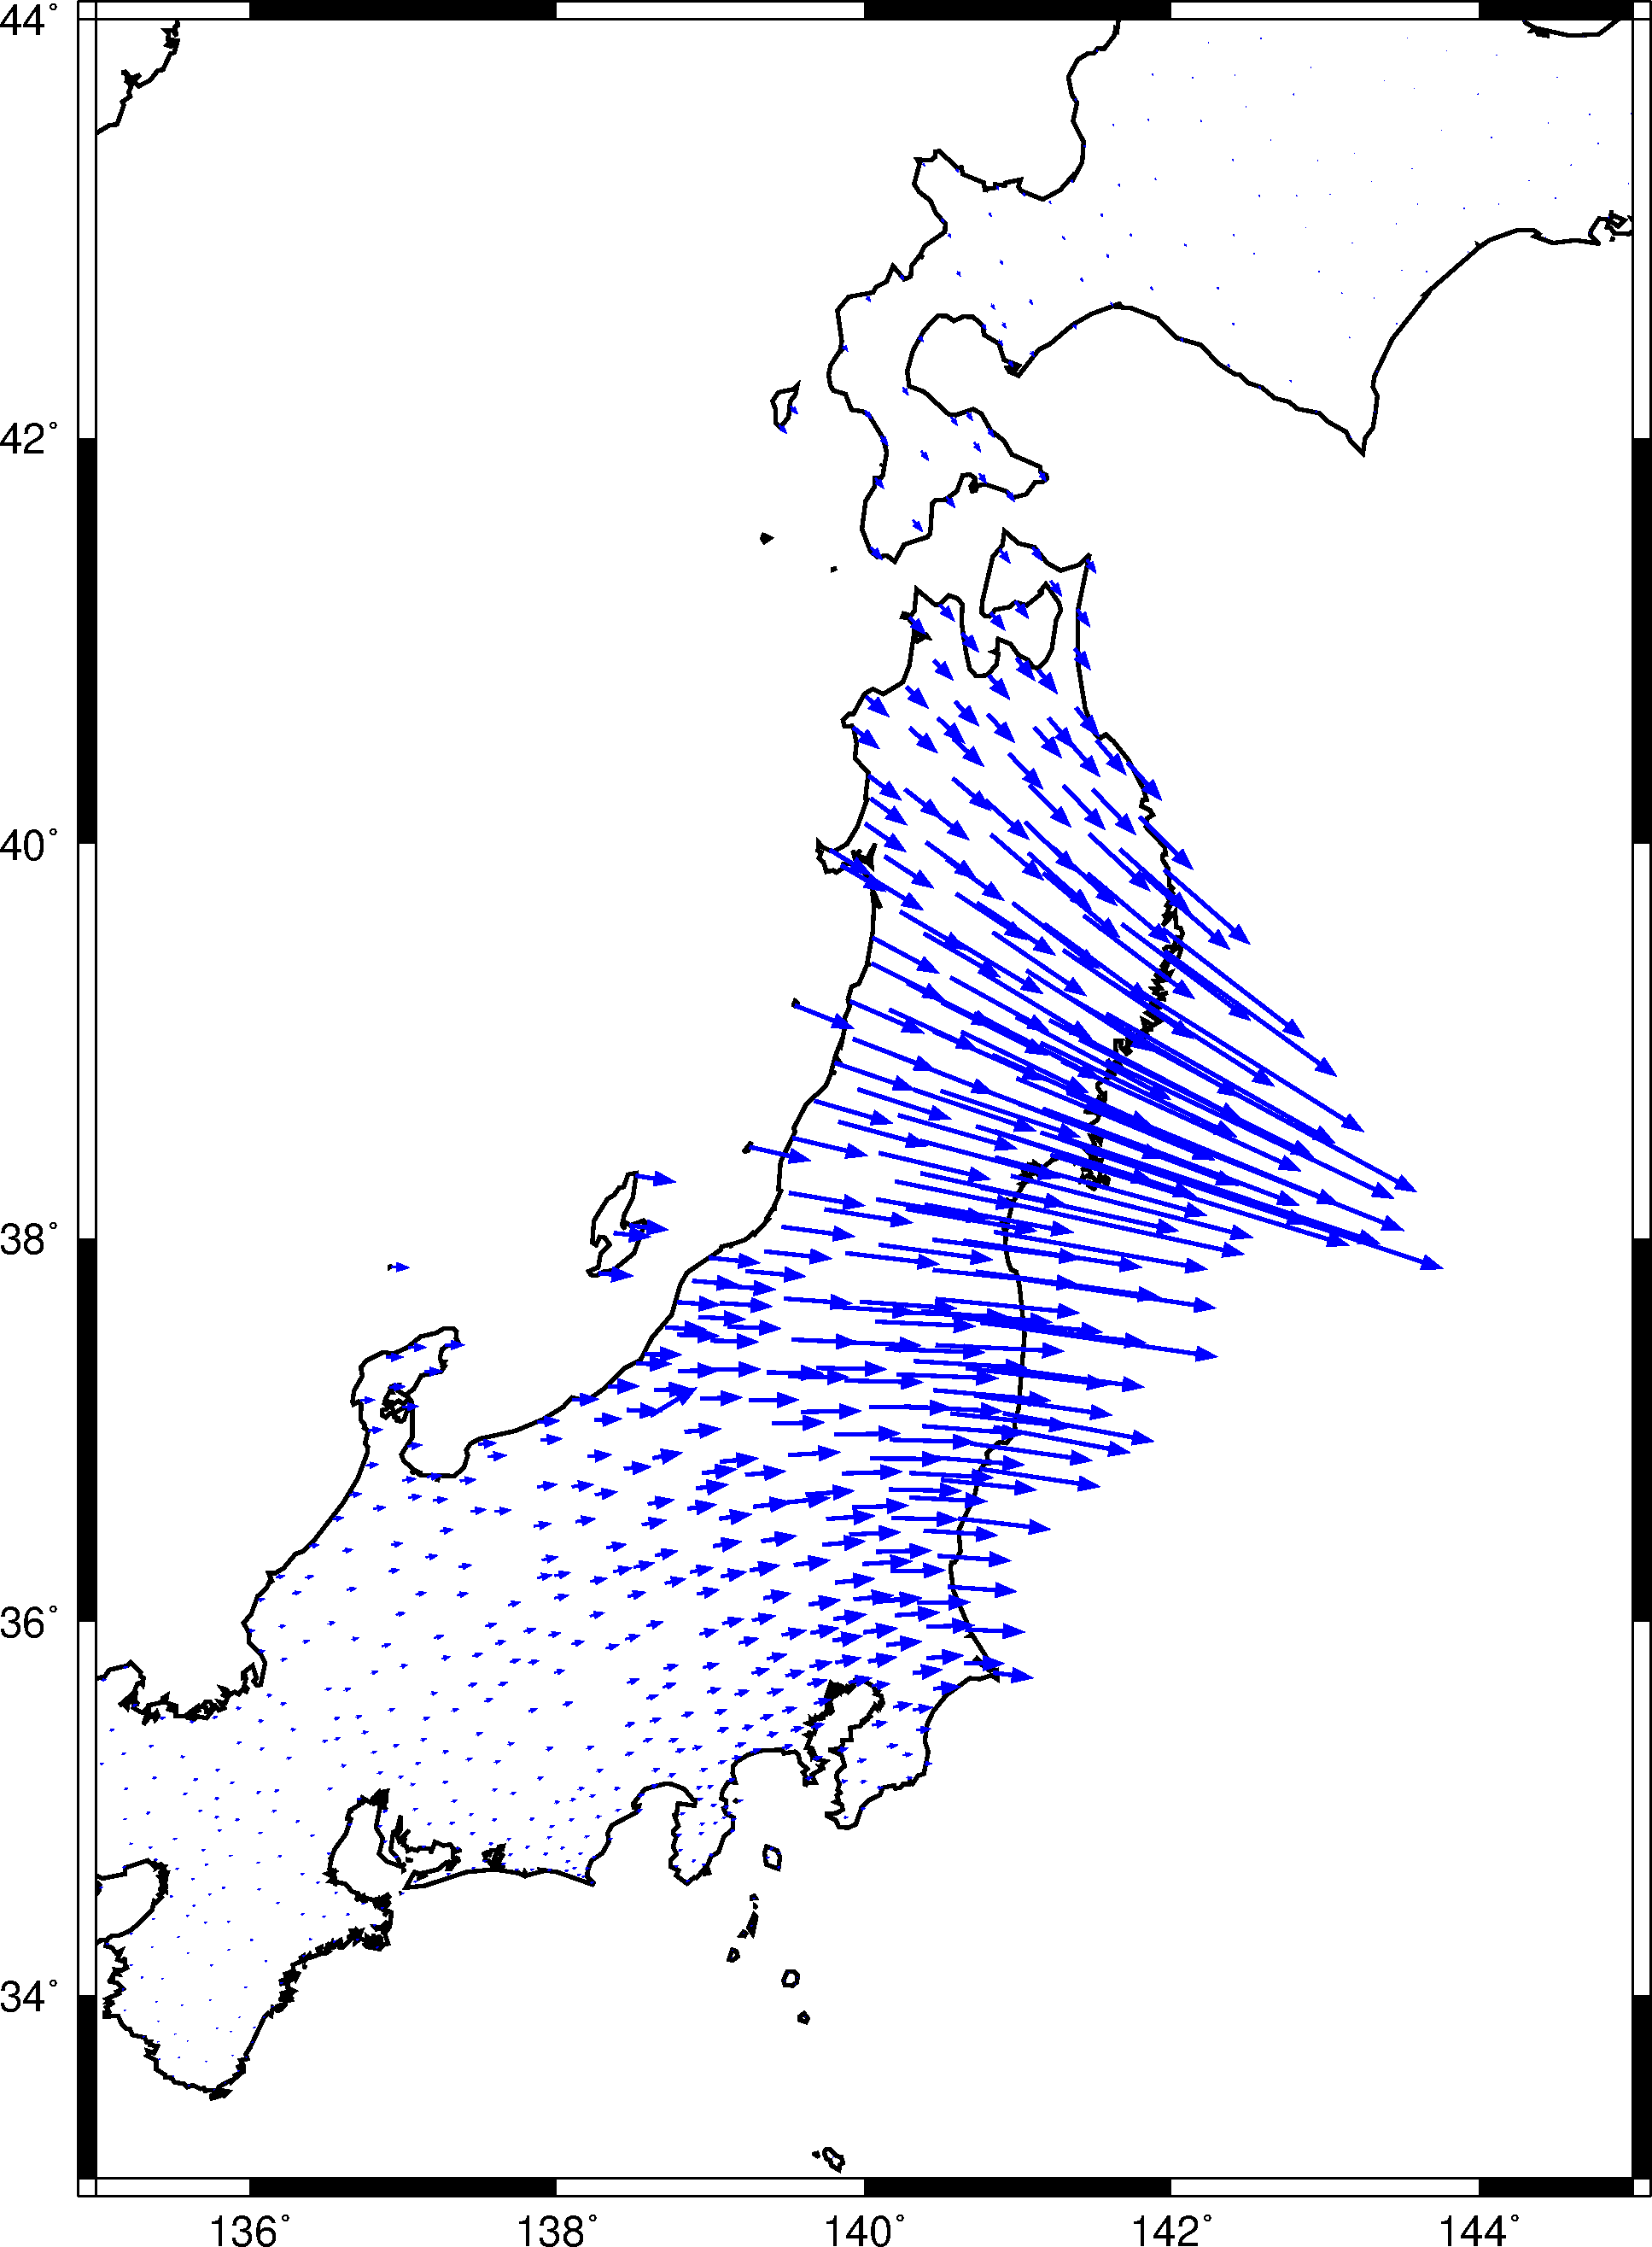
Introduction to psxy -Sv
awk '{print $1,$2,$3,$4*0.75}' tohoku2011.dat |\
gmt psxy -JM6i -R135/145/33/44 -SV6p+jb+e+a40+n0.12 -W1p,blue -Gblue \
-K -O >> japan2011.ps
-SV6p+jb+e+a40+n0.12
The appearance of the arrows is very customizable. The default arrowhead angle is 30 degrees. +a40 changes that angle to 40 degrees. There are also a lot of small displacements in southern Honshu and Hokkaido whose lengths are difficult to see beneath the arrowheads. +n0.12 scales down any vectors smaller than 0.12.
-W1p,blue -Gblue
The arrows can be colored, which may make them easier to distinguish. We color the vector lines with -W1p,blue and fill the arrows with -Gblue.

Slide 22
Introduction to psxy -Sv
echo 143 34 90 1.50 |\
gmt psxy -JM6i -R135/145/33/44 -SV6p+jb+e+a40+n0.12 -W1p,blue -Gblue \
-K -O >> japan2011.ps
echo 143 34 12,0,blue LB 2 m |\
gmt pstext -JM6i -R135/145/33/44 -F+f+j -D0/0.1i -N -K -O >> japan2011.ps
Finally, any figure like this needs a scale. There is room in the southeast corner of the map for a scaled vector symbol. We will do this by sending the plotting parameters via standard input to psxy and pstext.
echo 143 34 90 1.50
The arrow is plotted at 143ºE and 34ºN, with an azimuth of 90º and a length of 1.50. Remember, the scale from earlier is 0.75, so this length corresponds to a 2 meter vector. Use the same psxy -SV options as before.
echo 143 34 12,0,blue LB 2 m
The “2 m” label is plotted above the arrow with pstext. The text is also at (143º,34º), but nudged slightly upward with -D.

Slide 23
Earthquake Focal Mechanisms
The type of faulting during an earthquake is represented by its “focal mechanism” (or “moment tensor”)
These symbols can be plotted with the GMT command psmeca

Slide 24
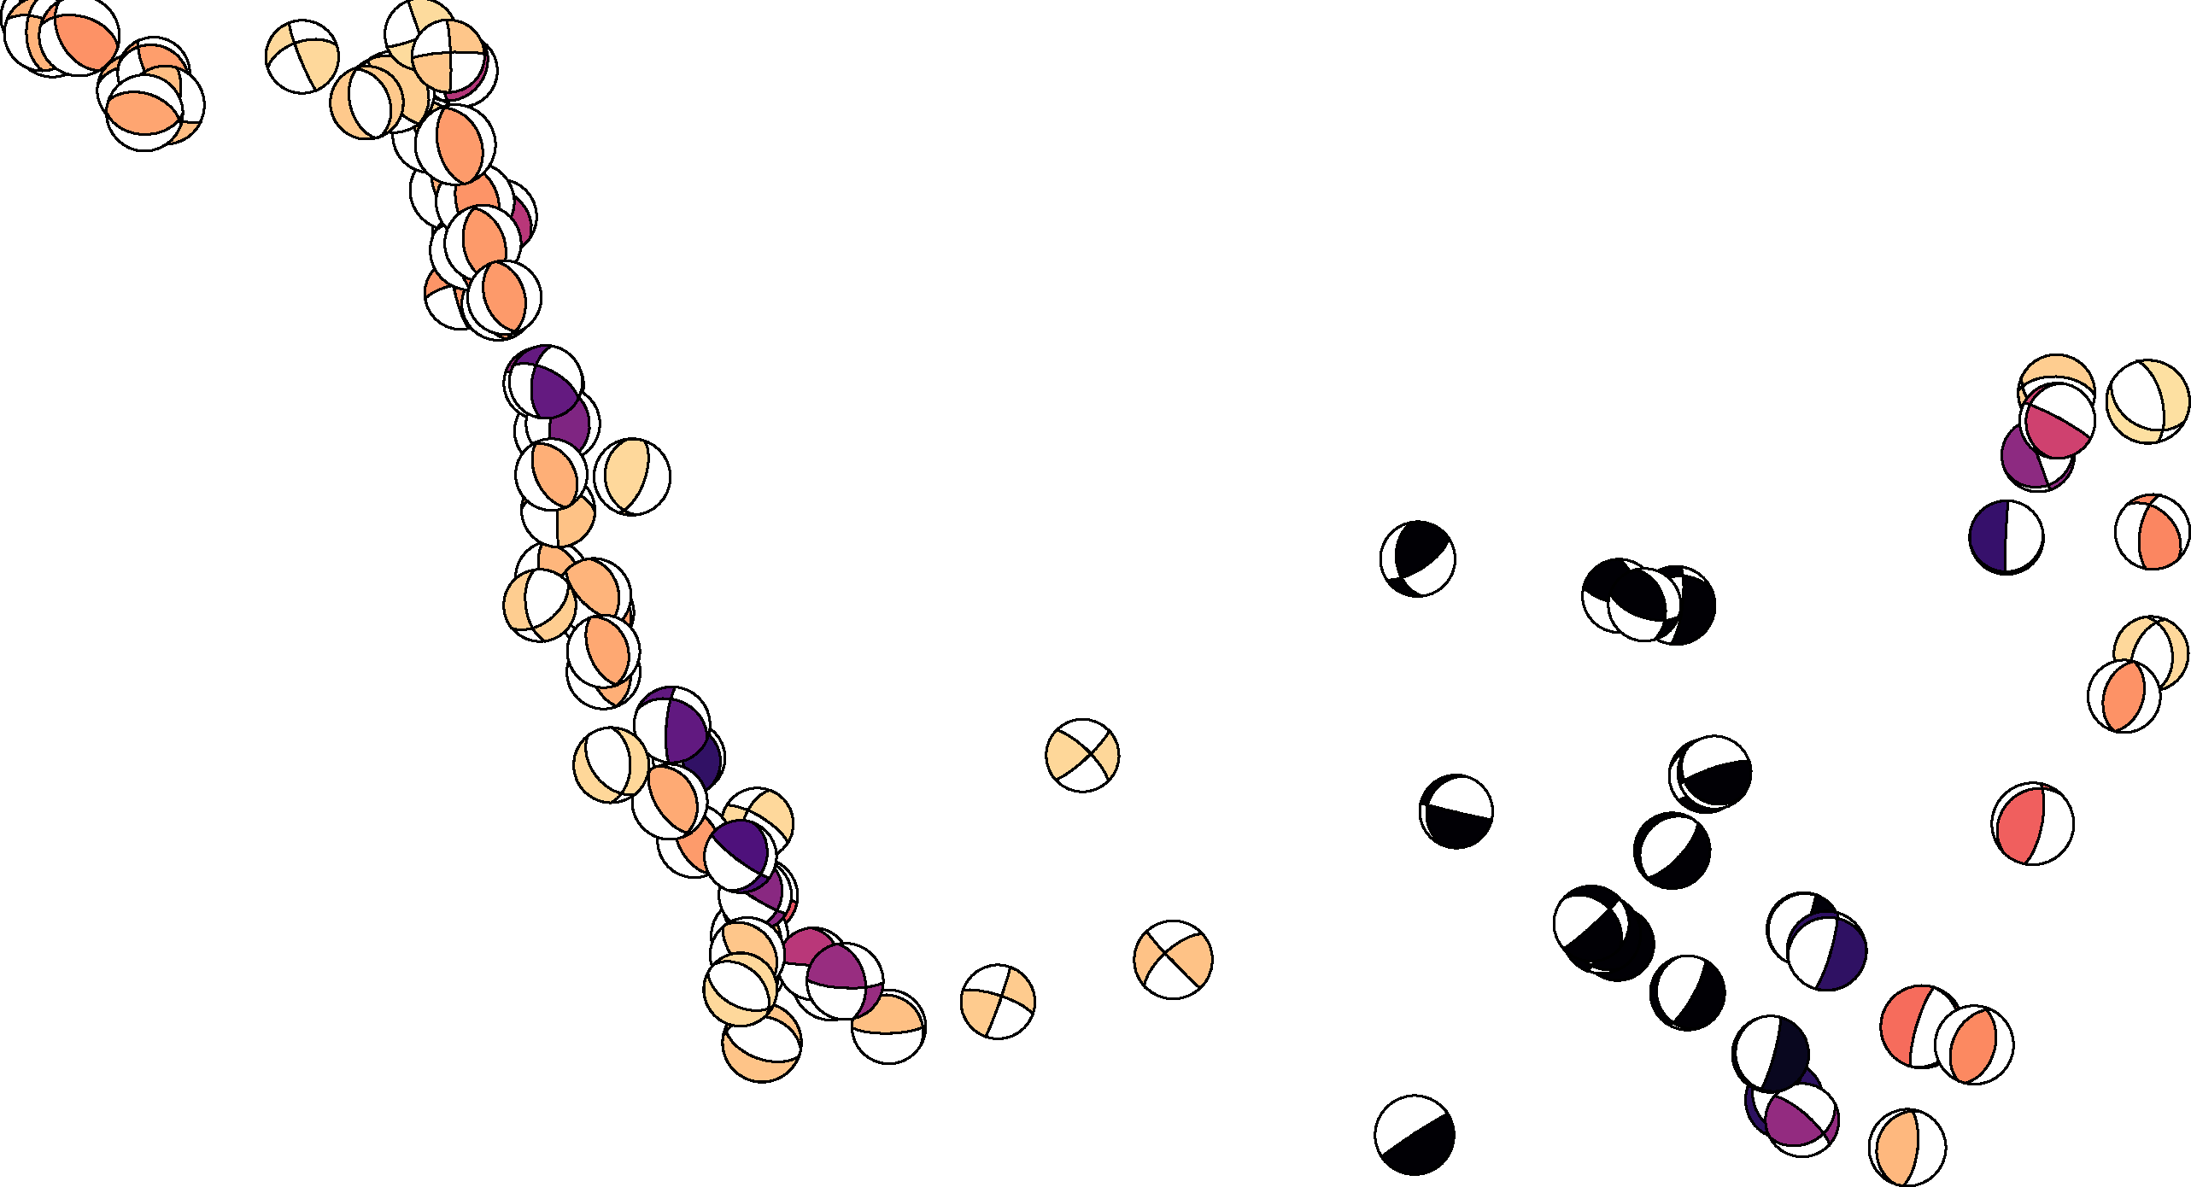
Introduction to psmeca
gmt psmeca fiji_mec.dat -JM9i -R160/190/-25/-10 \
-Sa0.2i -Zdep.cpt -W0.5p > fiji_mec.ps
gmt psmeca
The command psmeca is like a specialized version of psxy used exclusively for plotting earthquake focal mechanisms. The file fiji_mec.dat (link available on the tutorial website) contains the earthquake location (longitude, latitude, depth), the focal mechanism (strike, dip, rake), and the earthquake magnitude. The data are again from the GCMT catalog.
fiji_mec.dat:
188.090 16.770 50.3 190.2 62.3 122.0 7.31
160.590 10.220 40.4 159.2 55.5 97.4 7.35
185.090 22.860 61.3 196.6 78.9 -89.5 8.06
161.820 11.160 33.3 278.8 33.8 32.6 7.00
: : : : : : :

Slide 25
Introduction to psmeca
gmt psmeca fiji_mec.dat -JM9i -R160/190/-25/-10 \
-Sa0.2i -Zdep.cpt -W0.5p > fiji_mec.ps
-Sa0.2i
There are a few different ways to represent focal mechanisms (or the more general seismic sources possible using moment tensors). GMT is able to plot moment tensors from several commonly used formats. -Sa indicates that we will be using the Aki and Richards (2002) definition of the focal mechanism, i.e., the strike, dip, and rake. The number 0.2i is the diameter of a magnitude 5 earthquake, and the scaling is linear with magnitude.
Aki, K., Richards, P.G. (2002). Quantitative Seismology. University Science Books. (VERY TECHNICAL!)

Slide 26
Introduction to psmeca
gmt psmeca fiji_mec.dat -JM9i -R160/190/-25/-10 \
-Sa0.2i -Zdep.cpt -W0.5p > fiji_mec.ps
-Zdep.cpt
When the -Z flag is provided with a color palette, the compressive quadrant of the mechanism is shaded with the color corresponding to the value in the third column of the input. This is commonly the event depth, but can be other values (like origin time).
In this case, the input file fiji_mec.dat contains centroid depth in the third column, and the file dep.cpt was made with makecpt.
gmt makecpt -T0/200/1 -Cmagma -D -I > dep.cpt

Slide 27
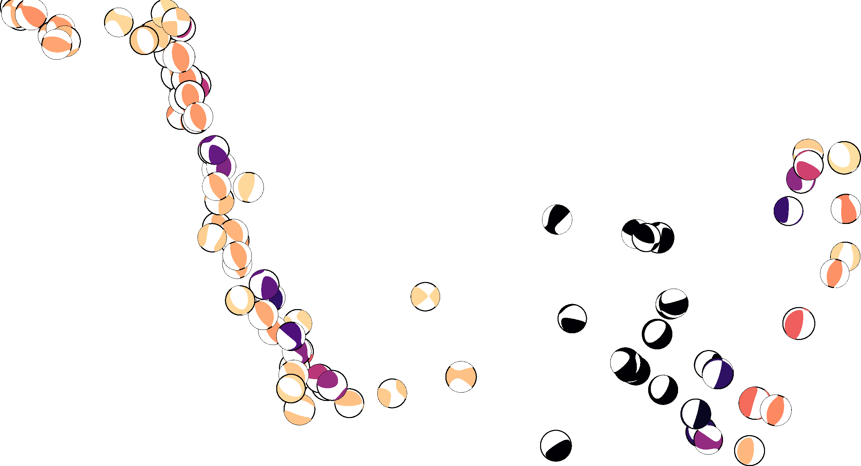
Introduction to psmeca
gmt psmeca fiji_mt.dat -JM9i -R160/190/-25/-10 \
-Sm0.2i -Zdep.cpt -W0.5p > fiji_mec.ps
-Sm0.2i
Another common way to represent an earthquake source is with a moment tensor, such as provided in the USGS or GCMT catalogs. A description of moment tensors is beyond the scope of this tutorial, but for the sake of plotting, you simply change the flag from -Sa to -Sm, and the input to: lon, lat, depth, mrr, mtt, mff, mrt, mrf, mtf, and the exponent of the seismic moment (in Nm). I have provided the file fiji_mt.dat on the tutorial page. Notice that the beachball symbols are similar to before, with slight differences in the details. These differences represent the deviations from a simple fault slip source, which are often small for natural earthquake sources.

Slide 28
Introduction to psmeca
gmt psmeca fiji_mt.dat -JM9i -R160/190/-25/-10 \
-Sm0.2i -Zdep.cpt -W0.5p -T > fiji_mec.ps
-T
By default, using -Sm just puts colors in the compressive quadrants of the symbol. It does not draw the curves representing the fault planes. To add the fault planes to the symbol, you must include the -T flag. This is most useful to see the corresponding focal mechanism when the shaded regions have a relatively light color, like the (shallow-depth) yellow and orange events in this figure.

Slide 29
Finally, we will make the map look nicer with a combination of grdimage, pscoast, pscoast, and psbasemap.

Slide 30
#!/bin/bash
PSFILE=psmeca_example.ps
PROJ="-JM9i -P"
LIMS=-R160/190/-25/-10
# Earthquake depth color palette
gmt makecpt -T0/200/1 -Cmagma -D -I > dep.cpt
# ETOPO5 topography/bathymetry
gmt grdimage ETOPO5.grd $PROJ $LIMS -Ctopo_custom.cpt -K > $PSFILE
# Coastline
gmt pscoast $PROJ $LIMS -Di -W0.5p -A0/0/1 -K -O >> $PSFILE
# USGS plate boundaries
gmt psxy usgs2015_plates.xy $PROJ $LIMS -W1p -K -O >> $PSFILE
# GCMT focal mechanisms
gmt psmeca fiji_mec.dat $PROJ $LIMS -Sa0.2i -Zdep.cpt -K -O >> $PSFILE
# Basemap
gmt psbasemap $PROJ $LIMS -Bxa2 -Bya2 -BWeSn -O >> $PSFILE
Shell script variables
Make earthquake depth
color palette
Plot topography
and bathymetry
Plot coastline
Plot plate boundaries
Plot mechanisms
Plot map frame
The topography, topo color palette, plate boundary file,
and focal mechanisms are available on the tutorial website.

Slide 31
Introduction to GMT (Part 3)
Complete!
Comments? Questions? Requests for future tutorials? Let me know!

