Slide 1
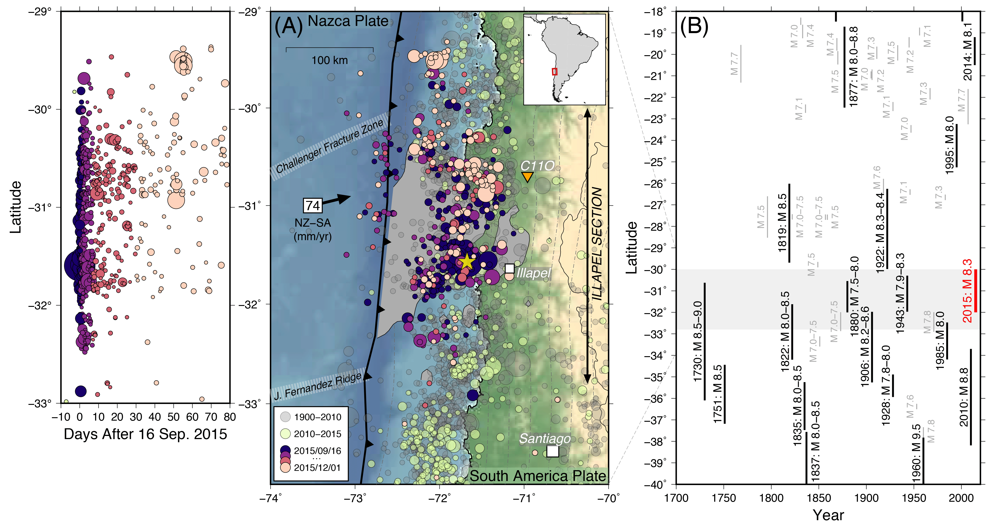
Introduction to GMT (Part 1)
An example of what you
can make with GMT!
Beth Meyers
Matt Herman
Last updated:

Slide 2
Objectives
Basic GMT commands
  psbasemap
  pscoast
  psxy
GMT syntax and command line options
Note: this tutorial is specifically for GMT version 5

Slide 3
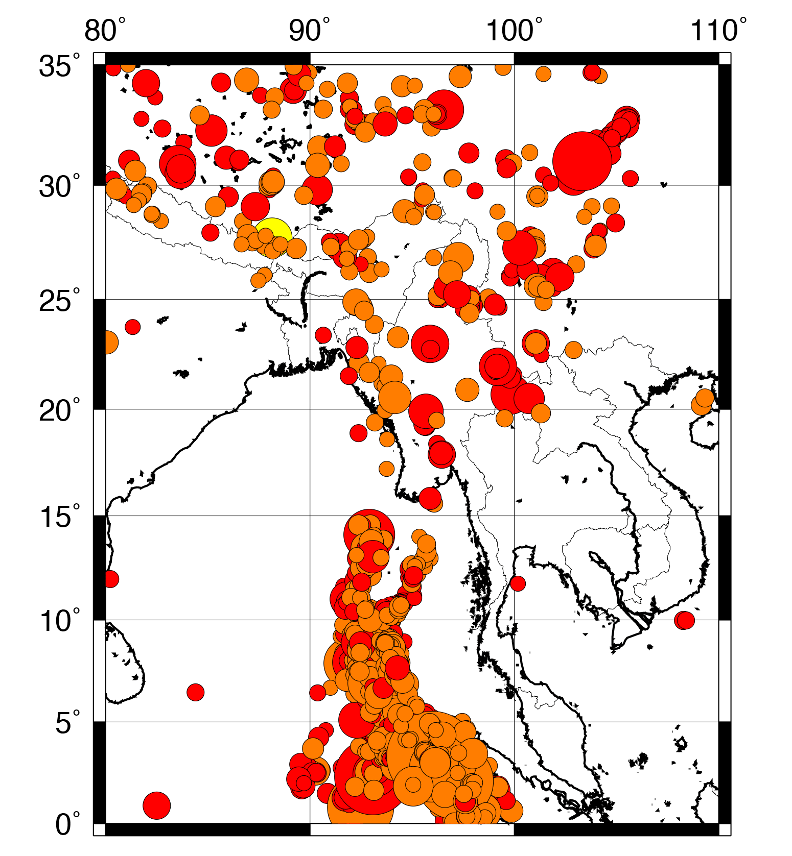
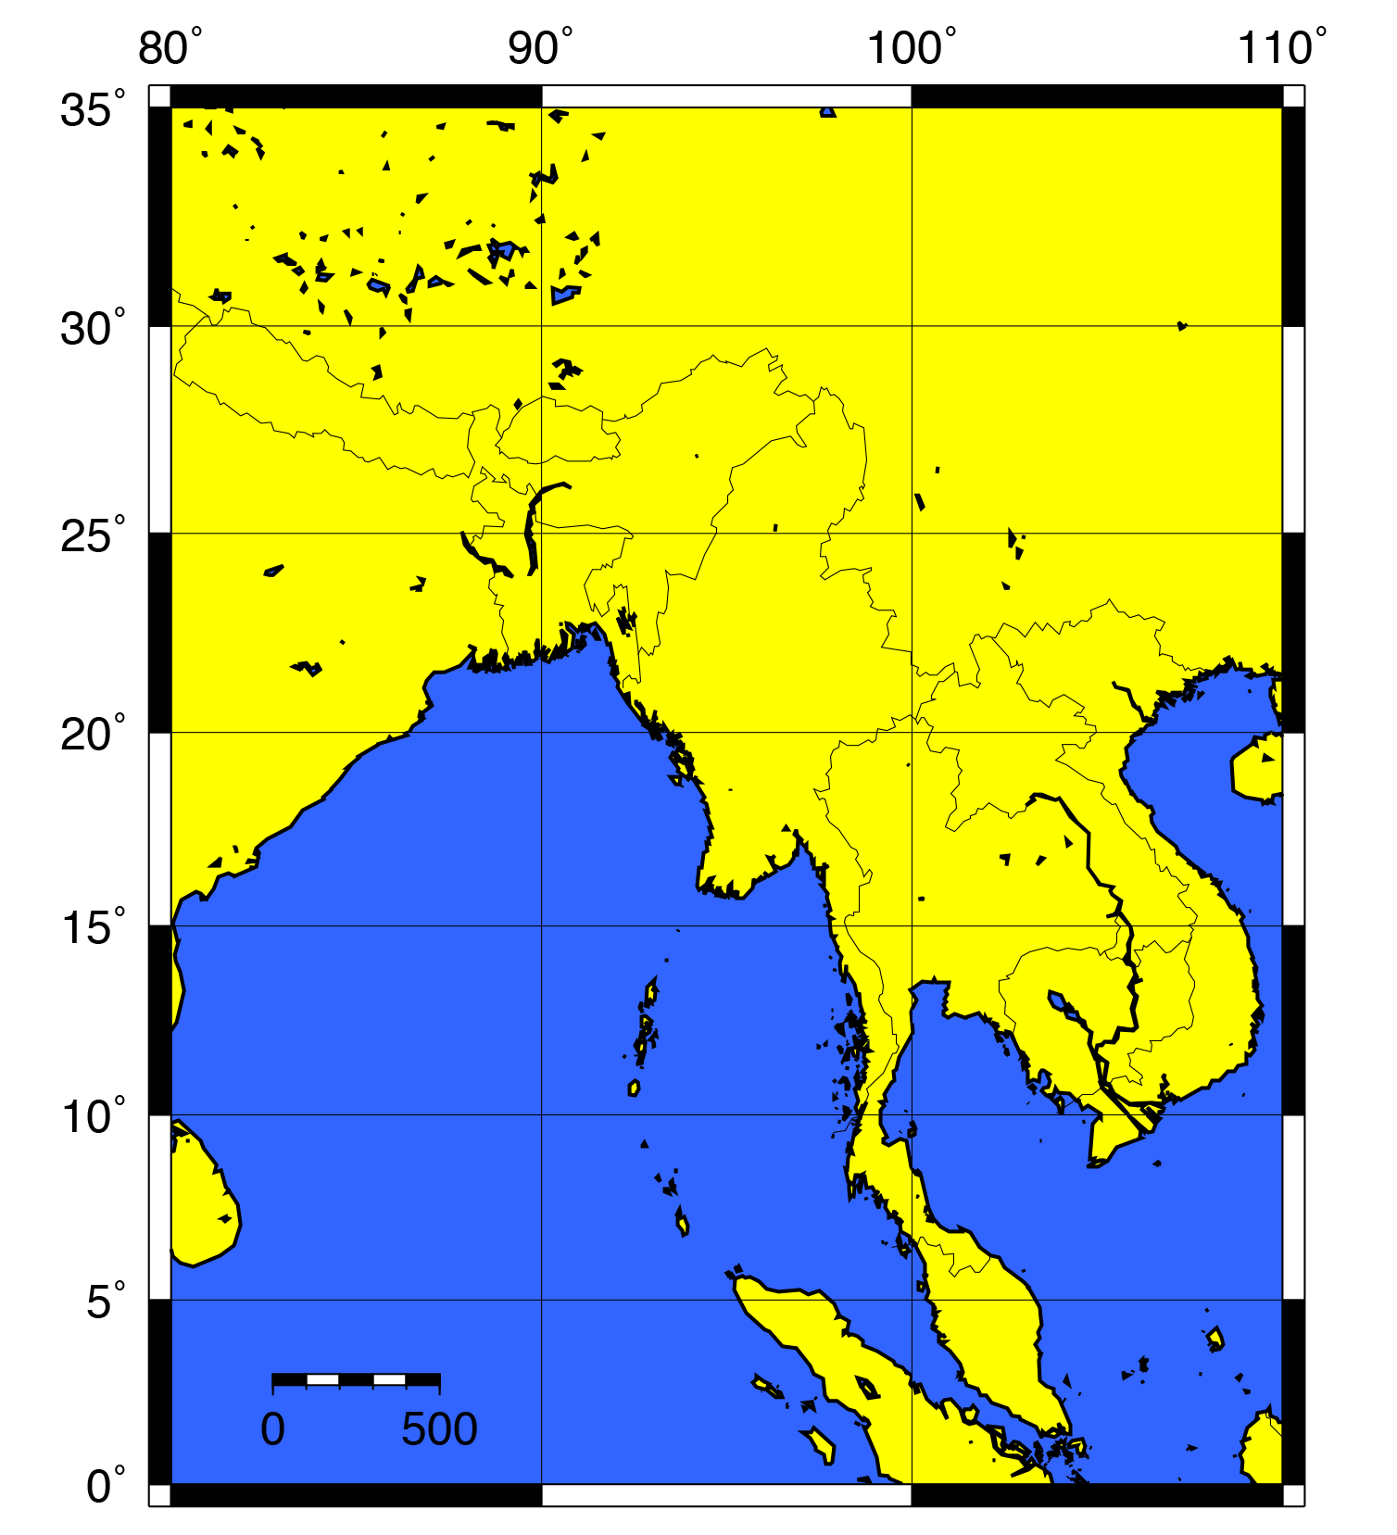
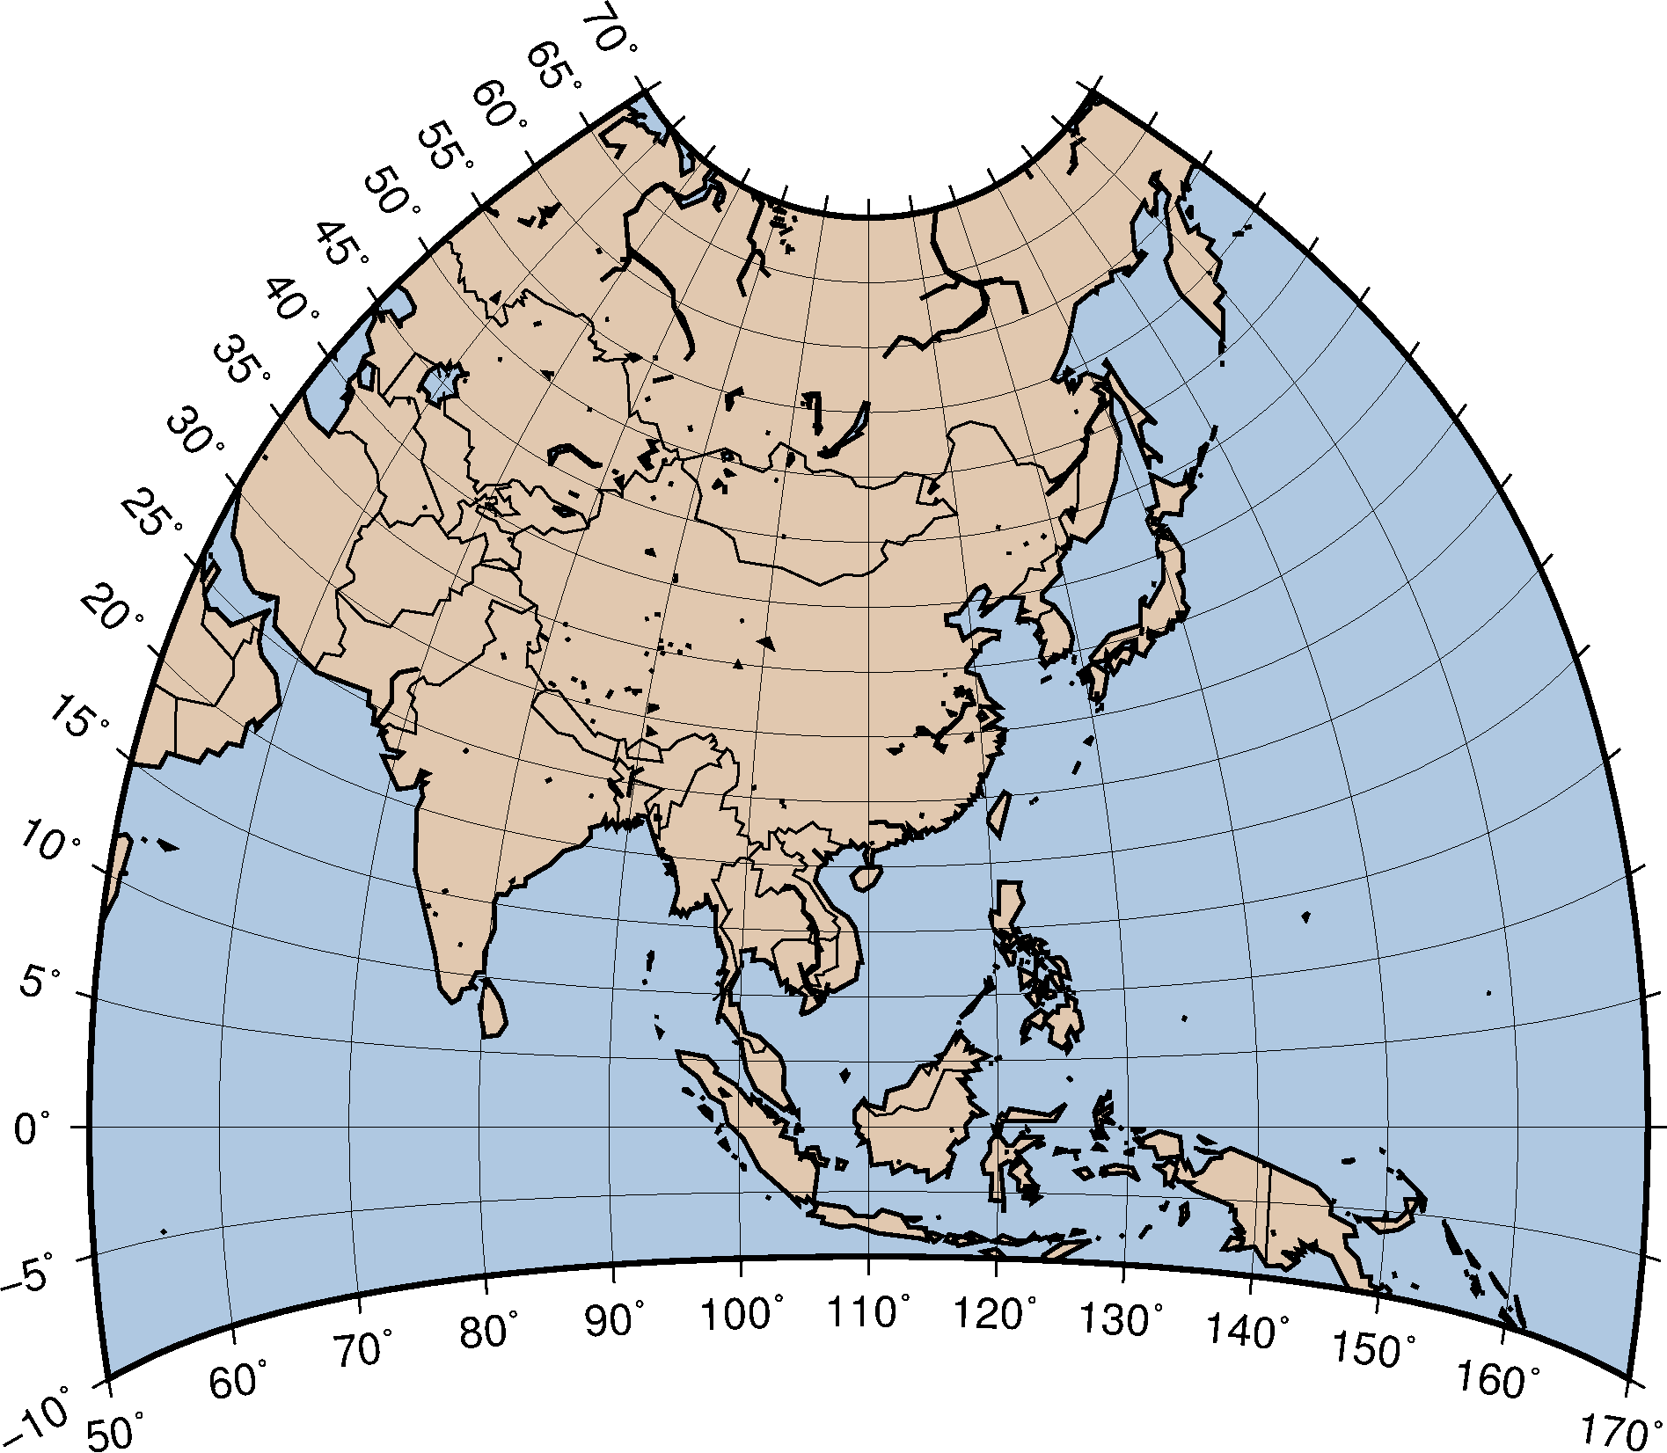
By the end of of this tutorial you will be able to create the following figures:

Slide 4
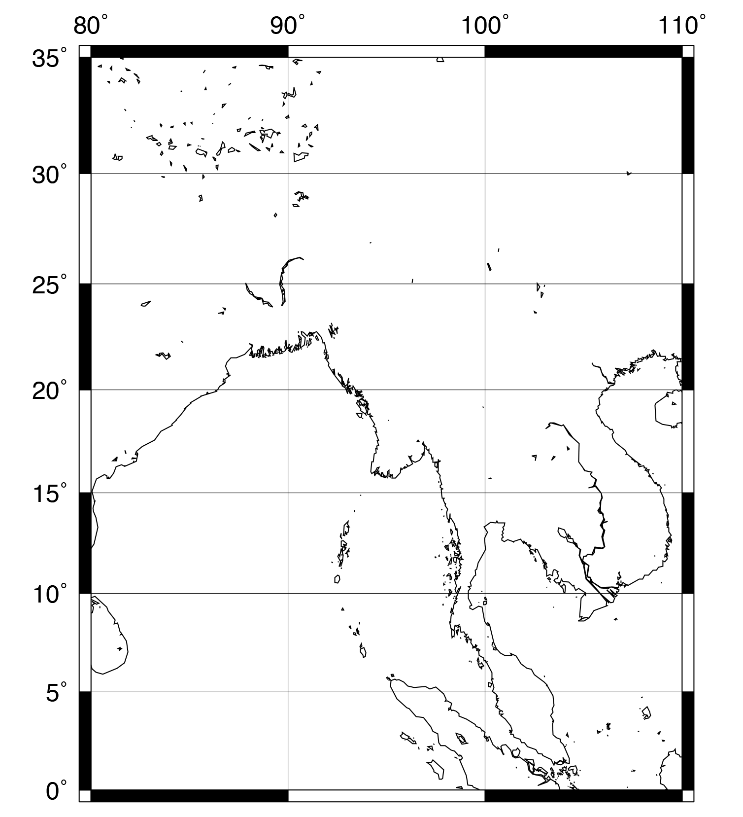
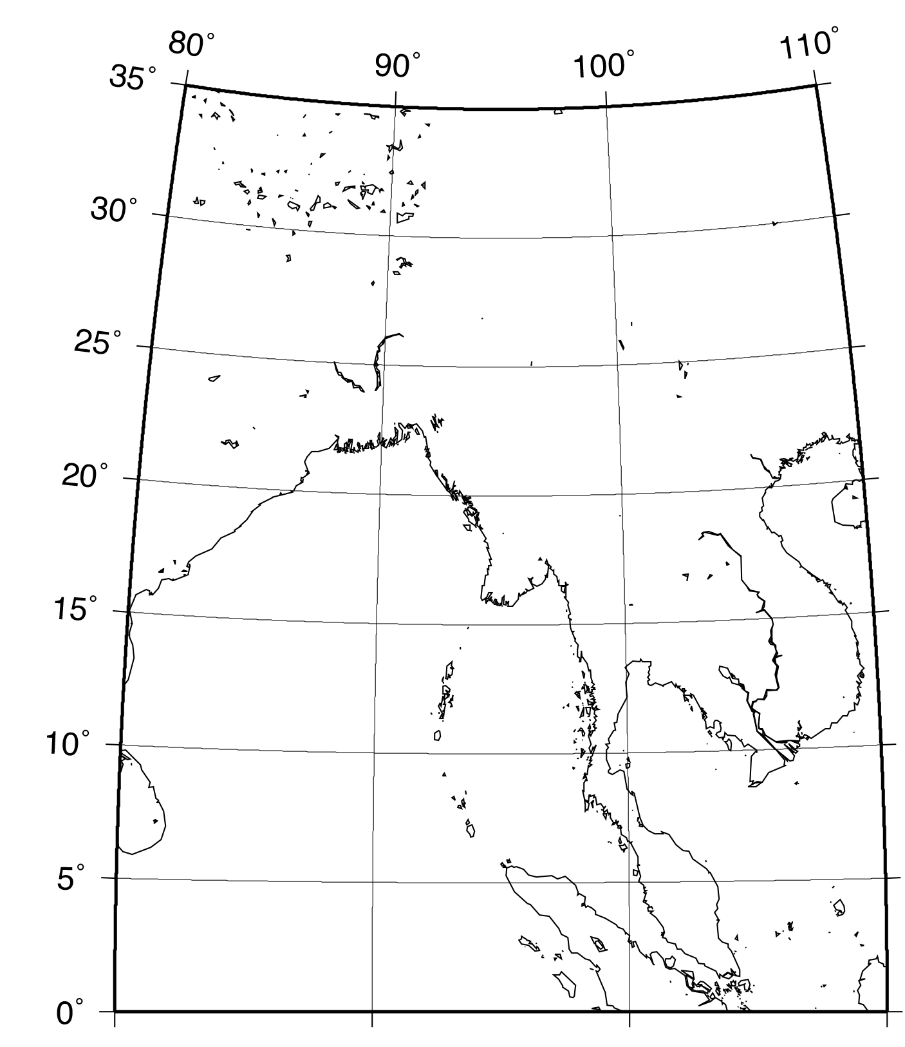
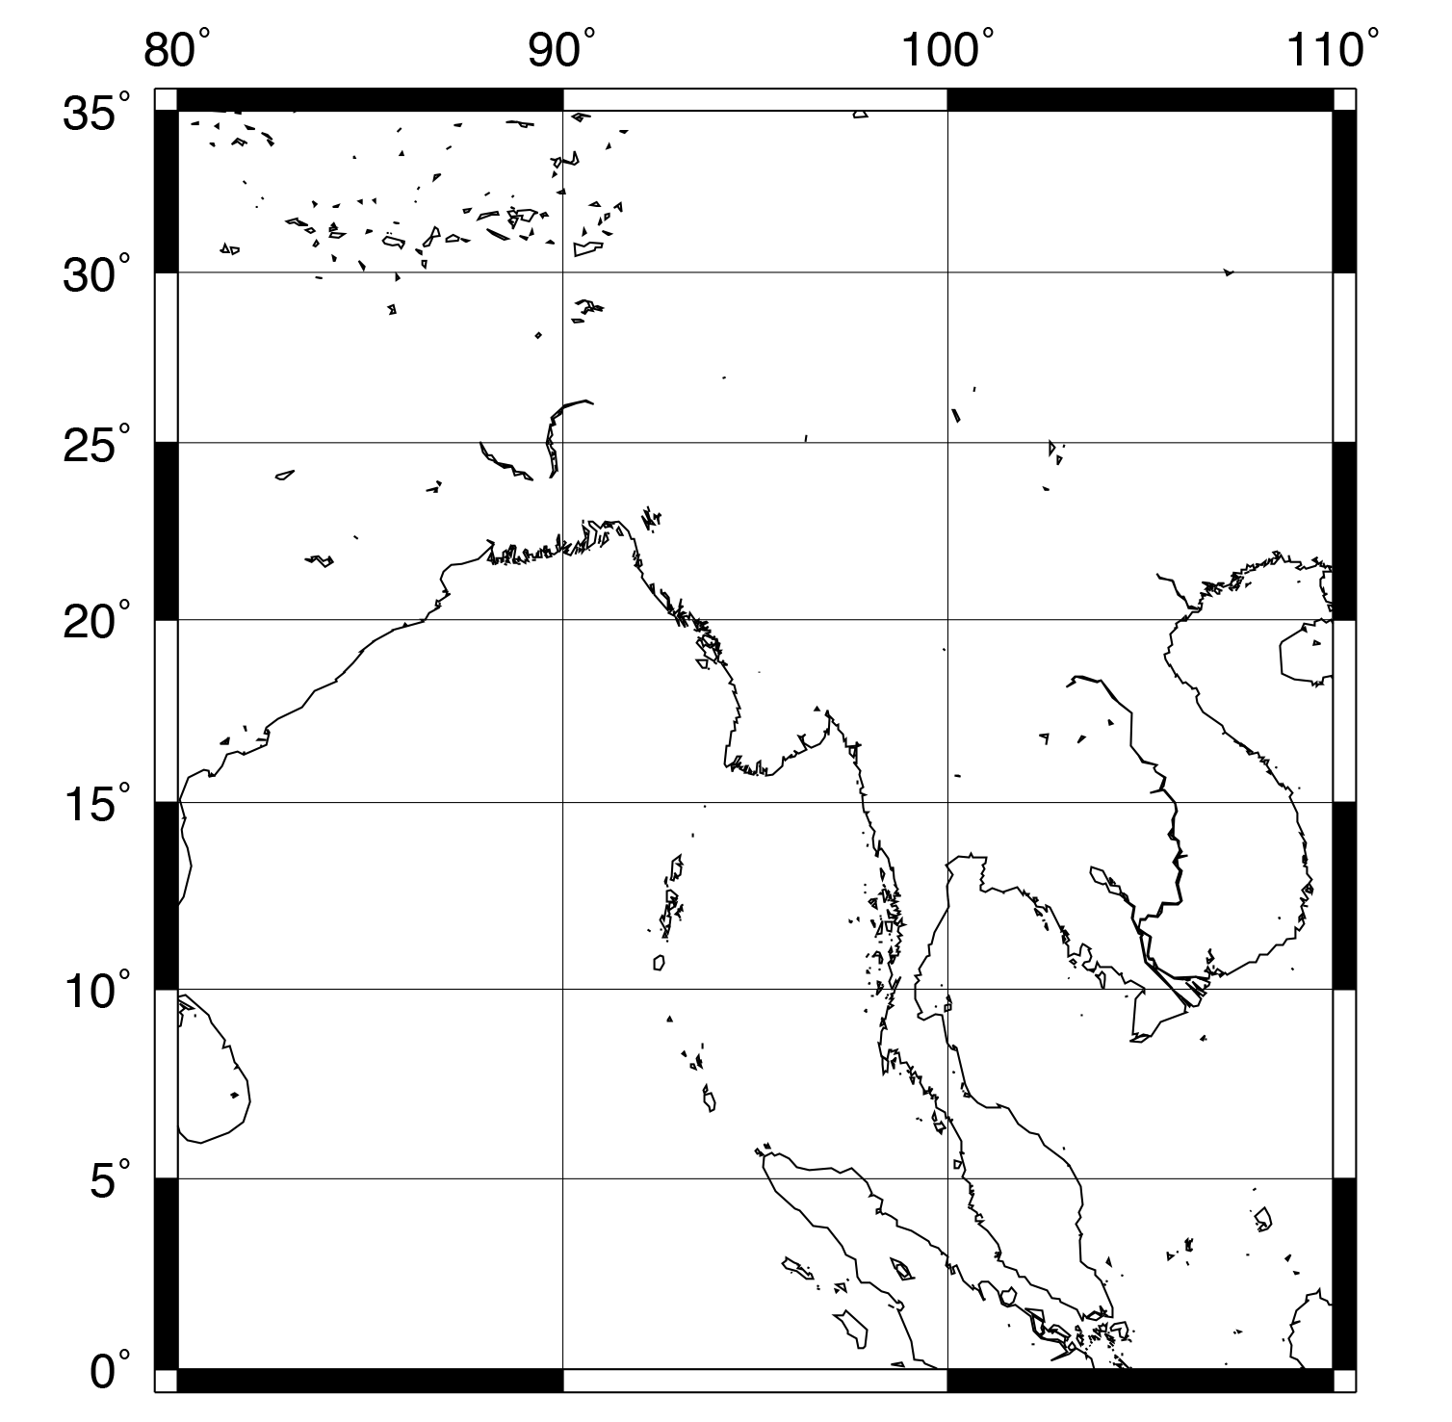
Map Projections
GMT plots the features of a spherical Earth on a flat surface. Note: It is impossible to unfold a sphere onto a flat surface perfectly. Therefore, any map projection distorts areas, angles, or both!
Mercator
Cylindrical Equal Area
Cassini
https://en.wikipedia.org/wiki/List_of_map_projections

Slide 5
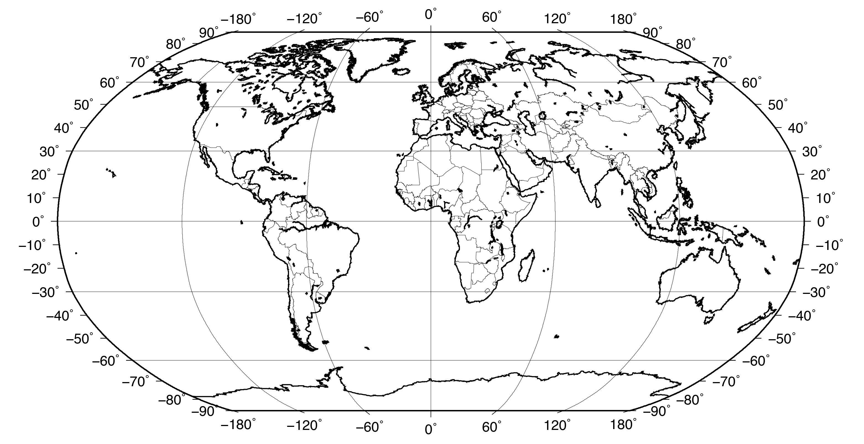
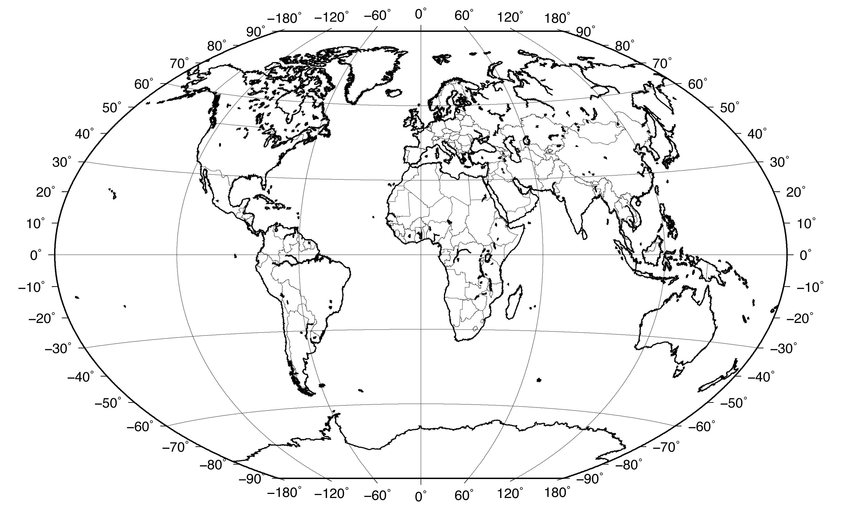
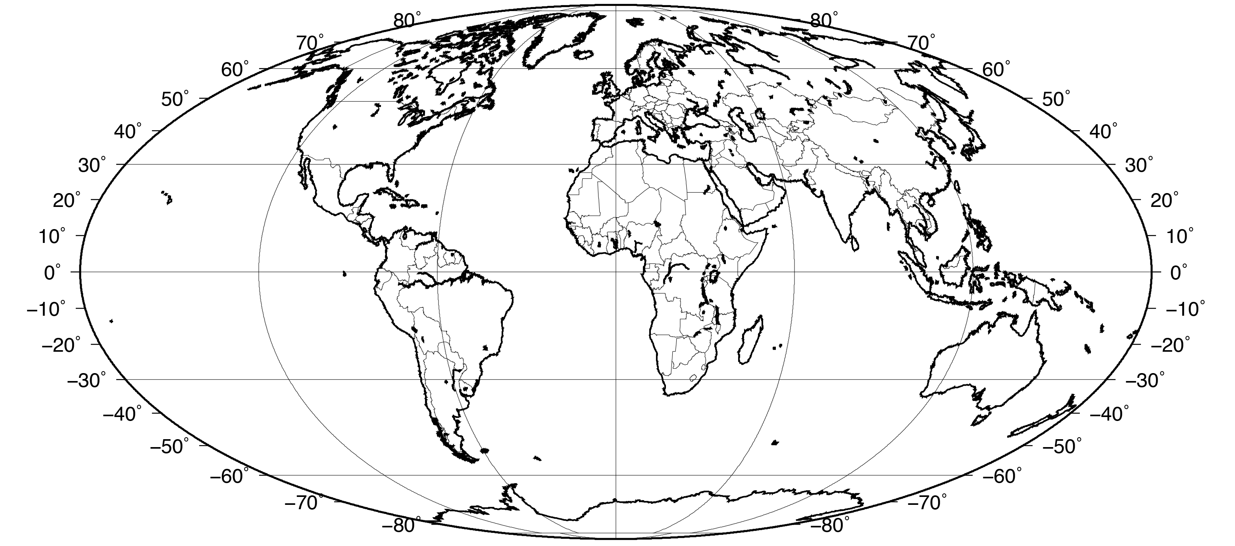
Map Projections
GMT plots the features of a spherical Earth on a flat surface. Note: It is impossible to unfold a sphere onto a flat surface perfectly. Therefore, any map projection distorts areas, angles, or both!
Robinson
Winkel
Mollweide
https://en.wikipedia.org/wiki/List_of_map_projections

Slide 6
Review of Unix Conventions and Terms
Naming files: Use only alphanumeric characters, “-”, and “_”. Don’t use spaces or any other characters (*&%$|^/\~) when naming a file since they have a special meaning in Unix. Unix is case sensitive so UPPER CASE filenames are different from lower case ones. Also, try to keep filenames short so there is less to type.
Command: The name of a program. When you press enter, the computer performs an action.
Options: These are specified after the command, and are usually indicated by a dash. They modify the behavior of the command to make it do what you want. See the command “man” page (manual pages) to learn more about the capabilities of each command.
Command line: The prompt on an active terminal where you can write a line of code. When you want to execute multiple commands, put them into a script (text file) to save yourself time typing.
Path: List of directories that your shell (the program that interprets the commands) searches when you enter a command.
Directory: Same as folders. Everything you use in one script must be in the same directory, or in your path.
Check out the Unix tutorial if you
are not familiar with these terms!

Slide 7
Unix Special Characters
Redirection of program outputs:
> command > file1 output of command overwrites file1
>> command >> file1 output of command appends to file1
| command1 | command2 output of command1 is input for command2
Directory specifications:
. current directory
.. directory above current directory
~ shorthand for the path to the home directory
Other scripting symbols:
# comment indicator; any characters following “#” will be ignored by script
\ escape character; treats the character immediately following as its literal value instead of substituting a behavior; useful for multi-line commands

Slide 8
Begin by opening the terminal application
You may want to make a new directory for the exercises in this tutorial
We start with psbasemap...

Slide 9
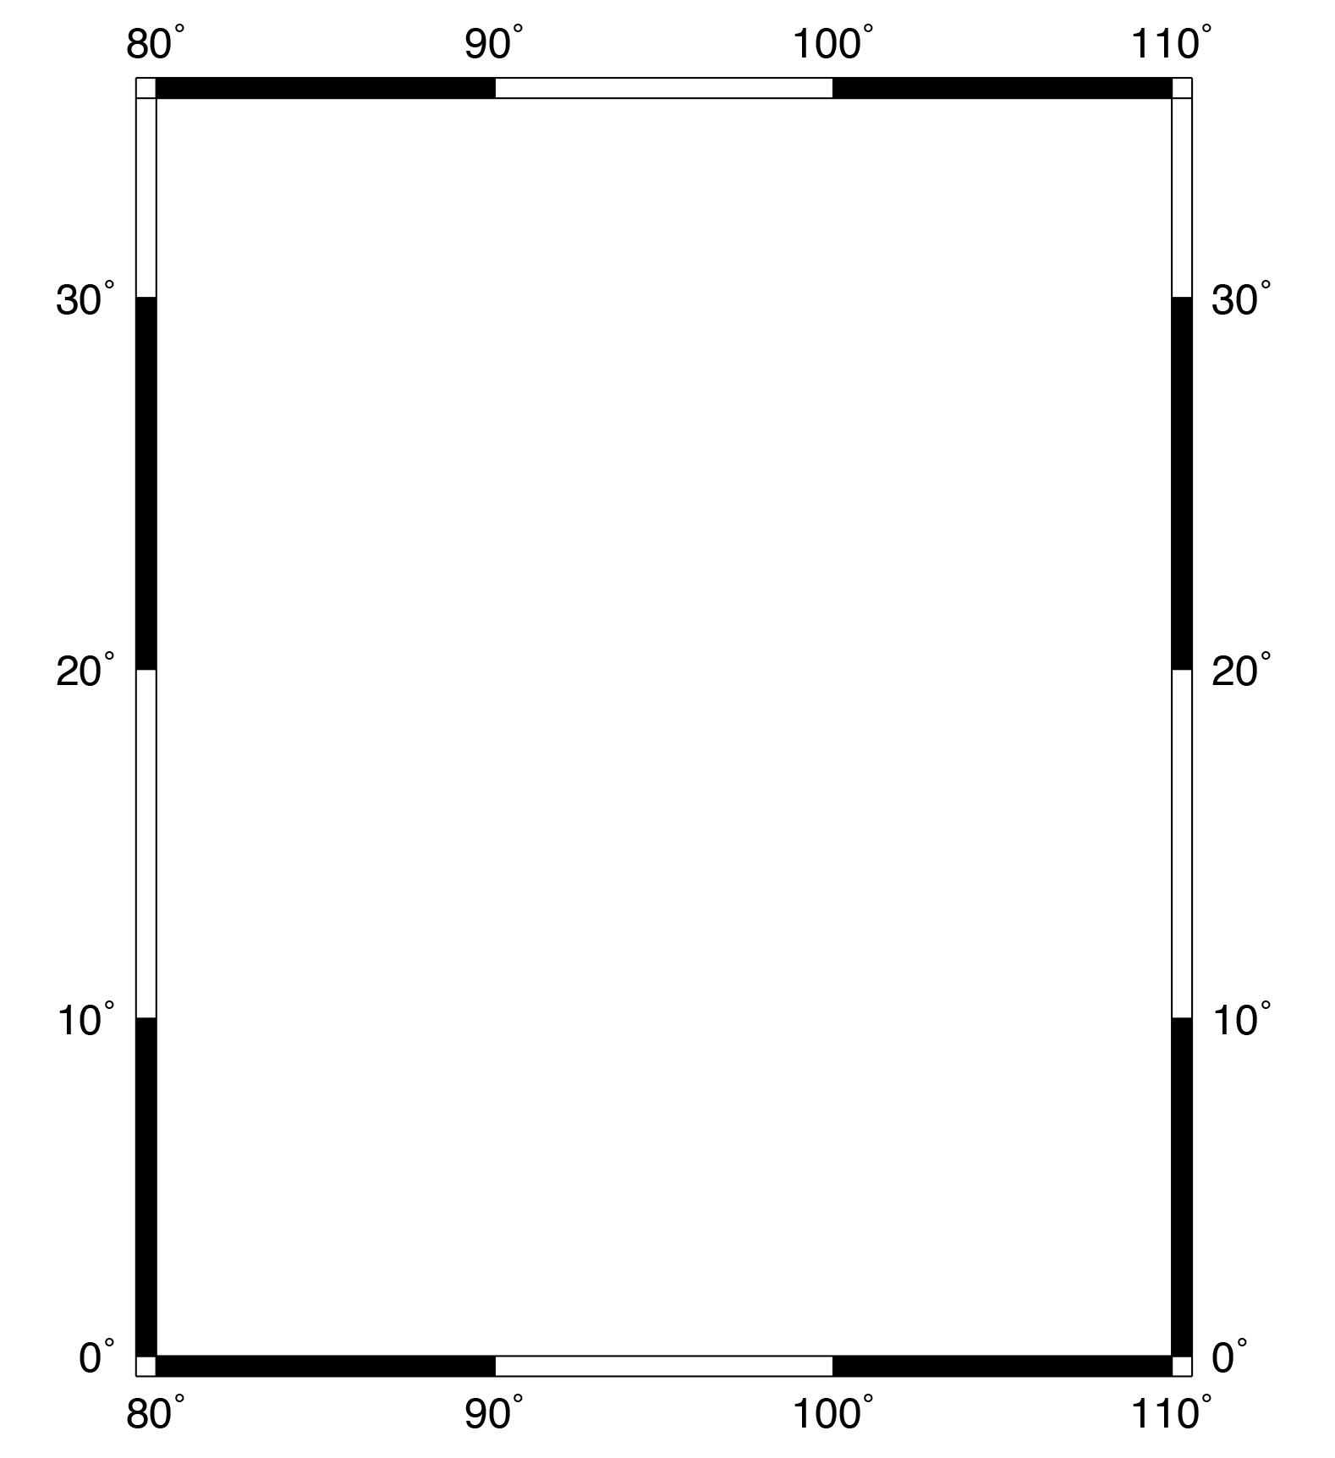
Introduction to psbasemap
Type this into the
command prompt
gmt psbasemap -JM10c -R80/110/0/35 -Ba10 > map1a.ps
gmt psbasemap
All GMT5 commands begin with the main program named gmt. The tool psbasemap produces a base map, as the name suggests.
-J -R -B
A single dash with a letter indicates an option (sometimes called a flag). Some options are required, others are added for controlling the output. Options must be separated by spaces. Some options have further specifications, e.g., -JM10c

Slide 10
Introduction to psbasemap
gmt psbasemap -JM10c -R80/110/0/35 -Ba10 > map1a.ps
-JM10c
The -J option specifies the type of map projection. The M indicates Mercator. When upper case, you specify the map width afterwards: 10c is 10 cm. You could instead use i for inches (e.g., -JM5i).
-R80/110/0/35
The -R option specifies the map limits in the format west/east/south/north.
-Ba10
The -Ba option specifies map boundary annotations. The number that follows is the increment, here every 10 units (degrees of longitude/latitude in this case).

Slide 11
Introduction to psbasemap
gmt psbasemap -JM10c -R80/110/0/35 -Ba10 > map1a.ps
> map1a.ps
Redirect the output of the psbasemap command into a file called map1a.ps.
GMT programs generate PostScript output, which is basically impossible to decipher. Fortunately, almost any computer can open PostScript files. On a Mac, we open the PostScript file directly from the terminal by typing:
open map1a.ps
On a Linux (or Windows) computer, PostScript files can be opened with ghostview, ghostscript, or other image viewing applications.

Slide 12
Introduction to psbasemap
gmt psbasemap -JM10c -R80/110/0/35 -Ba10 -P > map1a.ps
-P
If your map is appearing sideways add in the -P option. This option selects the portrait plotting mode. The default is landscape orientation.

Slide 13

Introduction to psbasemap
If you haven’t yet, you should start putting all your commands into scripts. For an intro to scripts, see our Unix Guide.
# change ”-Ba10” to “-Bg10”, “map1a.ps” to “map1b.ps”
gmt psbasemap –JM10c -R80/110/0/35 -Bg10 > map1b.ps
#
The first line starts with a pound sign. Everything on the line that comes after a pound sign is a comment and will not be interpreted as a command. Use comments to keep track of your work, remember what you have done, and so someone else can read your code.
-Bg10
Switching the a to g in the -B flag indicates gridline plotting instead of annotation (every 10 degrees). Since we removed the a we no longer have any boundary annotations.

Slide 14
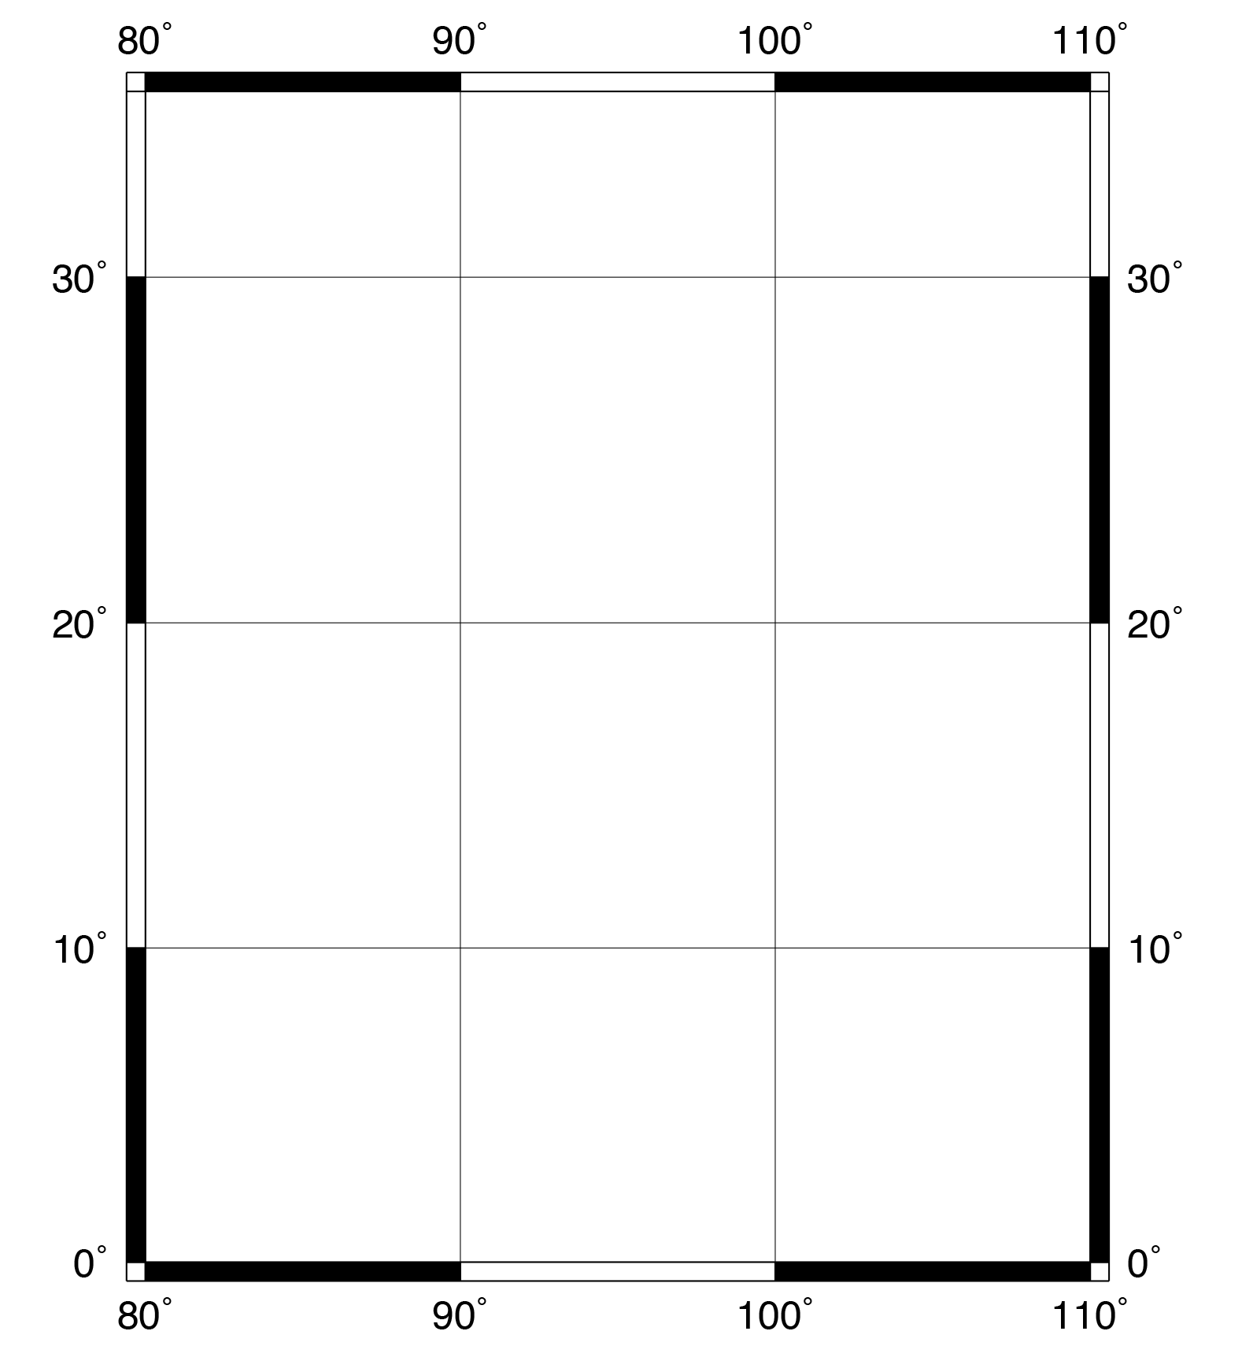
Introduction to psbasemap
gmt psbasemap -JM10c -R80/110/0/35 -Ba10g10 > map1c.ps
-Ba10g10
Here we combine a and g in the -B option to plot both annotations and gridlines. Since each letter has a 10 after it, each is plotted every 10 degrees.

Slide 15
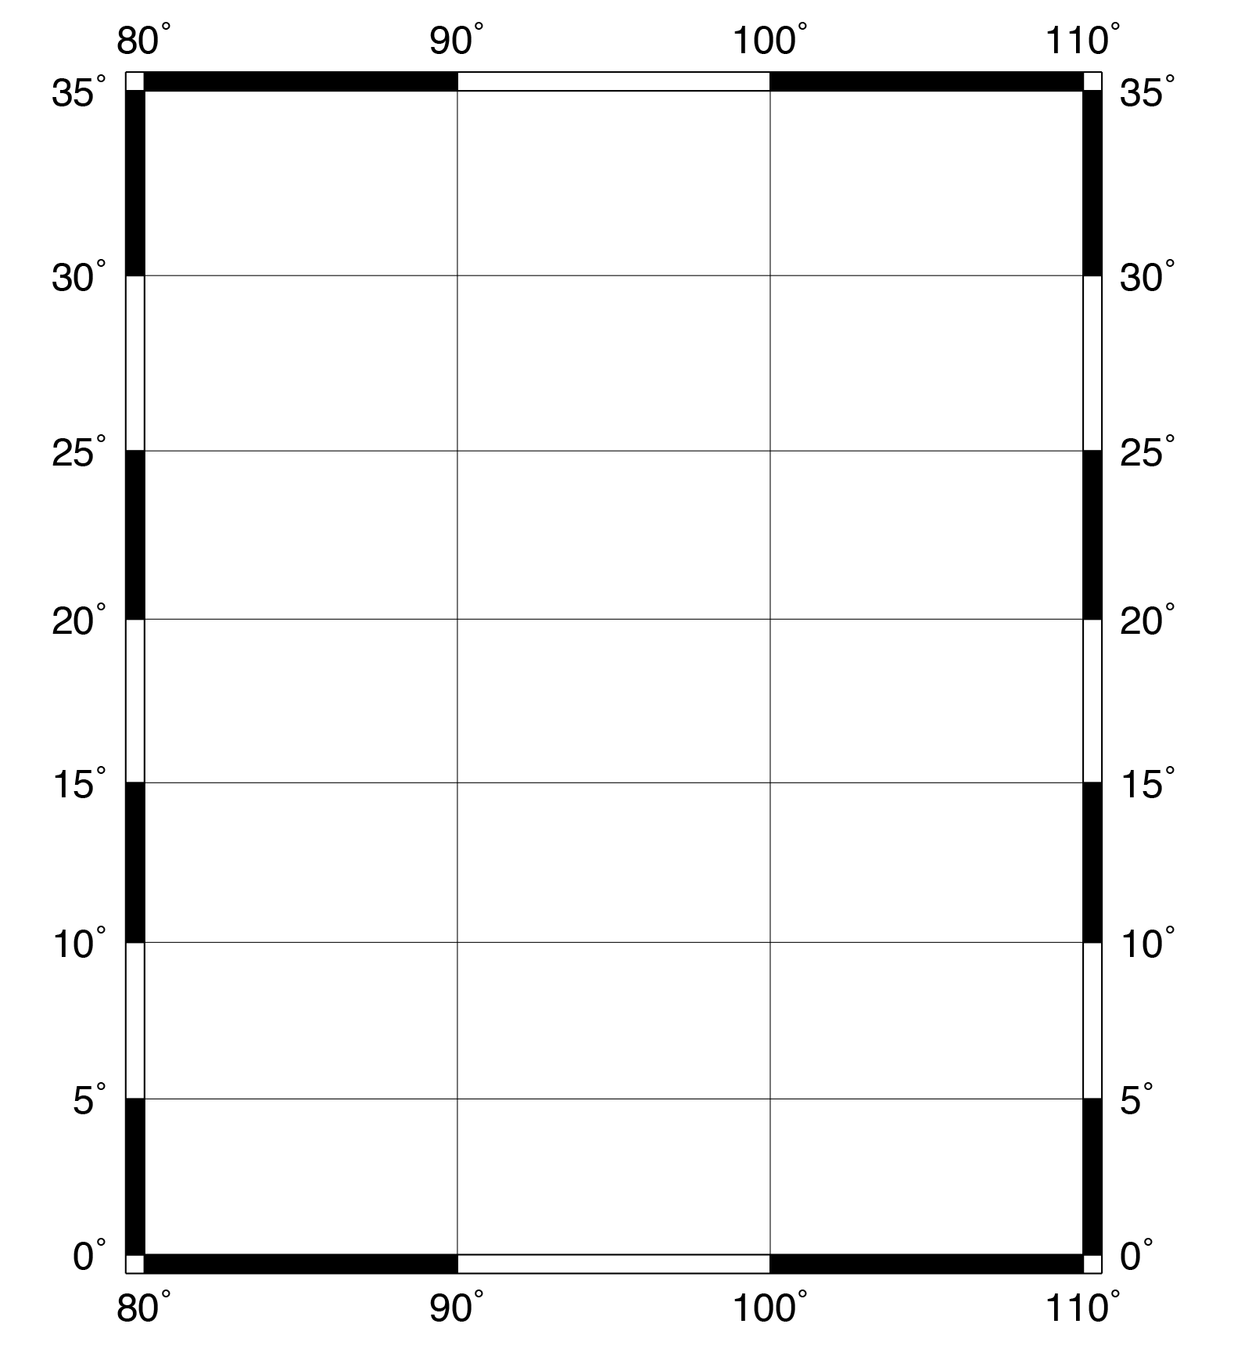
Introduction to psbasemap
This should all be on one line.
gmt psbasemap -JM10c -R80/110/0/35 -Bxa10g10 -Bya5g5 > map1d.ps
-Bxa10g10 -Bya5g5
What if we want different annotations and gridlines for latitude and longitude? To define axes independently, we can divide the -B option into x and y components, using -Bx and -By. The annotation and gridline syntax is the same as before, but now they can have different values. This can be especially useful for maps with large aspect ratios, near-polar maps, or unusual projections.

Slide 16
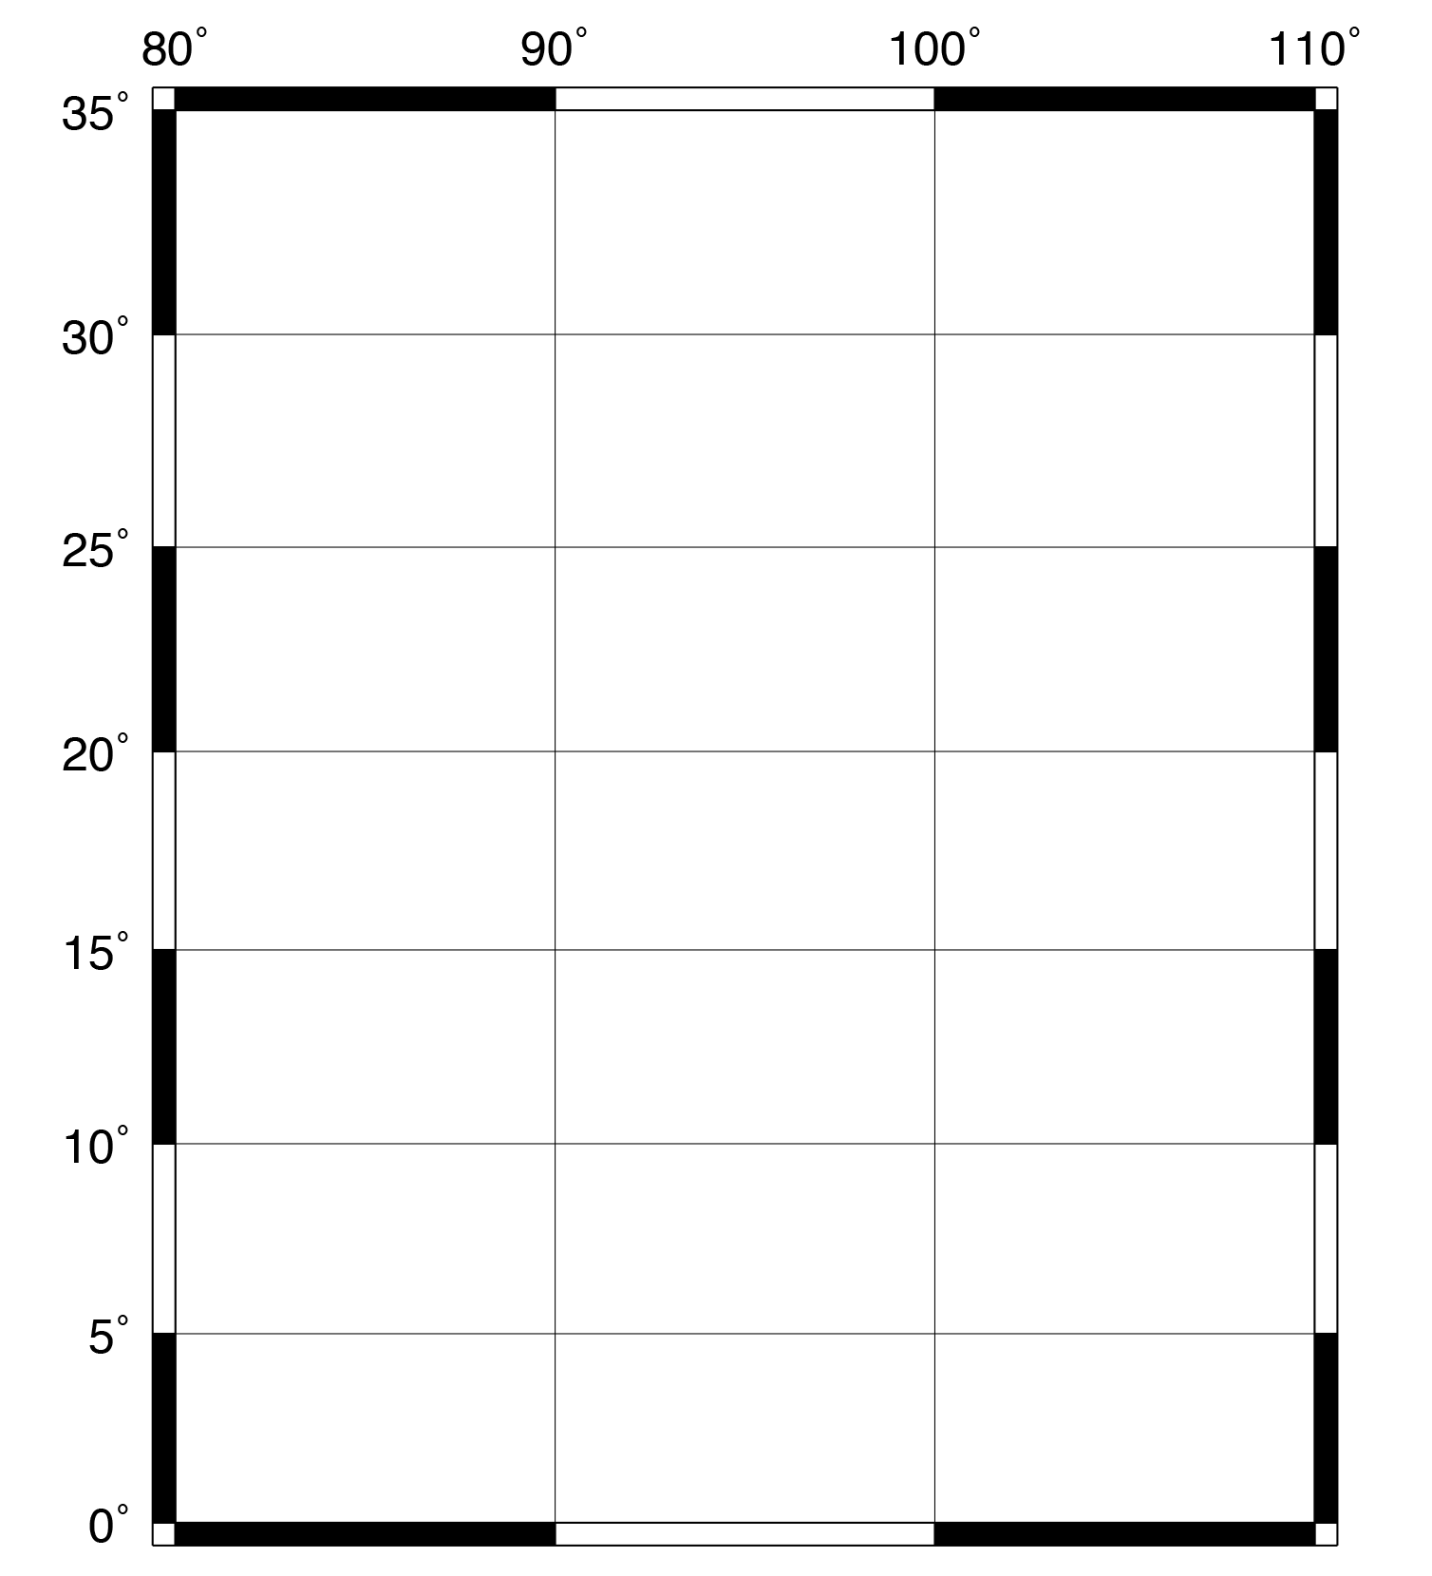
Introduction to psbasemap
gmt psbasemap -JM10c -R80/110/0/35 -Bxa10g10 -Bya5g5 -BWesN > map1e.ps
-Bxa10g10 -Bya5g5 -BWesN
Finally, we can define on what sides to plot the annotations with -BWesN. This specifies which edges (West, east, south, North) we would like to have longitude or latitude annotations. The capital letters W & N indicate which edges we want annotated, and the lowercase letters e & s indicate that we want to draw the east and south edges, but they will be left blank. If you omit a letter, that edge will not be drawn at all.

Slide 17
Recap of PSBASEMAP
Command to draw map frame
Produces PostScript output
Specify map projection and map limits (-J and -R)
Annotate map frame (-Ba)
Draw gridlines (-Bg)
Specify edges to draw (-BWeSn)

Slide 18
Introduction to pscoast
New command!
gmt pscoast -JM10c -R80/110/0/35 -W0.5p -K > map2a.ps
gmt psbasemap -JM10c -R80/110/0/35 -Bxa10g10 -Bya5g5 -BWesN –O >> map2a.ps
gmt pscoast
This command draws coastlines (surprise!) and a few other geographical features such as country or state boundaries.
Note: coastline datasets are included in the GMT package, so you do not need to find these separately unless something is wrong with the installation.
-JM10c -R80/110/0/35
Both pscoast and psbasemap (in fact, all gmt commands) have the same map projection and limits syntax. We want to use the same projection and syntax for both programs so the base map and the coastlines line up correctly.

Slide 19
Introduction to pscoast
gmt pscoast -JM10c -R80/110/0/35 -W0.5p -K > map2a.ps
gmt psbasemap -JM10c -R80/110/0/35 -Bxa10g10 -Bya5g5 -BWesN -O >> map2a.ps
-W0.5p
The -W option controls the pen that draws the coastline. The number specifies the thickness of the line. Here, 0.5p means draw a line half a point thick, where a point is 1/72 of an inch (the p indicates a measurement in points).
-K
We added this option to pscoast, indicating that we are going to add another layer to our map after this command. Every GMT command should include the -K option except the very last one.

Slide 20
Introduction to pscoast
gmt pscoast -JM10c -R80/110/0/35 -W0.5p -K > map2a.ps
gmt psbasemap -JM10c -R80/110/0/35 -Bxa10g10 -Bya5g5 -BWesN -O >> map2a.ps
The psbasemap command is almost the same as before, with a few minor changes:
-O
We added the -O (letter O, not number 0) option, which stands for “overlay,” and indicates that the features in this layer will be placed on top of the previous layer instead of starting a new plot. -O should be included in every GMT line except for the first.
>> map2a.ps
Instead of the single redirect symbol (>), we used the double redirect symbol (>>). Recall: a single > overwrites the file with the output from the command, while the double >> appends the program output to the file.

Slide 21
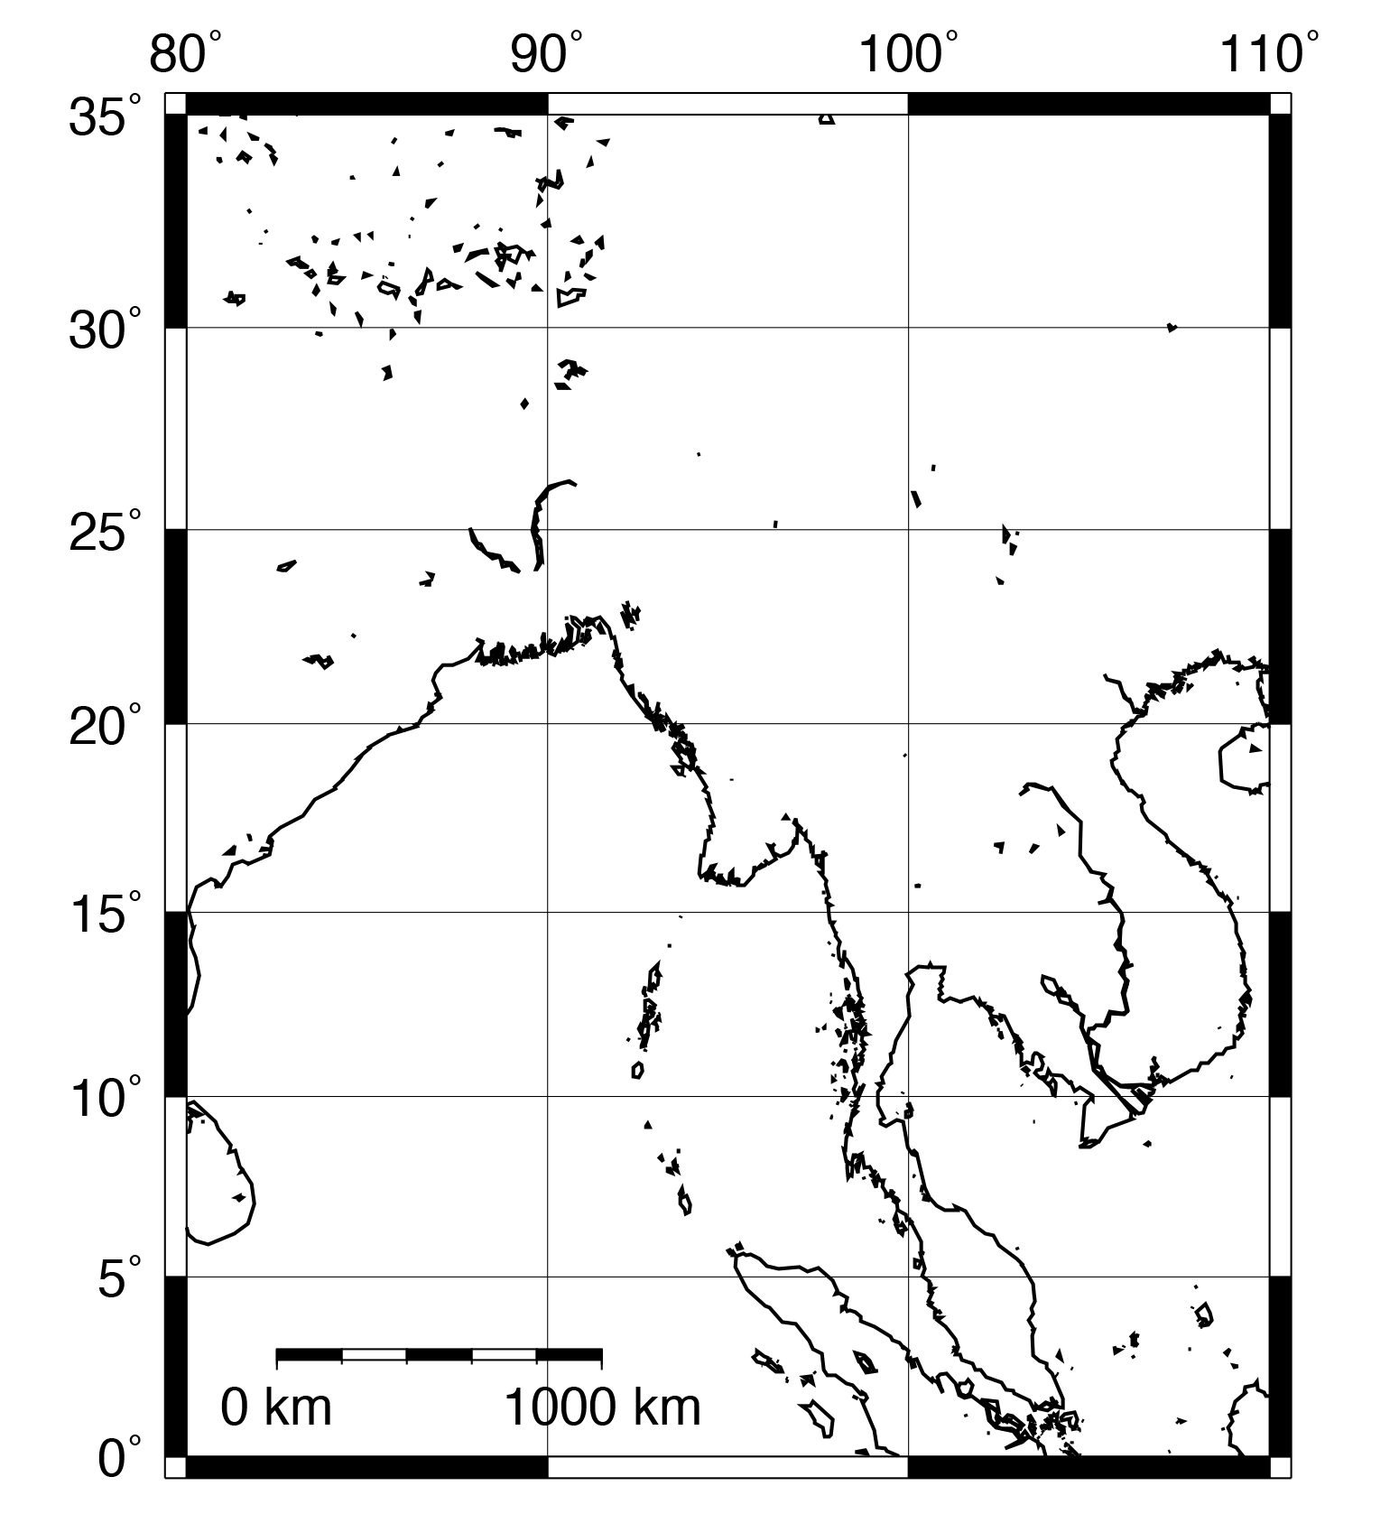
Introduction to pscoast
Option to add a scale bar
gmt pscoast -JM10c -R80/110/0/35 -W1p -L87/3+c3+w1000k+u -K > map2b.ps
-L87/3+c3+w1000k+u
A scale bar is a useful addition to any map. The -Llon/lat flag creates a map scale centered at lon/lat (in this example, 87/3). Most GMT options have additional options which allow for fine tuning the appearance. These are usually indicated with the + symbol. Here, +c3 means that the scale will be calculated at a latitude of 3ºN. The specifier +w1000k defines the length of the scale bar, with k indicating the units are km. Finally, +u tells GMT to plot the units on the scale bar.

Slide 22
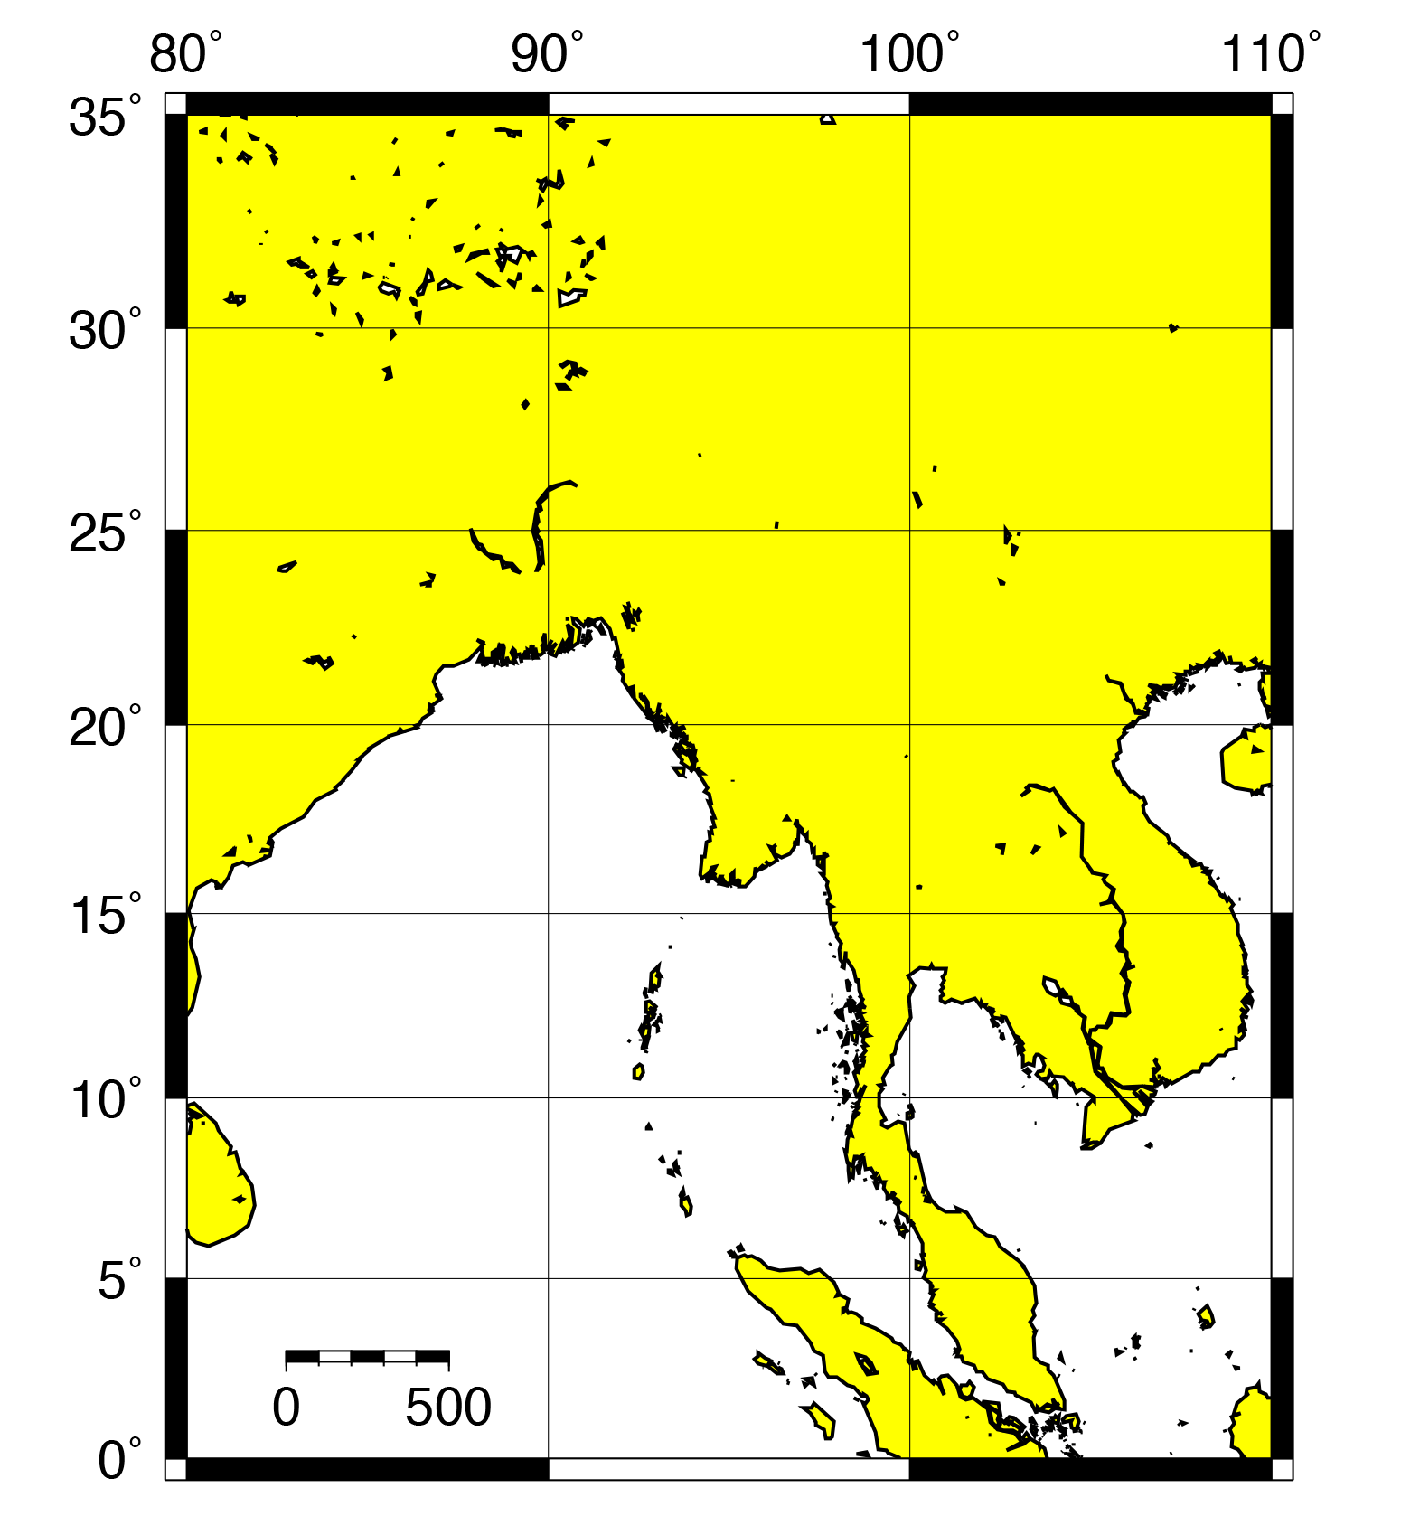
Introduction to pscoast
Scale bar is now 500 km long
gmt pscoast -JM10c -R80/110/0/35 -W1p -L87/3+c3+w500k+u -G255/255/0 -K > map2b.ps
Colors help to highlight or distinguish important features on your maps.
-G255/255/0
The -G option colors in dry areas, i.e. land. The color is defined by RGB (red/green/blue) triplets, where each of R, G, and B ranges from 0 to 255. Yellow is 255/255/0. GMT also recognizes many color names; in this case, we could have written –Gyellow and gotten the same result.
Search online for “gmt colors” to learn more about the built-in colors.

Slide 23
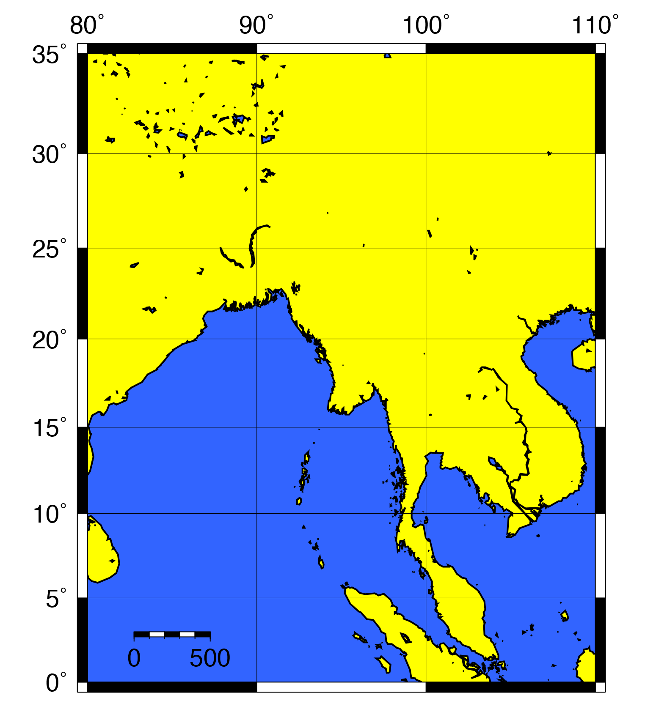
Introduction to pscoast
gmt pscoast -JM10c -R80/110/0/35 -W1p -L87/3+c3+w500k+u -G255/255/0 -S50/100/255 -K > map2b.ps
-S50/100/255
Just like -G fills in dry areas, -S fills in the wet areas, like oceans, lakes, and rivers. The syntax is the same as in the -G option.

Slide 24
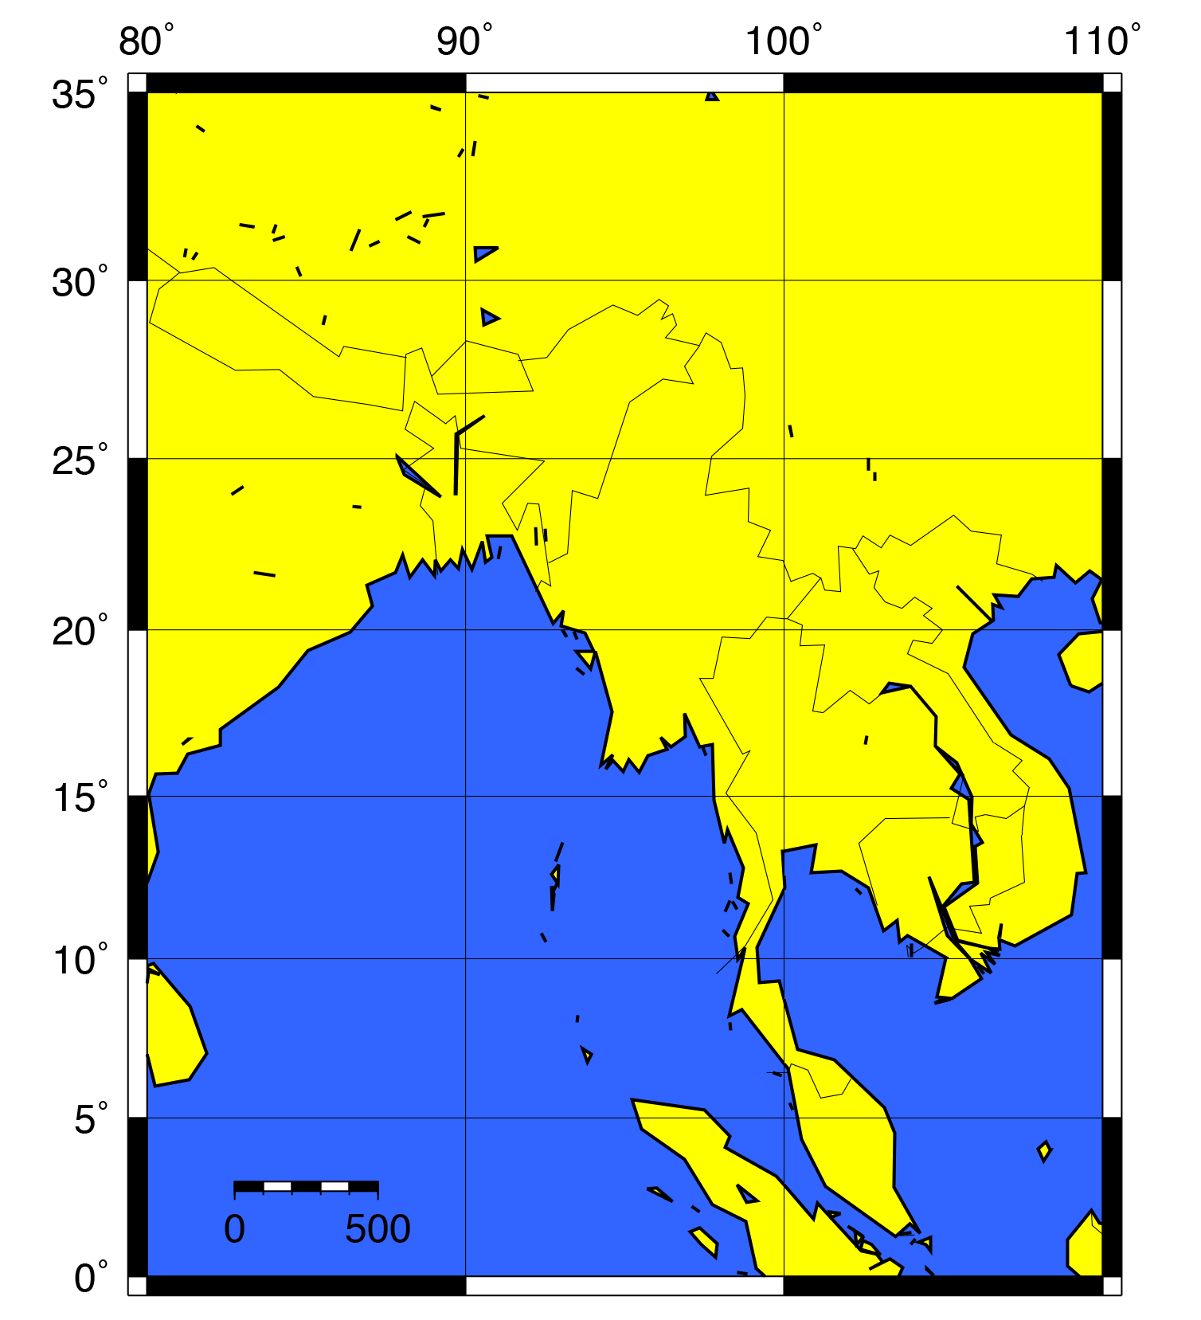
Introduction to pscoast
gmt pscoast -JM10c -R80/110/0/35 -W1p -L87/3+c3+w500k+u -G255/255/0 -S50/100/255 -N1/0.25p -Dc -K > map2b.ps
-N1/0.25p
The –N option draws political boundaries. The number directly afterwards specifies the type of boundary; -N1 draws country boundaries. The number after the slash indicates the pen style (similar to the -W option), so here we are drawing a line 0.25 points thick.
-Dc
You can specify the resolution of the coastline dataset, where the options are (f)ull, (h)igh, (i)ntermediate, (l)ow, and (c)rude. The default resolution is i. Lower resolution makes a smaller file size, useful for maps showing large regions, whereas high resolutions are better for showing details of zoomed-in areas.

Slide 25
Introduction to pscoast
gmt pscoast -JM10c -R80/110/0/35 -W1p -L87/3+c3+w500k+u -G255/255/0 -S50/100/255 -N1/0.25p -Di -K > map2b.ps
-Di
Intermediate resolution coastlines and country boundaries look better for our map region than crude resolution.

Slide 26
Recap of PSCOAST
Command to draw coastlines and country boundaries
Specify pen (-W)
Put in a scale bar (-L)
Color dry (-G) and wet (-S) areas
Draw country boundaries (-N)
Change resolution (-D)

Slide 27
Map of Asia
Now we are going to make a slightly different map of Asia using pscoast and psbasemap. We will use the relevant GMT options as well as shell scripting tools.
When we are finished, you will have the map shown at the right. Not a particularly useful map, but hey...

Slide 28
Map of Asia
We are creating a script to run GMT commands automatically instead of typing them into the terminal. If this does not make sense, see the Unix tutorial!
Save the following as a text file called map.sh:

Slide 29
Map of Asia
Save the following as a text file called map.sh:
First line indicates this a shell script.
#!/bin/sh
PROJ=“-JC15c”
LIMS=“-R50/170/-10/70”
BLUE=“50/100/255”
DRY="225/200/175"
PSFILE=“asia.ps”
gmt pscoast $PROJ $LIMS -W1p -G$DRY -S$BLUE -N1/0.25p \
-Dc -K > $PSFILE
gmt psbasemap $PROJ $LIMS -Bxa10g10 -Bya5g5 -BWeSn -O >> $PSFILE

Slide 30
Map of Asia
Recall: variables help organize, save space, and make it so you only have to change a value in one place rather than in every instance in your script.
Save the following as a text file called map.sh:
#!/bin/sh
PROJ=“-JC15c”
LIMS=“-R50/170/-10/70”
BLUE=“50/100/255”
DRY="225/200/175"
PSFILE=“asia.ps”
gmt pscoast $PROJ $LIMS -W1p -G$DRY -S$BLUE -N1/0.25p \
-Dc -K > $PSFILE
gmt psbasemap $PROJ $LIMS -Bxa10g10 -Bya5g5 -BWeSn -O >> $PSFILE
Define GMT options as variables in the script.

Slide 31
Map of Asia
Save the following as a text file called map.sh:
Map projection: -JC means Cassini cylindrical projection
#!/bin/sh
PROJ=“-JC15c”
LIMS=“-R50/170/-10/70”
BLUE=“50/100/255”
DRY="225/200/175"
PSFILE=“asia.ps”
gmt pscoast $PROJ $LIMS -W1p -G$DRY -S$BLUE -N1/0.25p \
-Dc -K > $PSFILE
gmt psbasemap $PROJ $LIMS -Bxa10g10 -Bya5g5 -BWeSn -O >> $PSFILE

Slide 32
Map of Asia
Save the following as a text file called map.sh:
#!/bin/sh
PROJ=“-JC15c”
LIMS=“-R50/170/-10/70”
BLUE=“50/100/255”
DRY="225/200/175"
PSFILE=“asia.ps”
gmt pscoast $PROJ $LIMS -W1p -G$DRY -S$BLUE -N1/0.25p \
-Dc -K > $PSFILE
gmt psbasemap $PROJ $LIMS -Bxa10g10 -Bya5g5 -BWeSn -O >> $PSFILE
Map limits: in this case, we have chosen a much larger range than in the previous exercise

Slide 33
Map of Asia
Save the following as a text file called map.sh:
#!/bin/sh
PROJ=“-JC15c”
LIMS=“-R50/170/-10/70”
BLUE=“50/100/255”
DRY="225/200/175"
PSFILE=“asia.ps”
gmt pscoast $PROJ $LIMS -W1p -G$DRY -S$BLUE -N1/0.25p \
-Dc -K > $PSFILE
gmt psbasemap $PROJ $LIMS -Bxa10g10 -Bya5g5 -BWeSn -O >> $PSFILE
The color for wet areas

Slide 34
Map of Asia
Save the following as a text file called map.sh:
#!/bin/sh
PROJ=“-JC15c”
LIMS=“-R50/170/-10/70”
BLUE=“50/100/255”
DRY="225/200/175"
PSFILE=“asia.ps”
gmt pscoast $PROJ $LIMS -W1p -G$DRY -S$BLUE -N1/0.25p \
-Dc -K > $PSFILE
gmt psbasemap $PROJ $LIMS -Bxa10g10 -Bya5g5 -BWeSn -O >> $PSFILE
The color for dry areas

Slide 35
Map of Asia
Name of the output PostScript file
Save the following as a text file called map.sh:
#!/bin/sh
PROJ=“-JC15c”
LIMS=“-R50/170/-10/70”
BLUE=“50/100/255”
DRY="225/200/175"
PSFILE=“asia.ps”
gmt pscoast $PROJ $LIMS -W1p -G$DRY -S$BLUE -N1/0.25p \
-Dc -K > $PSFILE
gmt psbasemap $PROJ $LIMS -Bxa10g10 -Bya5g5 -BWeSn -O >> $PSFILE
The name of the output PostScript file.

Slide 36
Map of Asia
Name of the output PostScript file
Save the following as a text file called map.sh:
Put a backslash at the end of the line. This continues the options for the program to the next line.
#!/bin/sh
PROJ=“-JC15c”
LIMS=“-R50/170/-10/70”
BLUE=“50/100/255”
DRY="225/200/175"
PSFILE=“asia.ps”
gmt pscoast $PROJ $LIMS -W1p -G$DRY -S$BLUE -N1/0.25p \
-Dc -K > $PSFILE
gmt psbasemap $PROJ $LIMS -Bxa10g10 -Bya5g5 -BWeSn -O >> $PSFILE

Slide 37
Map of Asia
Name of the output PostScript file
Save the following as a text file called map.sh:
#!/bin/sh
PROJ=“-JC15c”
LIMS=“-R50/170/-10/70”
BLUE=“50/100/255”
DRY="225/200/175"
PSFILE=“asia.ps”
gmt pscoast $PROJ $LIMS -W1p -G$DRY -S$BLUE -N1/0.25p \
-Dc -K > $PSFILE
gmt psbasemap $PROJ $LIMS -Bxa10g10 -Bya5g5 -BWeSn -O >> $PSFILE
Save your script and run it!

Slide 38
Map of Asia

Slide 39
Recap of GMT Scripts
Make scripts for using GMT! I cannot think of a single instance where typing the command directly into the terminal is better
Use variables for options, especially options that are repeated
The \ “escapes” a carriage return, continuing a command to the next line

Slide 40
Earthquakes in Southeast Asia
Save the following as a text file called earthquakes.sh:
#!/bin/sh
PROJ="-JM15c"
LIMS="-R80/110/0/35“
PSFILE=“earthquakes.ps“
gmt pscoast $PROJ $LIMS -W1p -Dc -N1/0.5p -K > $PSFILE
gmt psbasemap $PROJ $LIMS -Bxa10g10 -Bya5g5 -BWeSn \
-K -O >> $PSFILE
This script should look familiar: we are first generating a coastline with country boundaries and a base map.
Note: I included both -K and -O options in psbasemap, indicating that I am overlaying it on the previous map, and adding more afterwards.

Slide 41
Earthquakes in Southeast Asia
Save the following as a text file called earthquakes.sh:
#!/bin/sh
PROJ="-JM15c"
LIMS="-R80/110/0/35“
PSFILE=“earthquakes.ps“
gmt pscoast $PROJ $LIMS -W1p -Dc -N1/0.5p -K > $PSFILE
gmt psbasemap $PROJ $LIMS -Bxa10g10 -Bya5g5 -BWeSn \
-K -O >> $PSFILE
gmt psxy ....
Let’s add some more map content with psxy!

Slide 42
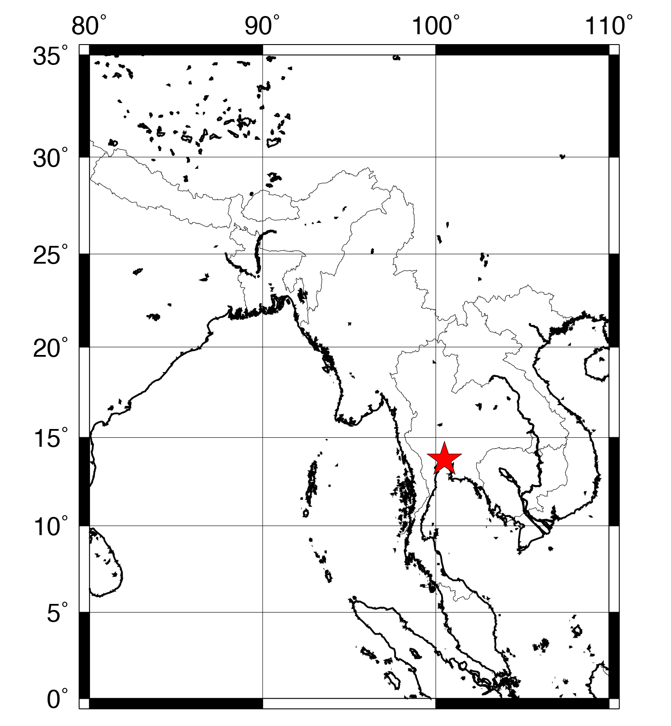
Introduction to psxy
gmt psxy stars.xy $PROJ $LIMS -Sa0.3i -W0.25p -Gred \
-O -K >> $PSFILE
gmt psxy
This command plots x-y data as lines or symbols on the map. If you specify a file after psxy, the program will look for input from the file. The data must have the first column be longitude and the second be latitude (Note: at some point you will flip these; always check your input file).
stars.xy
Create a text file named stars.xy with the coordinates of Bangkok:
100.49 13.75
Save this file in the same folder as your script.

Slide 43
Introduction to psxy
gmt psxy stars.xy $PROJ $LIMS -Sa0.3i -W0.25p -Gred \
-O -K >> $PSFILE
-Sa0.3i
To draw symbols, we use the -S option. There are many different types of symbols you can use; to see your options, look at the psxy man page (type man psxy). To draw a star that fits into a circle 0.3 inches in diameter, use -Sa0.3i.
-W0.25p -Gred
To outline and color symbols, use the -W and -G options, where -W defines the pen style that outlines the symbol, and -G defines the symbol fill color. These options should look familiar from pscoast! At least one of these options must be used. If no fill option is selected, the symbol is transparent.

Slide 44
Introduction to psxy
gmt psxy stars.xy $PROJ $LIMS -Sa0.3i -W0.25p -Gred \
-O -K >> $PSFILE
$PROJ $LIMS
We use the same projection and limits variables as the other commands to plot the star in the correct location on the page.
-K -O
Because this layer is overlain on the previous layer, we must have -O. We are also going to add more to the map, so we also have -K.

Slide 45
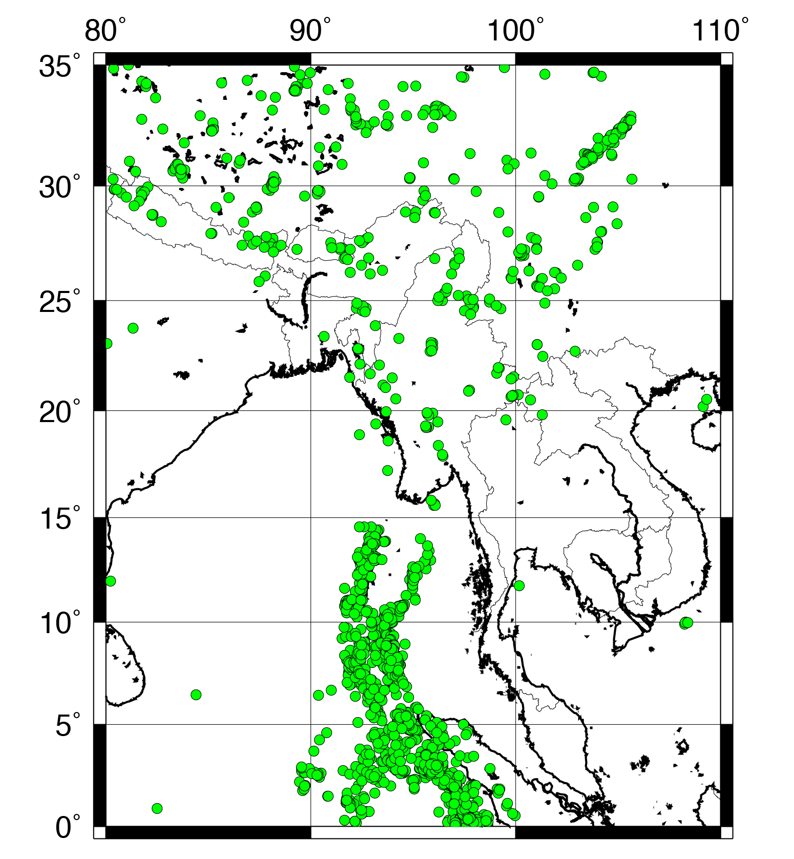
Plotting earthquake data using psxy
gmt psxy eqs.xy $PROJ $LIMS -Sc0.15i -W0.5p -Ggreen \
-O -K >> $PSFILE
Now we are going to add earthquake locations to the map. You can download a text file with the earthquakes at:
www.matthewwherman.com/tutorials/eqs.xy
This text file contains magnitude 5 and greater earthquakes in the vicinity of the mapped region from 1996 to 2006.
101.903 25.523 10 5.2
95.432 2.901 36.5 5.2
96.117 2.633 25.9 5
91.78 8.264 35 5.1
95.739 6.443 264 5
93.9 1.983 10 5
105.171 32.302 37.9 5
93.746 3.279 10 5
92.746 3.753 10 5.3
If for some reason the link is broken, save this subset of events as a file called eqs.xy. The columns are:
lon lat depth magnitude

Slide 46
Plotting earthquake data using psxy
gmt psxy eqs.xy $PROJ $LIMS -Sc0.15i -W0.5p -Ggreen \
-O -K >> $PSFILE
eqs.xy
The input file for psxy is the earthquake file you just downloaded.
-Sc0.15i
We generally plot earthquakes as circles, which are specified with -Sc. The diameter of the symbols is 0.15 inches.
-W0.5p -Ggreen
Symbol outline and fill are chosen the same as usual. You can set the fill to any color you choose (we are going to change it soon), but here it is set to green with -Ggreen.

Slide 47
Plotting earthquake data using psxy
gmt psxy eqs.xy $PROJ $LIMS -Scc -W0.5p -Ceq.cpt \
-O -K >> $PSFILE
The data file also contains information about the event depth (3rd column) and magnitude (4th column). We can visualize these by adjusting the symbol color and size.
-Ceq.cpt
(Changed from -Ggreen) This option tells psxy you want to color the symbols based on the value of the 3rd column of the input data, using the coloring scheme defined in the file eq.cpt. An earthquake depth color palette file might look like this (save it as eq.cpt):
0 255/0/0 10 255/0/0
10 255/155/0 25 255/155/0
25 0/255/0 50 0/255/0
50 0/0/255 100 0/0/255
B 255/0/0
F 0/0/255
Do not worry too much about the details of making color palette files. They will be in another lesson.

Slide 48
Plotting earthquake data using psxy
gmt psxy eqs.xy $PROJ $LIMS -Scc -W0.5p -Ceq.cpt \
-O -K >> $PSFILE
The data file also contains information about the event depth (3rd column) and magnitude (4th column). We can visualize these by adjusting the symbol color and size.
-Scc
(Changed from -Sc0.15i) Instead of explicitly defining the size of the symbol in the -S option, we do not specify a value here, only a unit (c for cm). Doing this tells psxy to scale the the symbol dimension to be the value of the size column in cm.

Slide 49
Plotting earthquake data using psxy
gmt psxy eqs.xy $PROJ $LIMS -Scc -W0.5p -Ceq.cpt \
-O -K >> $PSFILE
The data file also contains information about the event depth (3rd column) and magnitude (4th column). We can visualize these by adjusting the symbol color and size.
If a color palette is defined (as it is here with -Ceq.cpt), then the color value must be in the 3rd column of the input, immediately after the x and y values. Then the symbol size is in the 4th column.
If you do not define a color palette, then the value in the 3rd column of the input is taken as the size and the color can be specified with -G.
To manipulate columns in files, use awk (see our Beginner’s Guide to Awk online!).

Slide 50
At this point, your script should look something like this:
#!/bin/sh
PROJ="-JM15c"
LIMS="-R80/110/0/35“
PSFILE=“earthquakes.ps“
gmt pscoast $PROJ $LIMS -W1p -Dc -N1/0.5p -K > $PSFILE
gmt psbasemap $PROJ $LIMS -Bxa10g10 -Bya5g5 -BWeSn \
-K -O >> $PSFILE
gmt psxy stars.xy $PROJ $LIMS -Sa0.3i -W0.25p -Gred \
-O -K >> $PSFILE
gmt psxy eqs.xy $PROJ $LIMS -Scc -W0.5p -Ceq.cpt \
-O -K >> $PSFILE

Slide 51
Recap of PSXY
-S indicates symbol plotting
-W and -G specify pen and color of symbols
The size of the symbol can be specified with -S or with the input file
The color of the symbol can depend on the file if you make a color palette file and use the -C option

Slide 52
Introduction to GMT (Part 1)
Complete!
Next up:
  Plotting raster images (xyz2grd, surface, grdcontour, and grdimage)
  Creating/drawing color scales (makecpt and psscale)
  Writing text (pstext)

