Slide 1
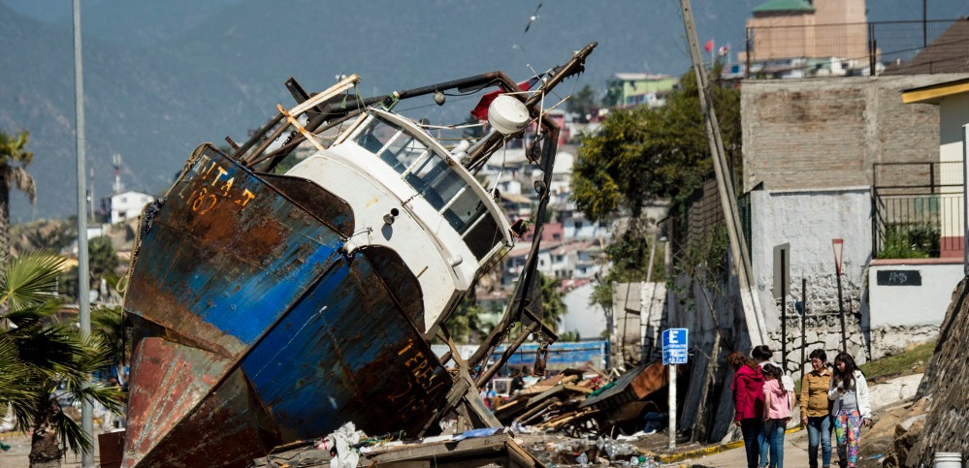
Integrated Geophysical Characteristics of the 2015 Illapel, Chile, Earthquake
Matthew Herman, William Yeck, Jennifer Nealy, Gavin Hayes, William Barnhart, Harley Benz, Kevin Furlong
Notes:
Hello everyone. Thanks for sticking it out to Friday afternoon. Today I'd like to talk to you about our work combining several geophysical datasets into an integrated understanding of the Illapel earthquake sequence. Although I'm up here talking, this work has been a collaborative effort between people from Penn State, the USGS National Earthquake Information Center, and the University of Iowa.

Slide 2
Posted online on September 24, 2015
http://earthquake.usgs.gov/learn/topics/Coquimbo_Educational_Slides.pdf
Notes:
Before getting into a detailed analysis of the earthquake, I'd like to point out that we produced a preliminary version of this presentation a week after the main shock. Following this rapid educational response, we refined our analyses significantly, and I will show you the improved results in this talk.

Slide 3
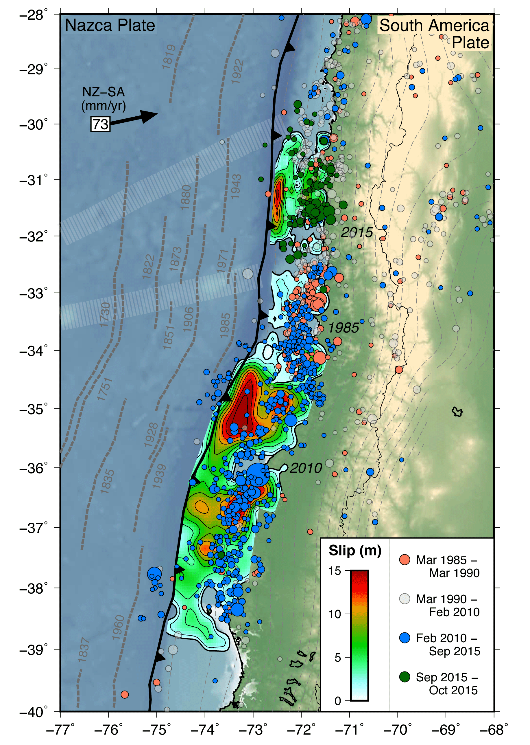
Multidisciplinary Approach
Teleseismic and regional moment tensors
Seismological finite fault modeling
Hypocenter relocation
Coseismic GPS/InSAR
Geodetic finite fault modeling
Stress modeling
Notes:
In a large collaborative effort like this, we have the benefit of having people with many different areas of scientific expertise. In this study, we apply all of these tools. We compute moment tensors for the main shock and aftershocks, we compute seismic and geodetic finite fault models, we precisely locate seismicity, we observe the upper plate deformation during the earthquake, and model the stresses in the subduciton zone. As I go through each of these analyses, I will combine them into a comprehensive picture of the earthquake and its aftershock sequence.

Slide 4
Illapel Main Shock Moment Tensor Analysis
Notes:
Let's start with the main shock moment tensor.

Slide 5
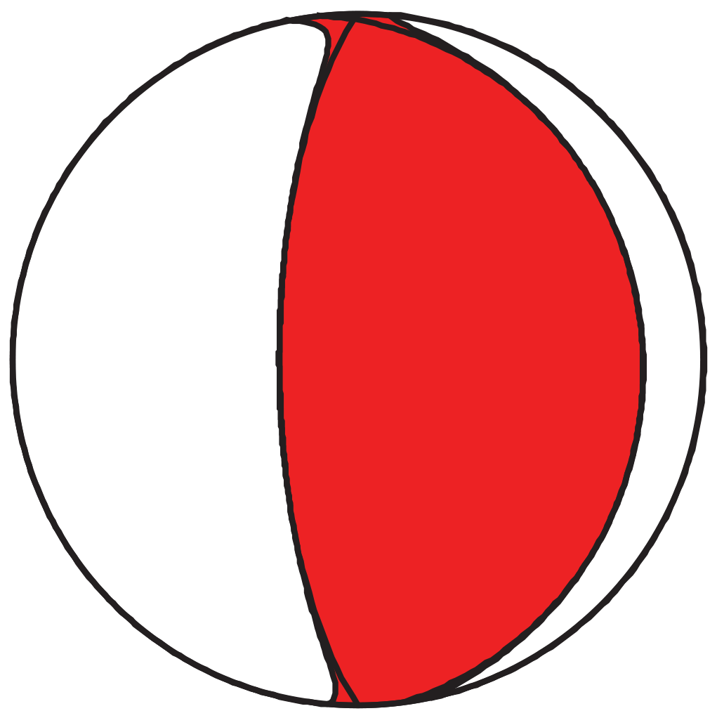
Single Source W-phase
Moment Tensor
Single point source
Long period (200-1000 s) teleseismic observations
Mw 8.3 thrust faulting event
Size, location, mechanism consistent with megathrust earthquake
Notes:
In a moment tensor inversion, the event is treated as a single point source, and to do this for such a large event, the teleseismic waveforms must be filtered in a long period band, in this case 200-1000 seconds. In this analysis, the W-phase component of the waveforms is used for the inversion, and this results in a magnitude 8.3 thrust faulting earthquake with the mechanism show here. The size, location, and mechanism are all consistent with its location on the subduction plate boundary.

Slide 6
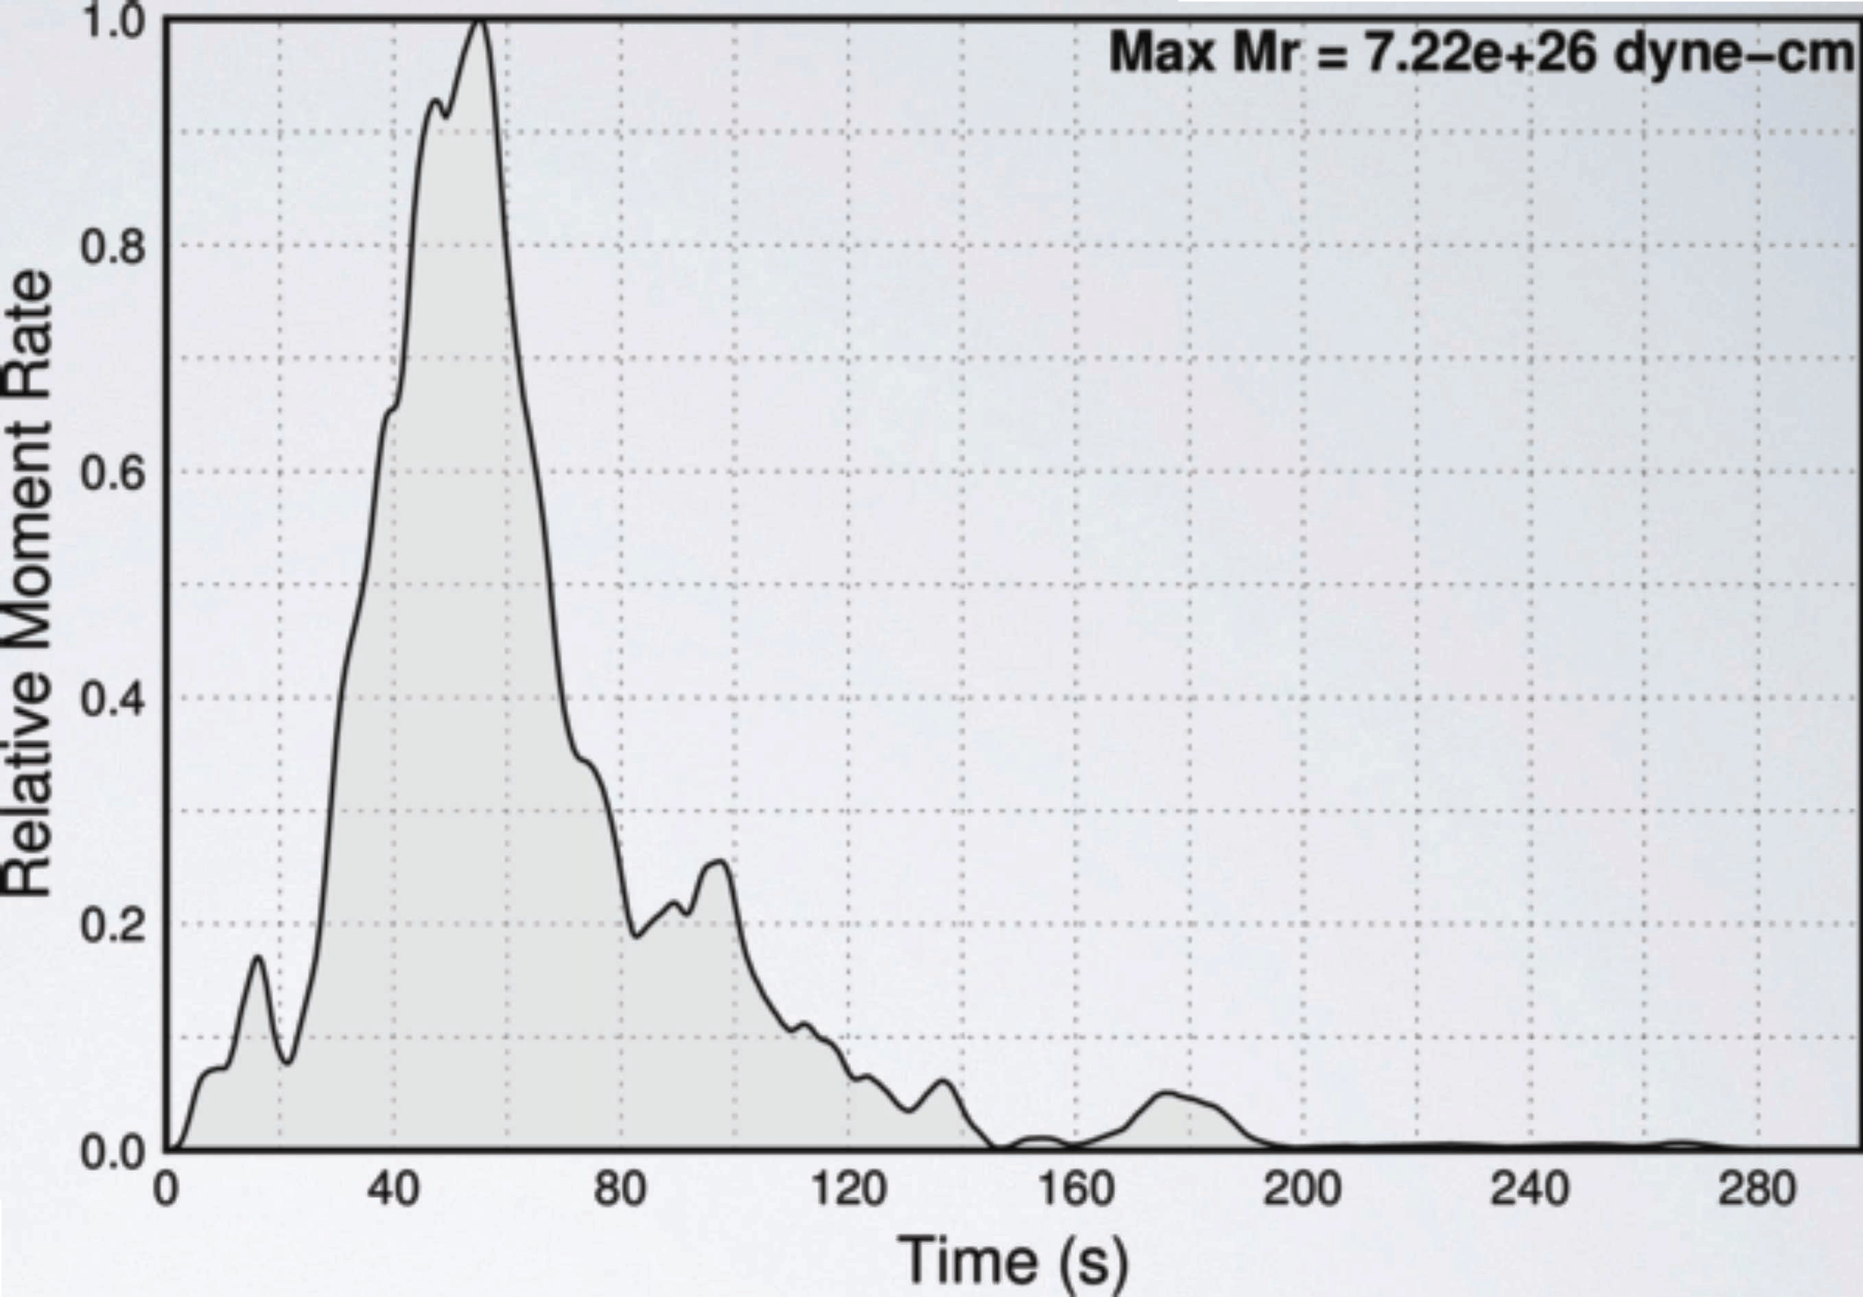
Single Source W-phase
Moment Tensor
Single point source
Long period (200-1000 s) teleseismic observations
Mw 8.3 thrust faulting event
Size, location, mechanism consistent with megathrust earthquake
Finite fault model
moment-rate function
Notes:
Here I've added the moment-rate function for the event, and essentially the single moment tensor includes all of the moment released over the 2 minutes that the earthquake took to rupture.

Slide 7
Single Source W-phase
Moment Tensor
Single point source
Long period (200-1000 s) teleseismic observations
Mw 8.3 thrust faulting event
Size, location, mechanism consistent with megathrust earthquake
Finite fault model
moment-rate function
Notes:
However, you can see that there are two peaks in the moment rate function, suggesting a more complicated earthquake source.

Slide 8
Double Source W-phase
Moment Tensor
Nealy and Hayes (2015)
Two sub-events
Mw 7.3 at ~20 sec
Mw 8.2 at ~50 sec
Finite fault model
moment-rate function
Notes:
So a double source Wphase moment tensor inversion was performed, using the technique developed by Nealy and Hayes. This analysis yields two subevents: an initial magnitude 7.3 at 20 seconds, followed by the main moment release in a magnitude 8.2 at 50 seconds.

Slide 9
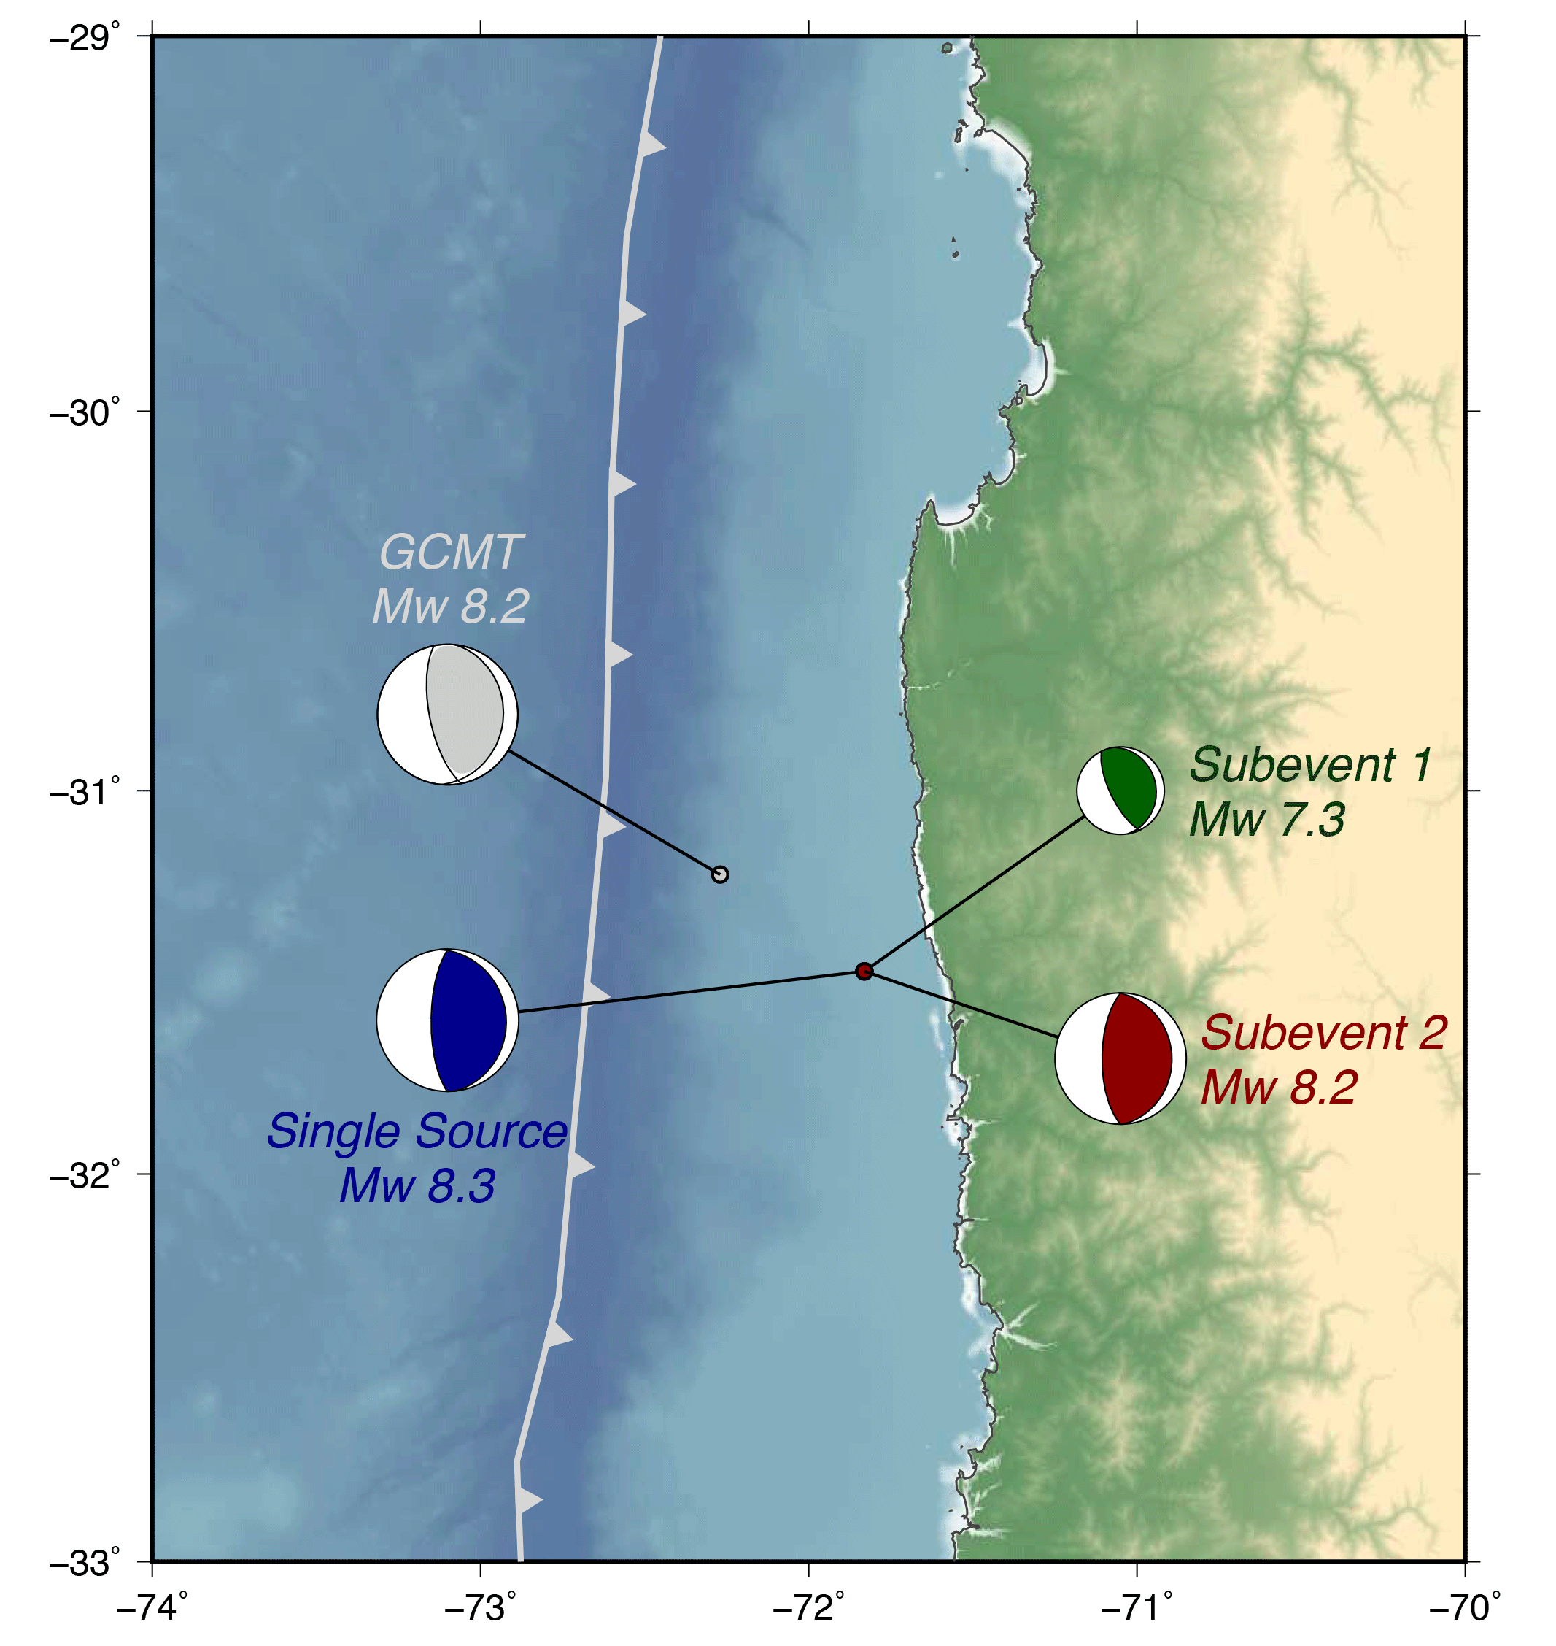
Main Shock
Moment Tensor
Megathrust earthquake
Two subevents ~30 seconds apart
Small initial event followed by large main event
Agreement with GCMT

Slide 10
Seismological Finite Fault Modeling
Notes:
Let's move on to the finite fault modeling.

Slide 11
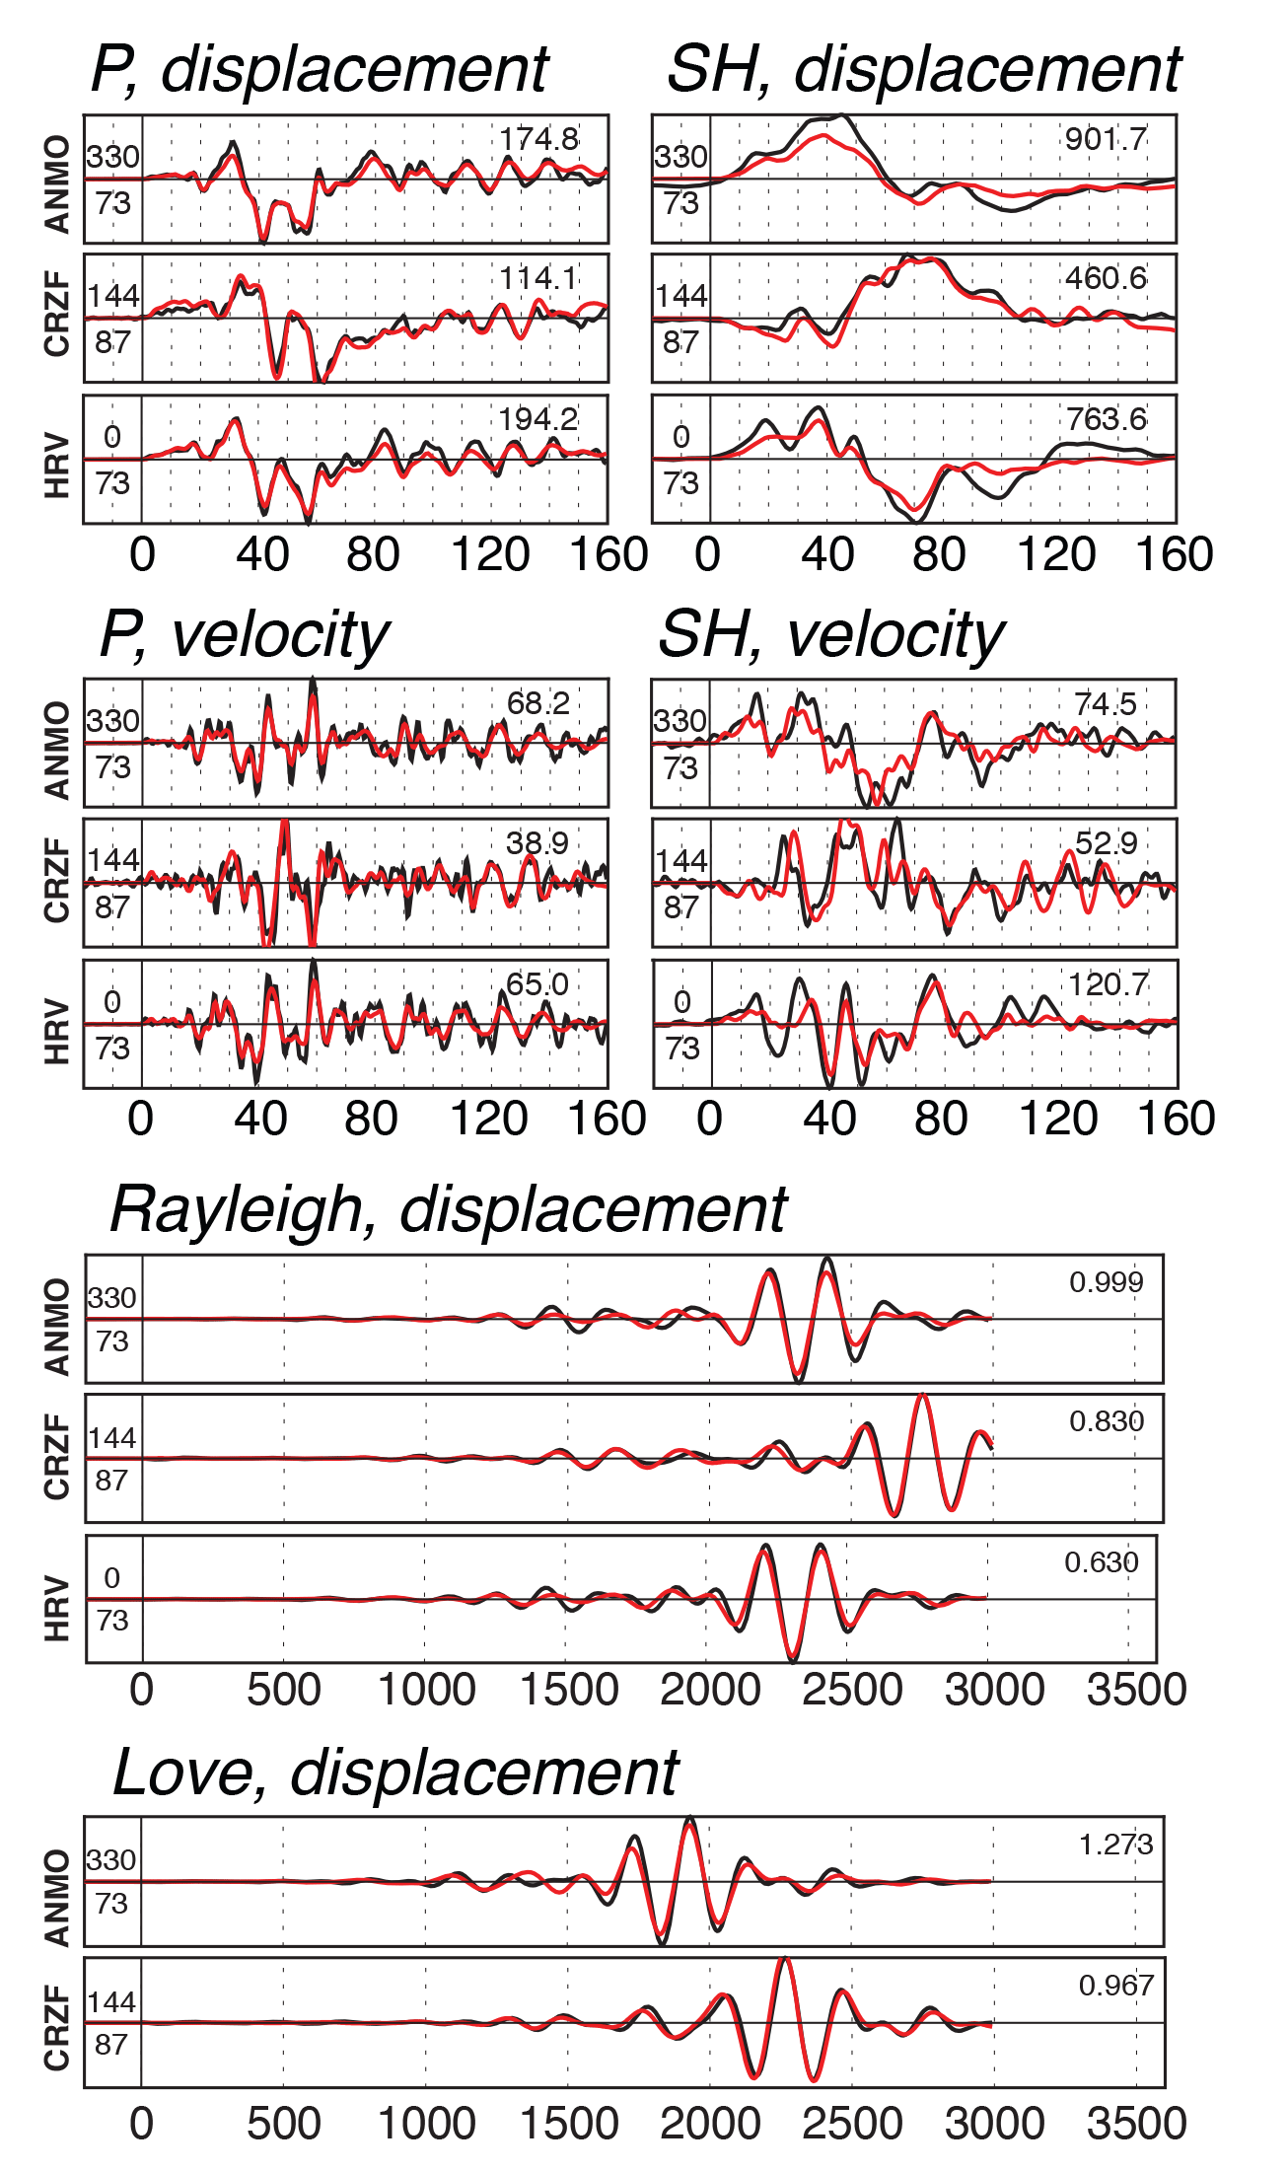
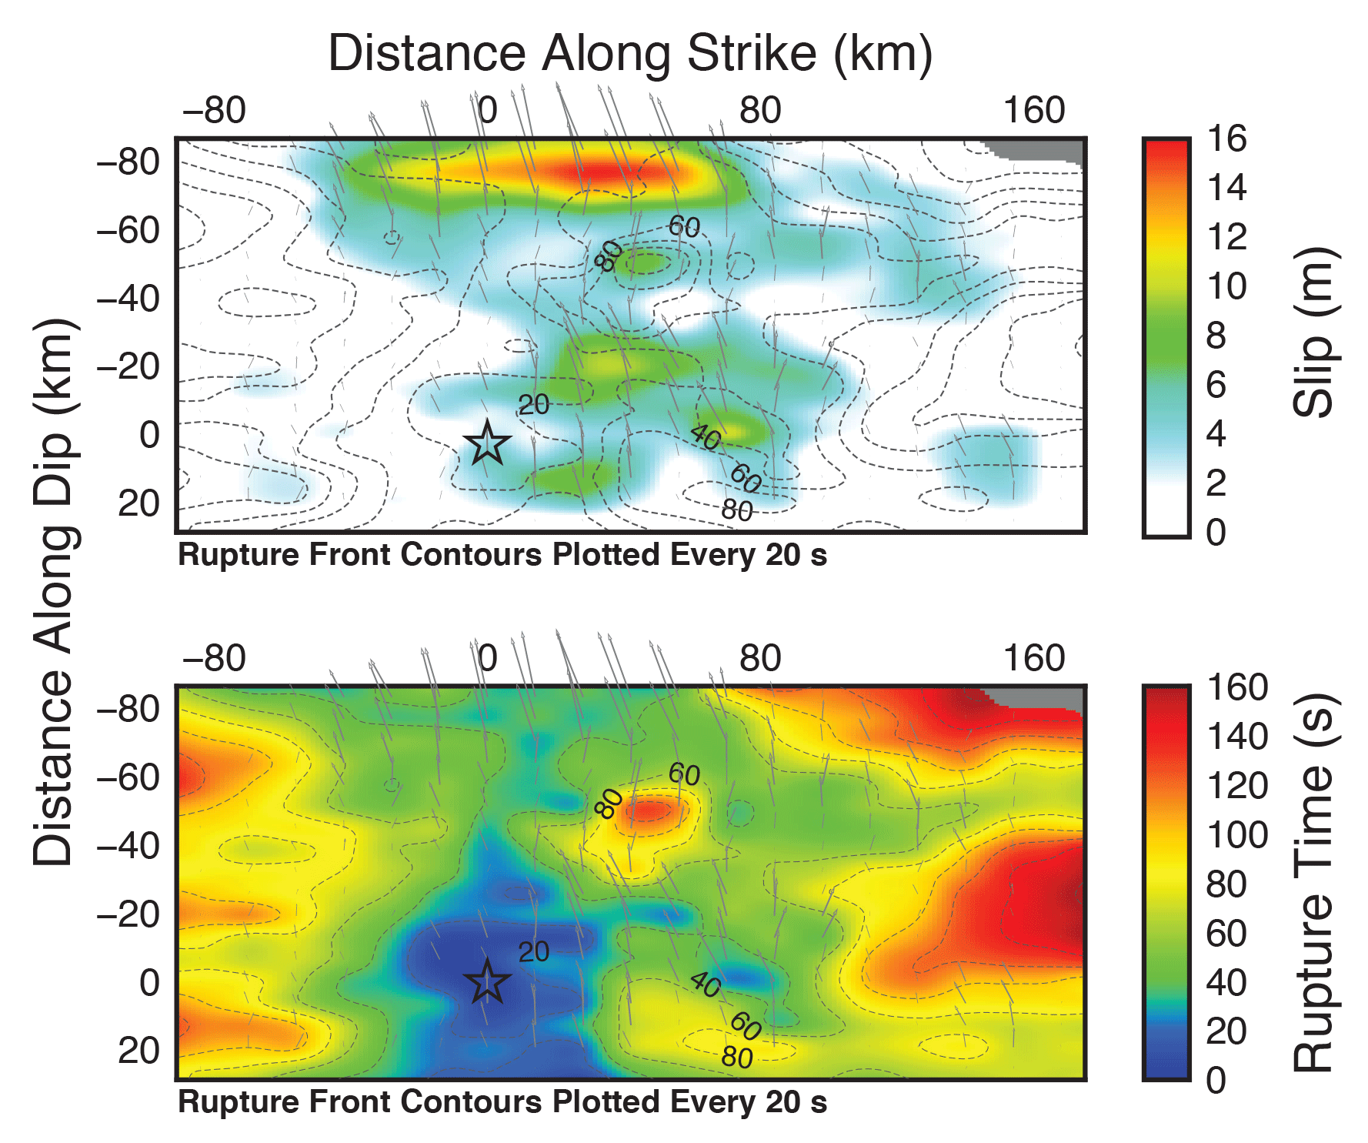
Invert velocity and displacement
Multiple period bands
Slip distribution and amplitude (top),
and timing (bottom)
Notes:
To determine the evolution of the rupture in space and time, the subduction fault is divided into many smaller subfaults, each of which acts as an individual earthquake. By fitting teleseismic velocity and displacement waveforms, the timing and slip of each of these subfaults can be constrained. Both velocity and displacement are used to provide multiple period bands in the inversion and resolve some of the higher frequency features. On the left, you can see that some representative waveform fits are quite good for the finite fault solution on the right. The top figure shows slip on the fault, with the shallow portion shown at the top, and the bottom figure shows the timing of slip.

Slide 12
Hypocenter
Depth = 28 km
North
Notes:
Let's look a little more closely at these fault models. The earthquake started at a depth of 28 km here at the star, and you can see in the timing that it ruptured to the north and up-dip simultaneously. There is patch of significant slip of up to 10 meters at the same depth as the hypocenter, and even larger slip up to about 15 meters near the trench

Slide 13
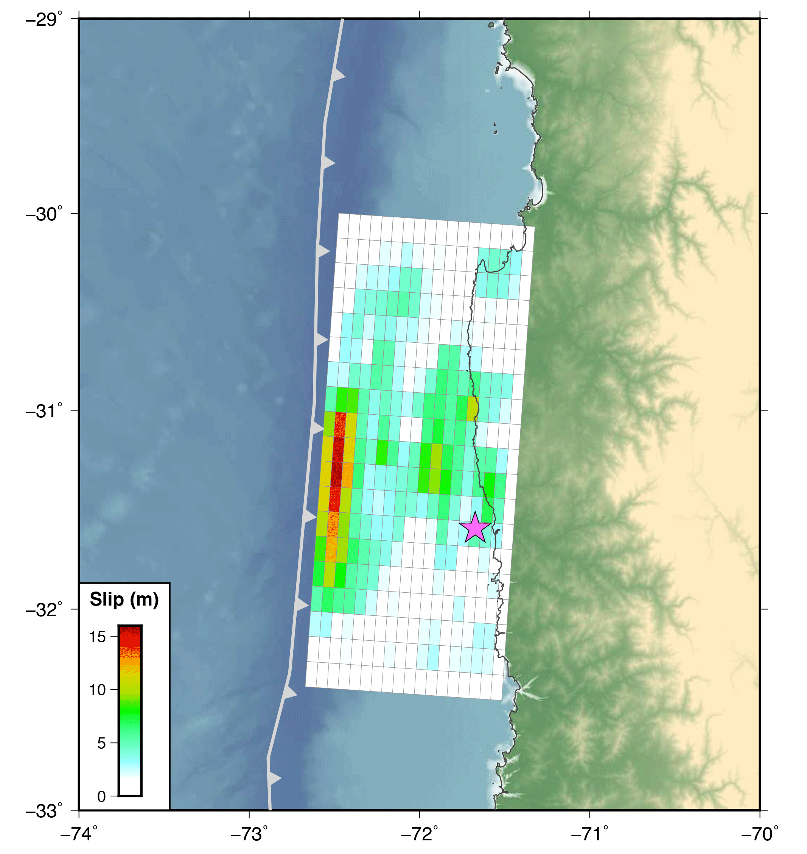
Seismological
Finite Fault
Main Shock
Moment Tensor
Rupture began at ~28 km depth
15+ meters of shallow fault slip
10 meters of fault slip near coast
Duration of ~2 minutes
Notes:
Plotting this on the regional map, you can see the model in its context off the coast. This has rotated it about 90 degrees counter clockwise, and the fault lies on the dipping plate boundary.

Slide 14
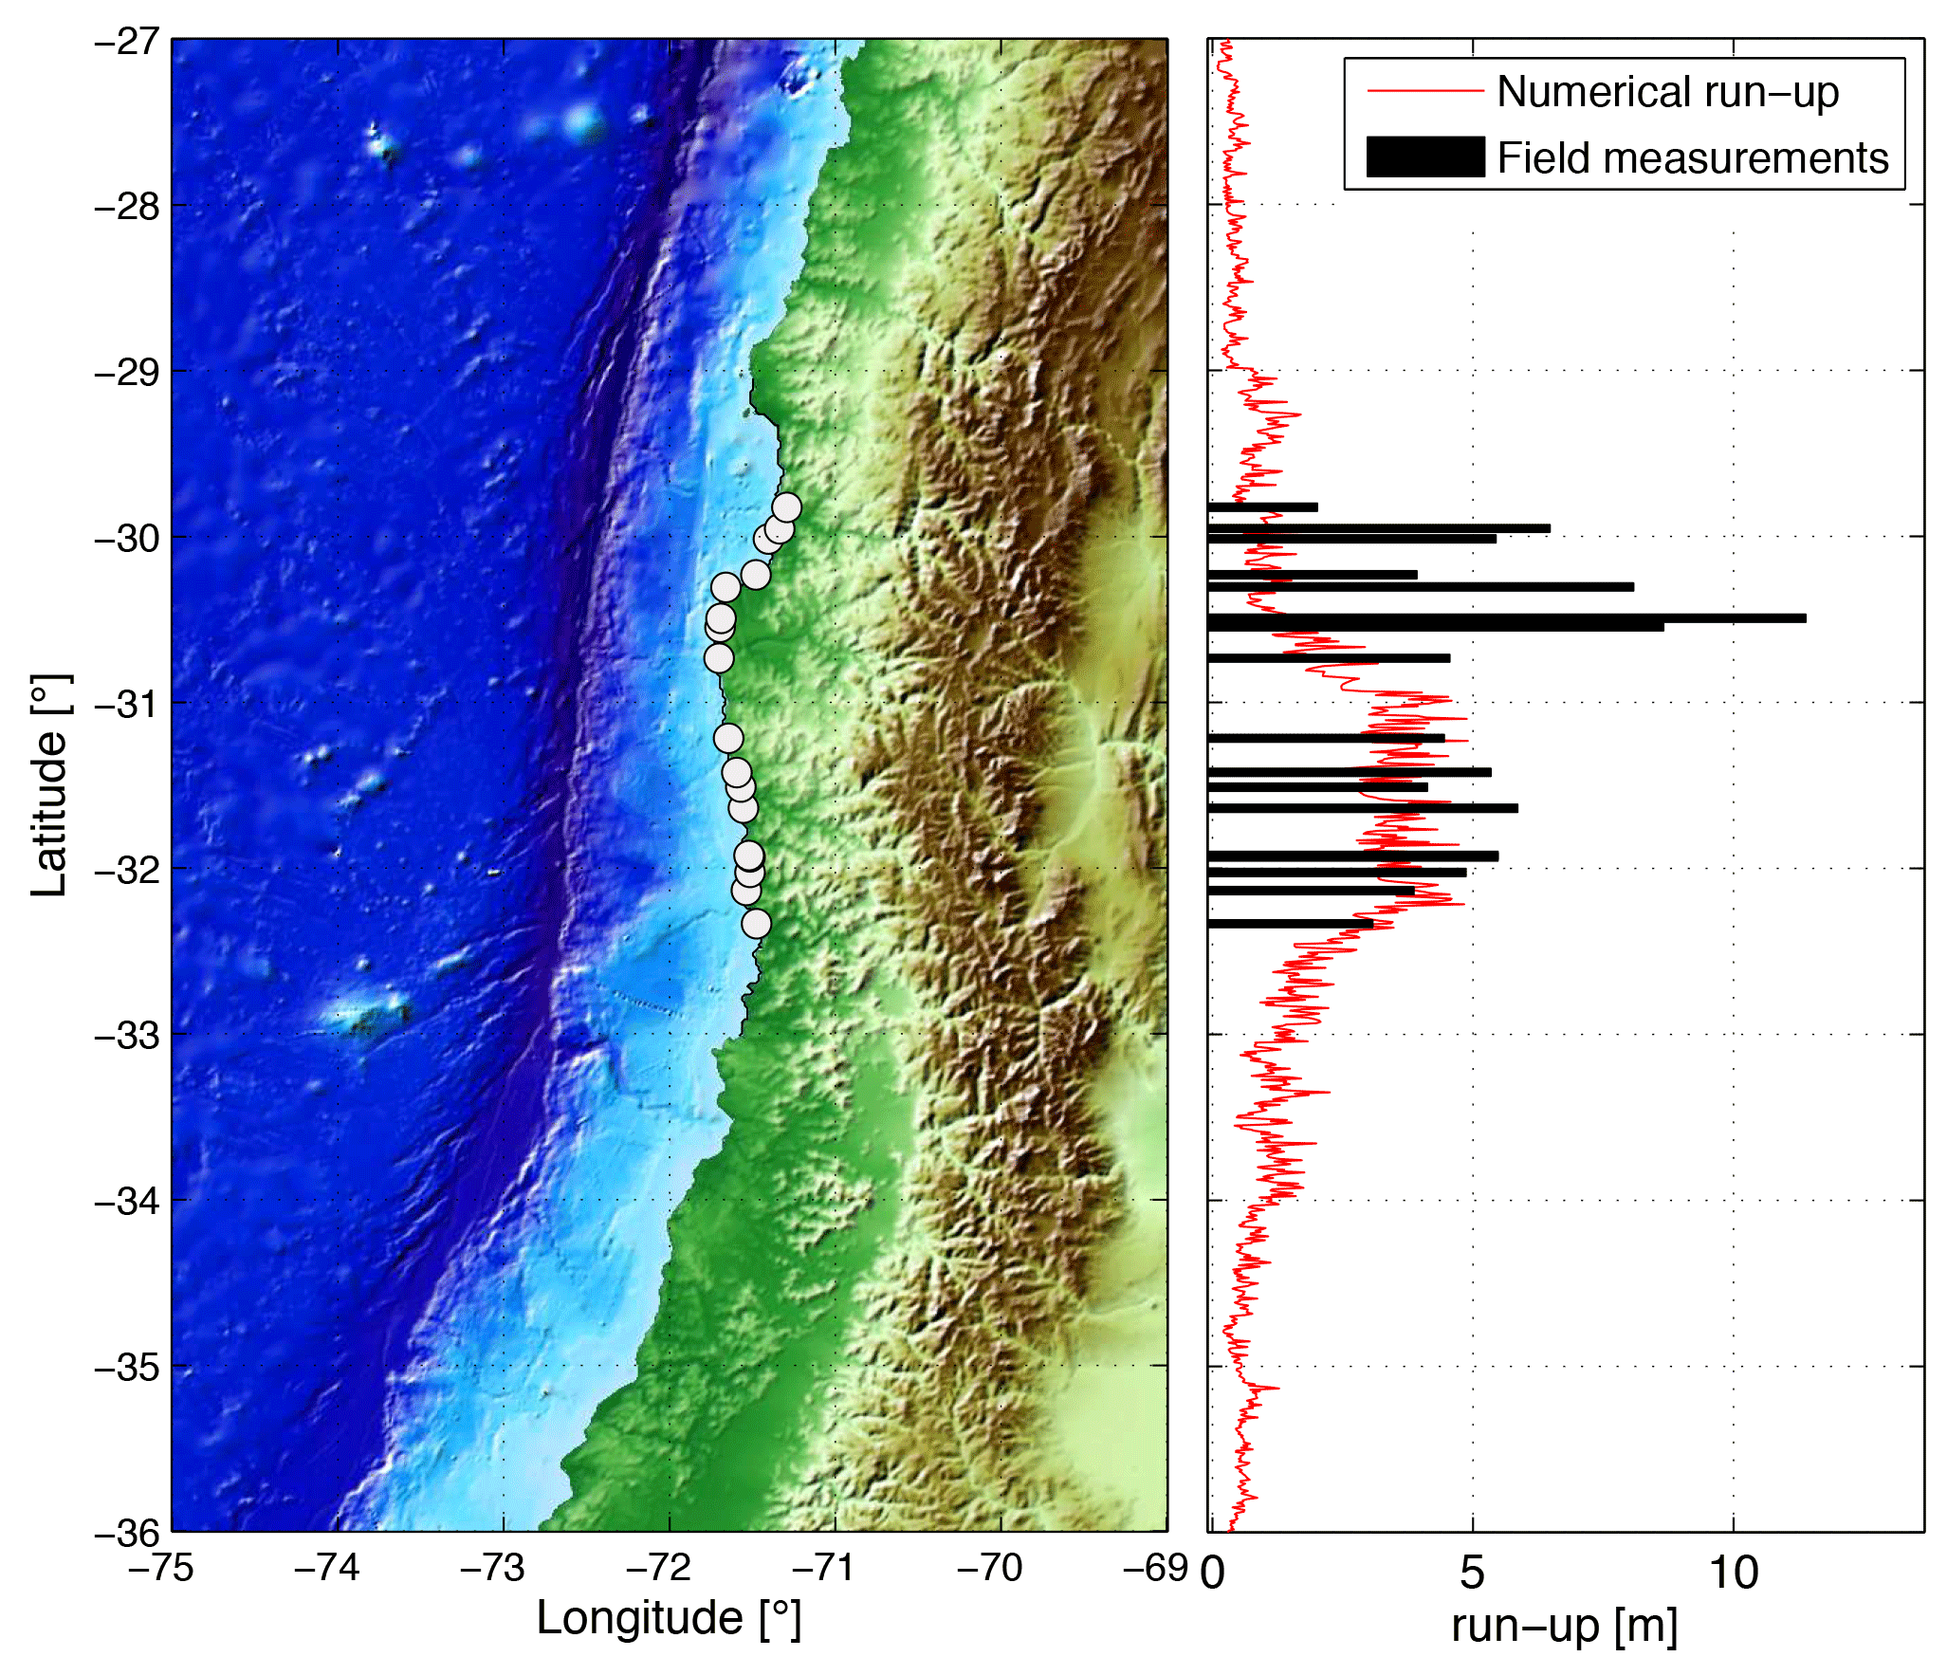
Tsunami data courtesy of Sebastian Riquelme
Notes:
I also want to point out that, as you might have expected, the significant shallow slip is consistent with generating a tsunami. And here you can see that the tsunami run up along the coast was up to 5-10 meters in some places. Thank you to Sebastian for sharing this data.

Slide 15
Hypocentral Relocation
Notes:
Okay, let's move on. The earthquake had a large aftershock sequence, and all these events have been relocated.

Slide 16
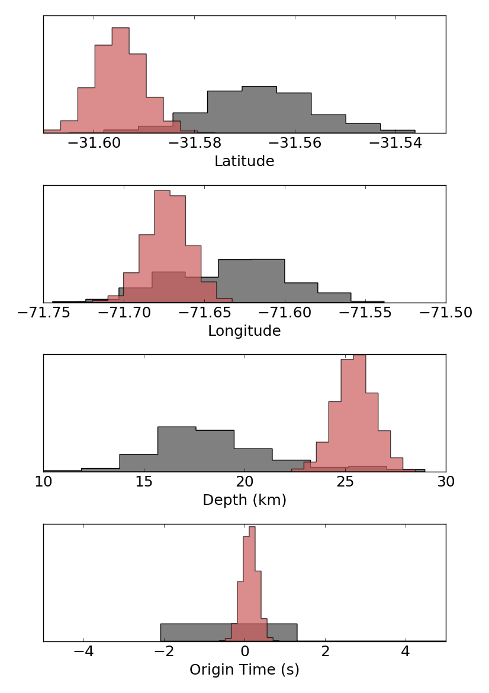
Main Shock
Probability Distributions
Bayesian Multiple Event
Relocation
Latitude
Following Myers et al. (2007, 2009)
Absolute location and uncertainty estimates
Relies on Pg, Pn, P, Sn, Sg phase observations
Longitude
Depth
Origin Time
Prior distribution
Posterior distribution
Notes:
We have used a Bayesian multiple event relocation technique, following Myers et al. (2007, 2009). Using several different phase observations, this technique yields absolute location and uncertainty estimates for the earthquake hypocenters. On the right are the probability distributions for the main shock latitude, longitude, depth, and origin time. The grey are the probability distributions before the relocation, and the red are the probability distributions after the relocation.

Slide 17
Main Shock
Probability Distributions
Bayesian Multiple Event
Relocation
South
Latitude
Following Myers et al. (2007, 2009)
Absolute location and uncertainty estimates
Relies on Pg, Pn, P, Sn, Sg phase observations
West
Longitude
Depth
Down
Origin Time
Prior distribution
Posterior distribution
Notes:
In this case, you can see that the main shock hypocenter moves slightly south, west, and down.

Slide 18
Relocation Vectors
Hypocentral Depth
Notes:
On the left are the relocation vectors for each event. In this sequence, most of the events moved slightly eastward, but the relocation vectors are fairly small. What I really want you to focus on is the figure on the right, which shows our preferred relocated hypocenters.

Slide 19
Relocation Vectors
Hypocentral Depth
Notes:
Large cluster of aftershocks right off the coast

Slide 20
Relocation Vectors
Hypocentral Depth
Notes:
Gap in aftershocks in shallow part of subduction zone

Slide 21
Relocation Vectors
Hypocentral Depth
Notes:
Clusters of shallower aftershocks to north and south.

Slide 22
Relocation Vectors
Hypocentral Depth
Notes:
Earthquakes in subducting plate outboard of trench

Slide 23
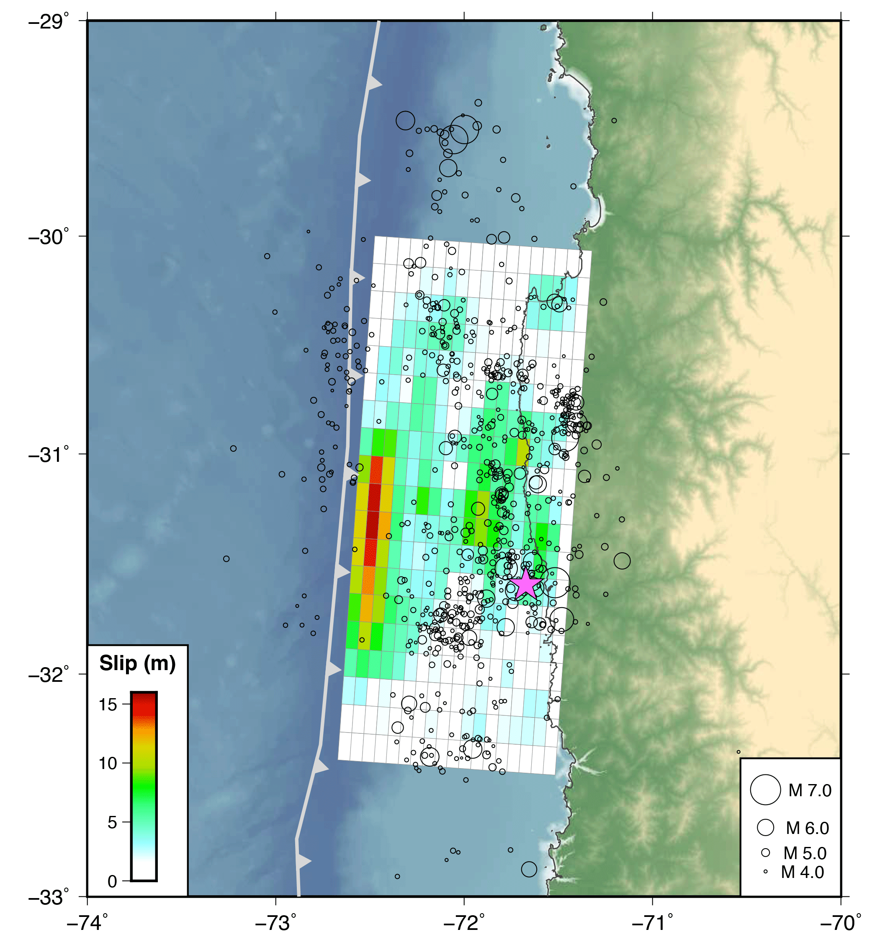
Hypocentral Relocation
Main Shock
Moment Tensor
Concentrated near down-dip slip
Surround shallow slip area
Extend along strike beyond rupture
Notes:
Finally, here we have added the relocated seismicity to our comprehensive picture.

Slide 24
Aftershock Moment Tensors
Notes:
In addition to relocating the aftershock sequence, we can determine source parameters for the larger aftershocks.

Slide 25
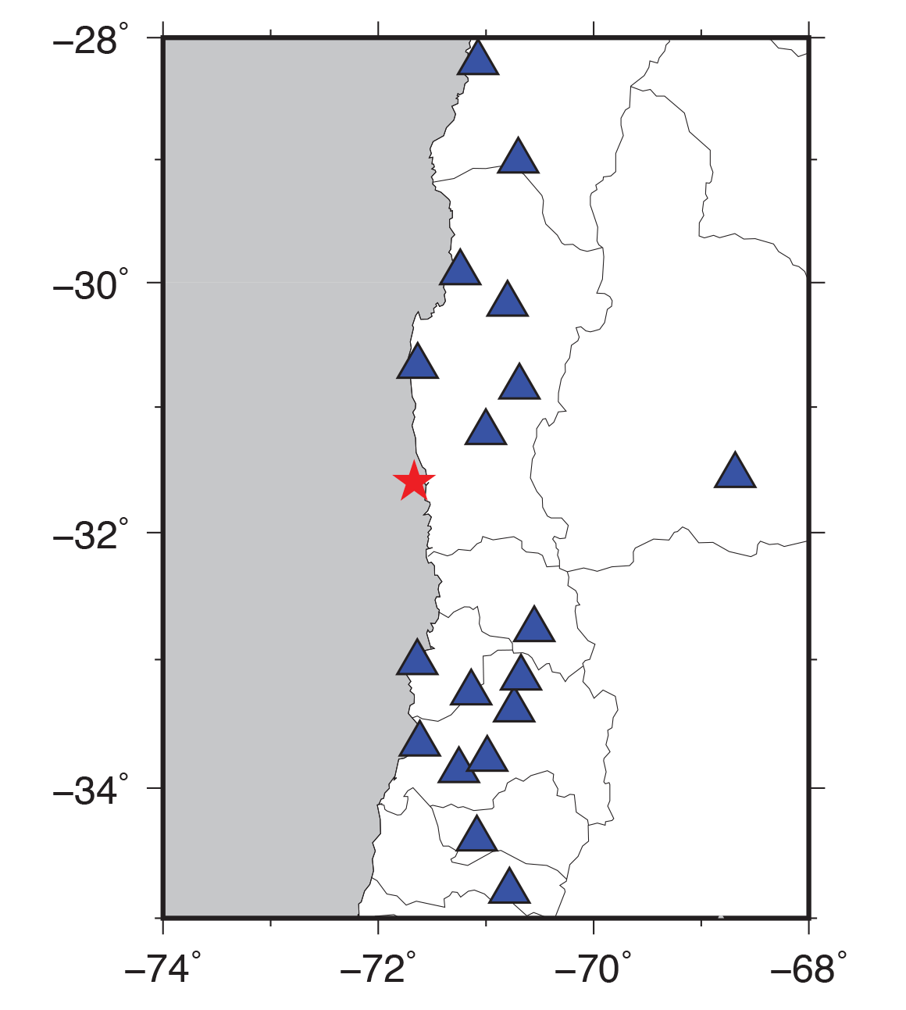
Regional Network
Used for relocation and regional moment tensors
~800 relocated aftershocks M3.5+
55 M5.0+ events (teleseismic MT)
170 M4.0+ events (regional MT)

Slide 26
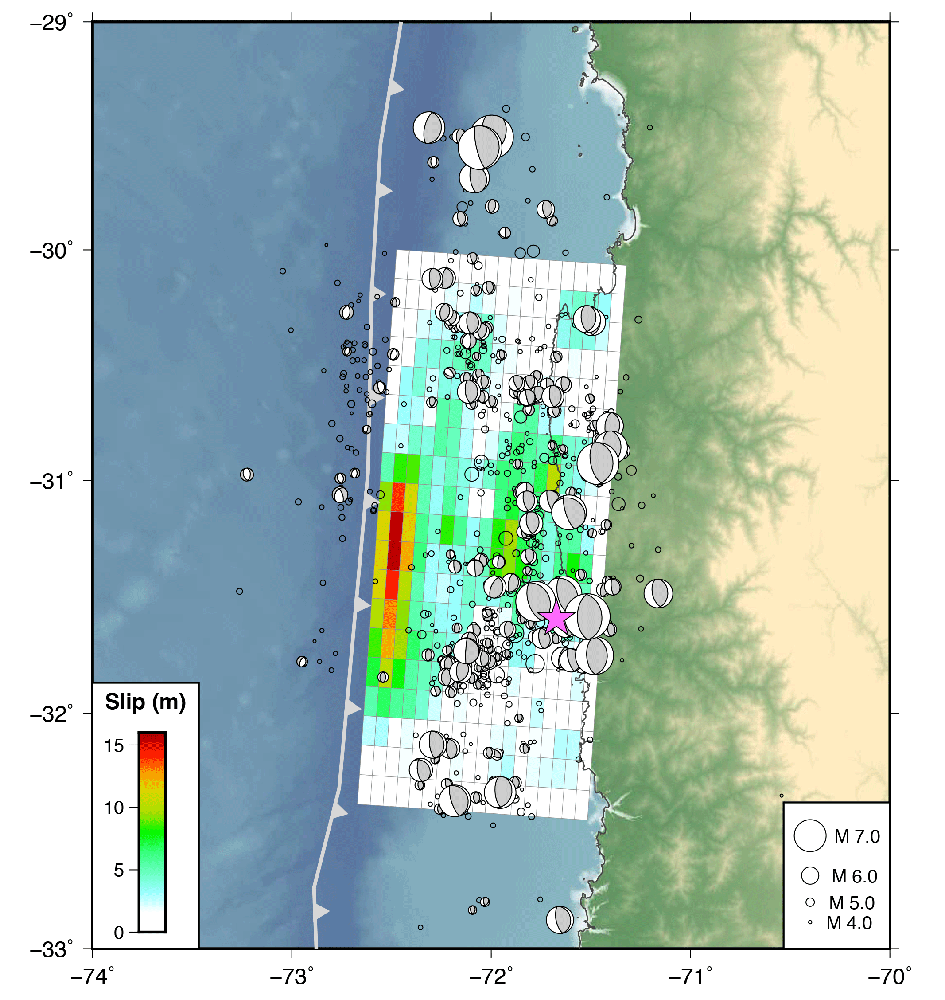
Aftershock Moment Tensors
Main Shock
Moment Tensor
Dominantly thrust faulting near plate interface
Largest events near down-dip edge, and along-strike
Outer rise normal faulting events

Slide 27
Static Surface Deformation

Slide 28
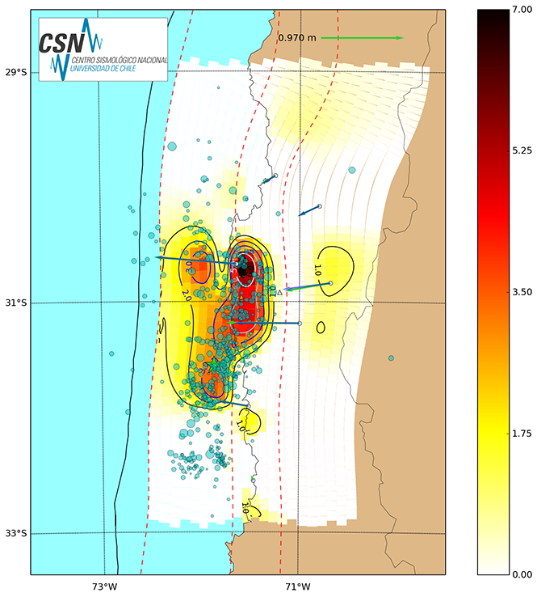
Rapid GPS offsets, geodetic finite fault model published by CSN soon after Illapel earthquake
https://www.csn.uchile.cl/desplazamientos-del-terremoto-de-illapel-2015/

Slide 29
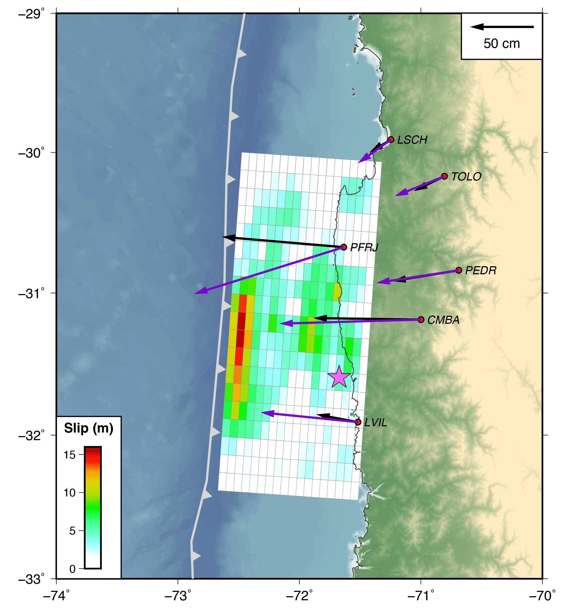
Forward
Model GPS
Observed
Predicted
Predict GPS displacements using seismic FFM
Reasonably good fits, without any geodetic input
GPS data: https://www.csn.uchile.cl/desplazamientos-del-terremoto-de-illapel-2015/
Notes:
Predicted and observed

Slide 30
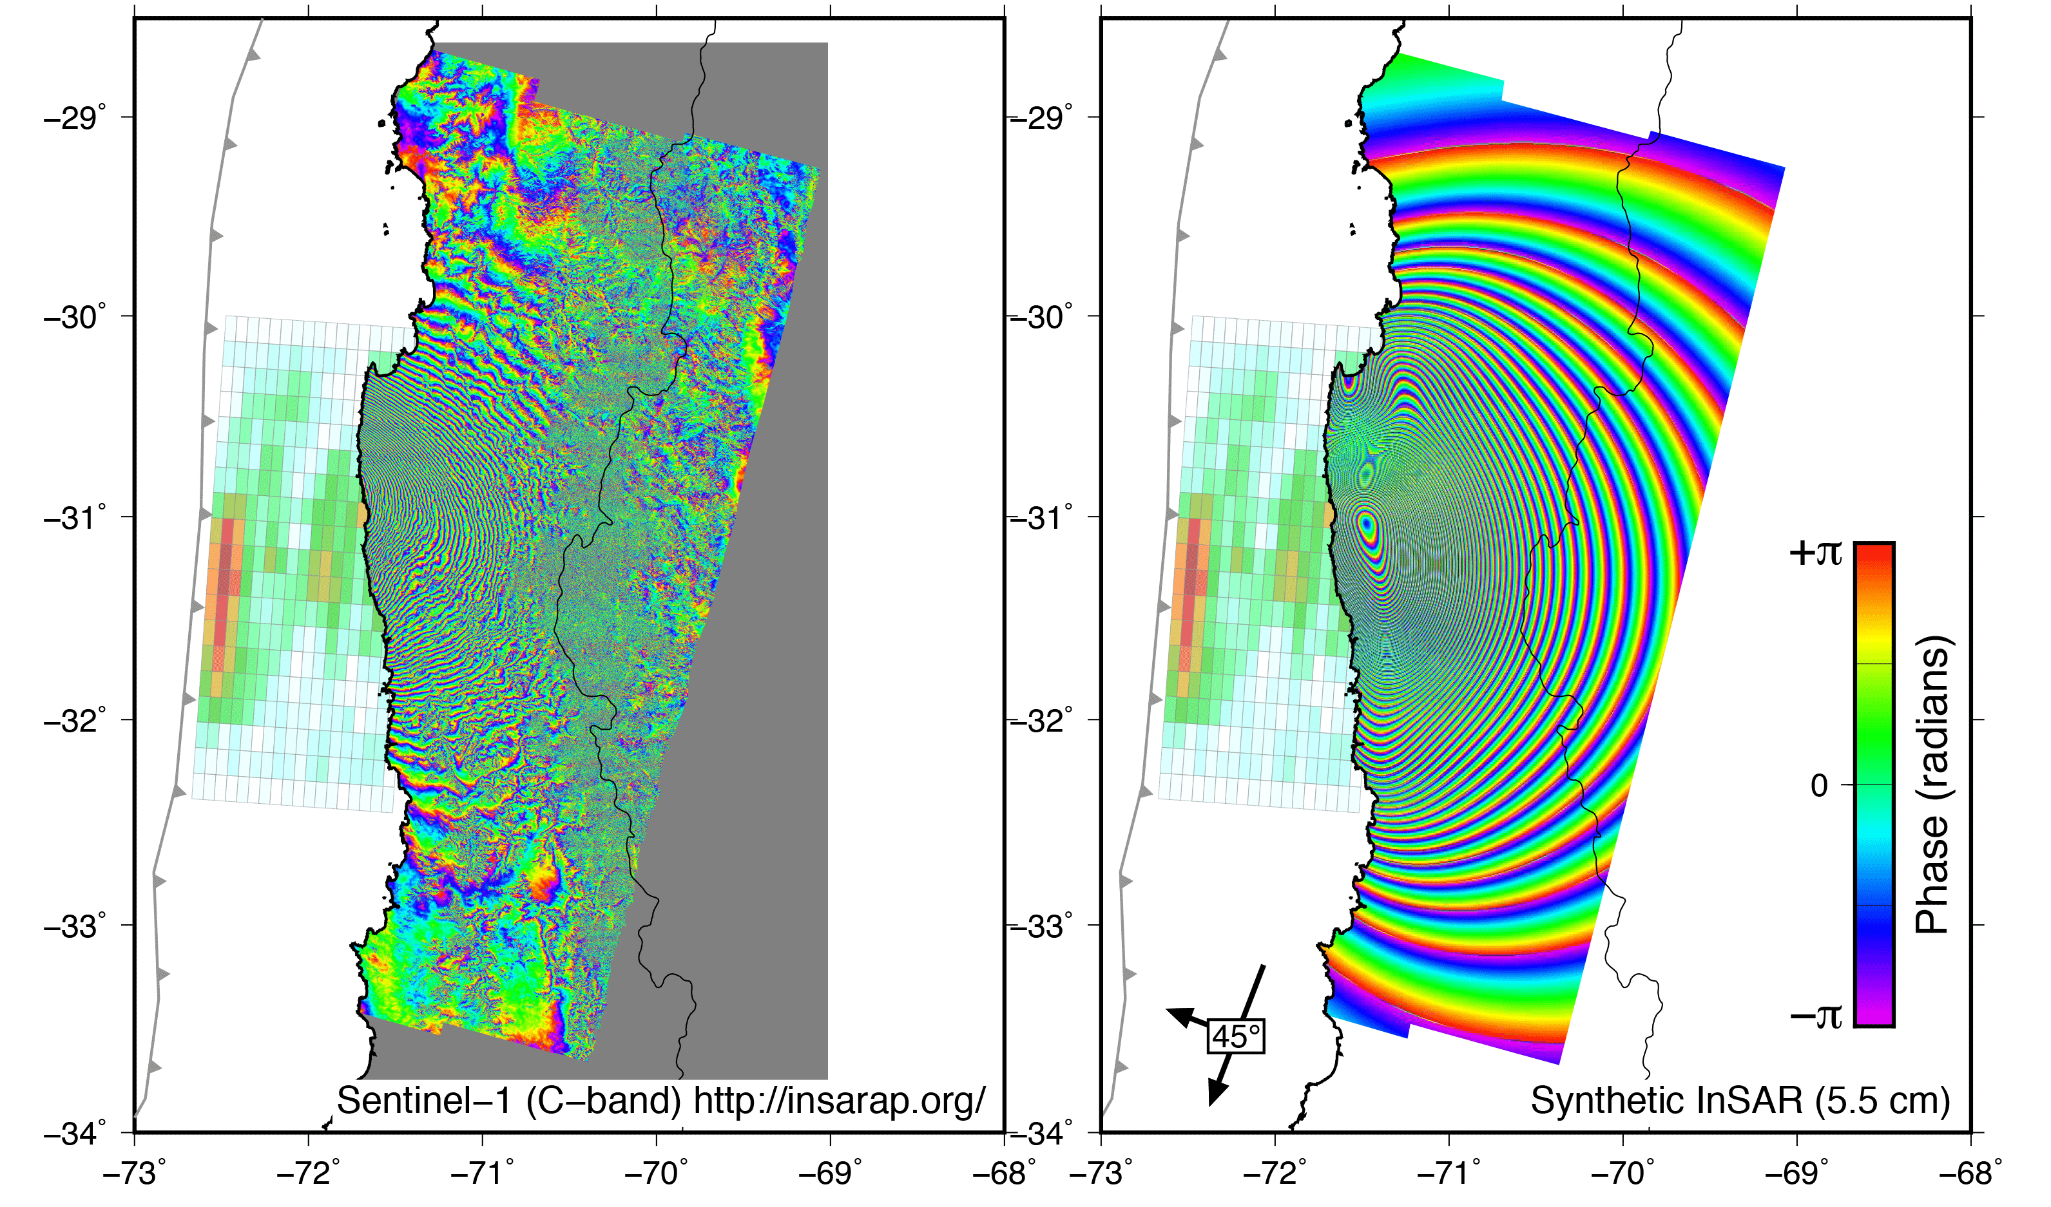
Predict InSAR interferogram using seismic FFM
Reasonably good fits, slightly shifted in space

Slide 31
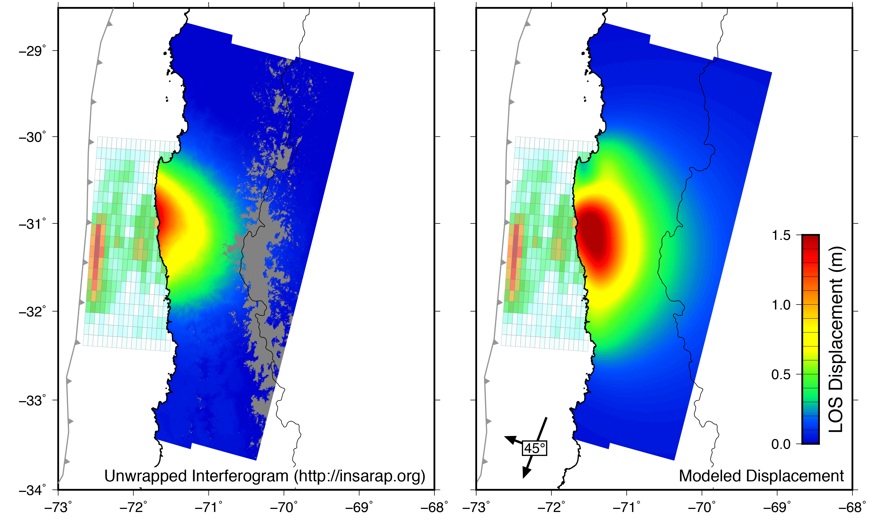
Predict InSAR interferogram using seismic FFM
Reasonably good fits, slightly shifted in space
Notes:
Put FFM behind InSAR

Slide 32
Geodetic Finite Fault Modeling

Slide 33
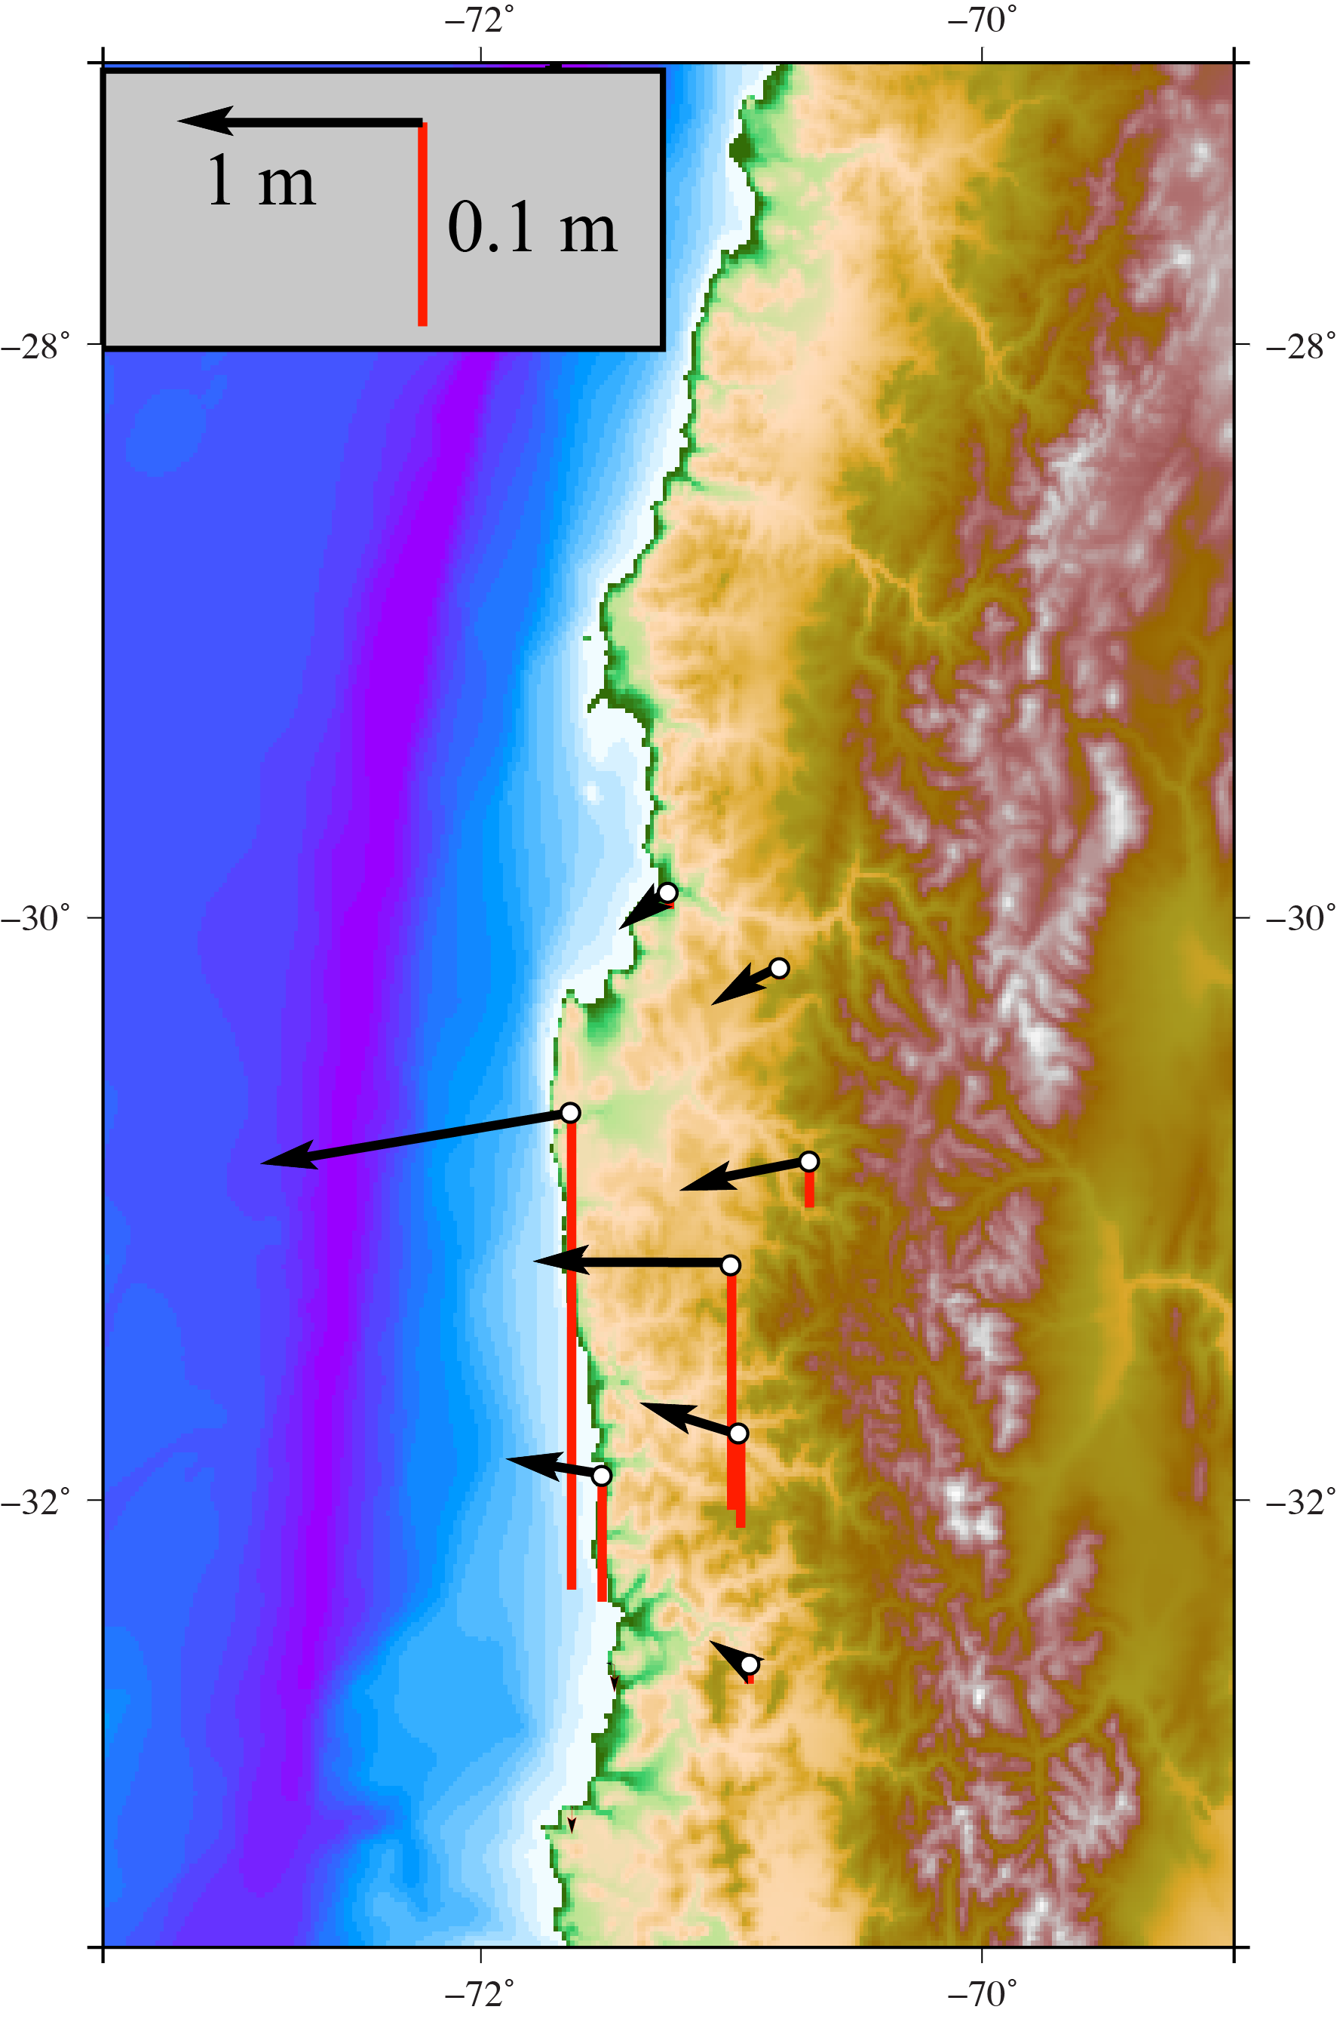
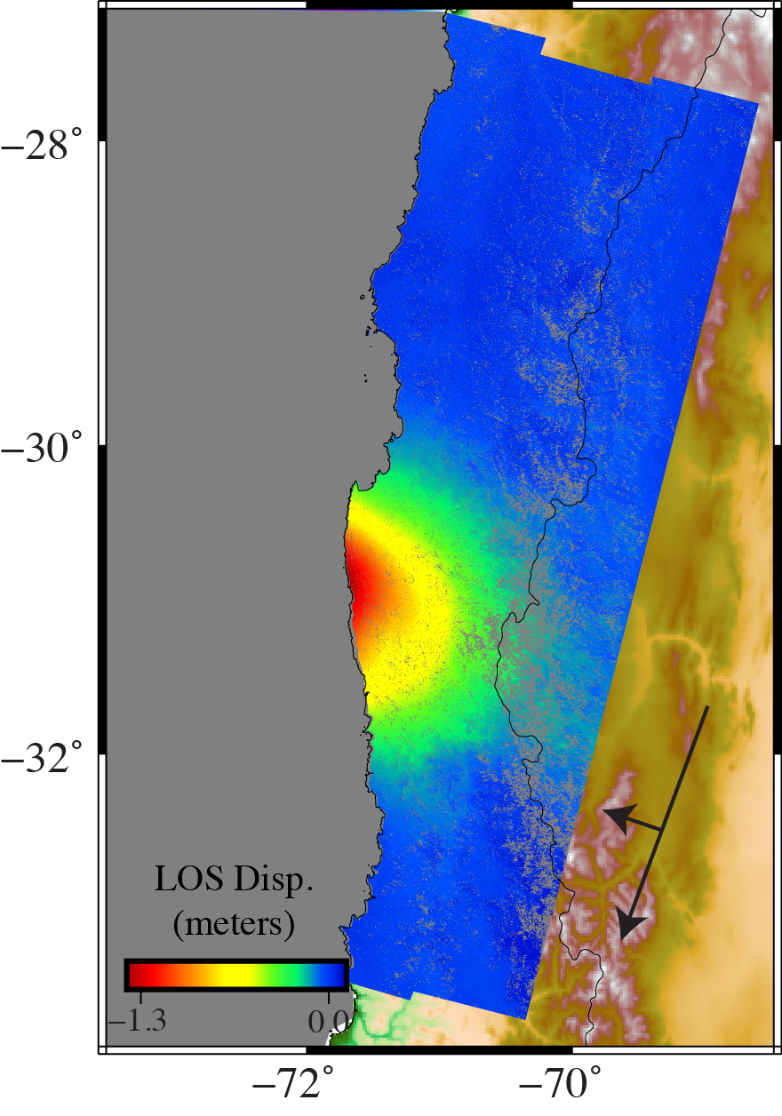
InSAR processing: P. Gomez, U. Missouri
GPS processing: J. Svarc, USGS

Slide 34
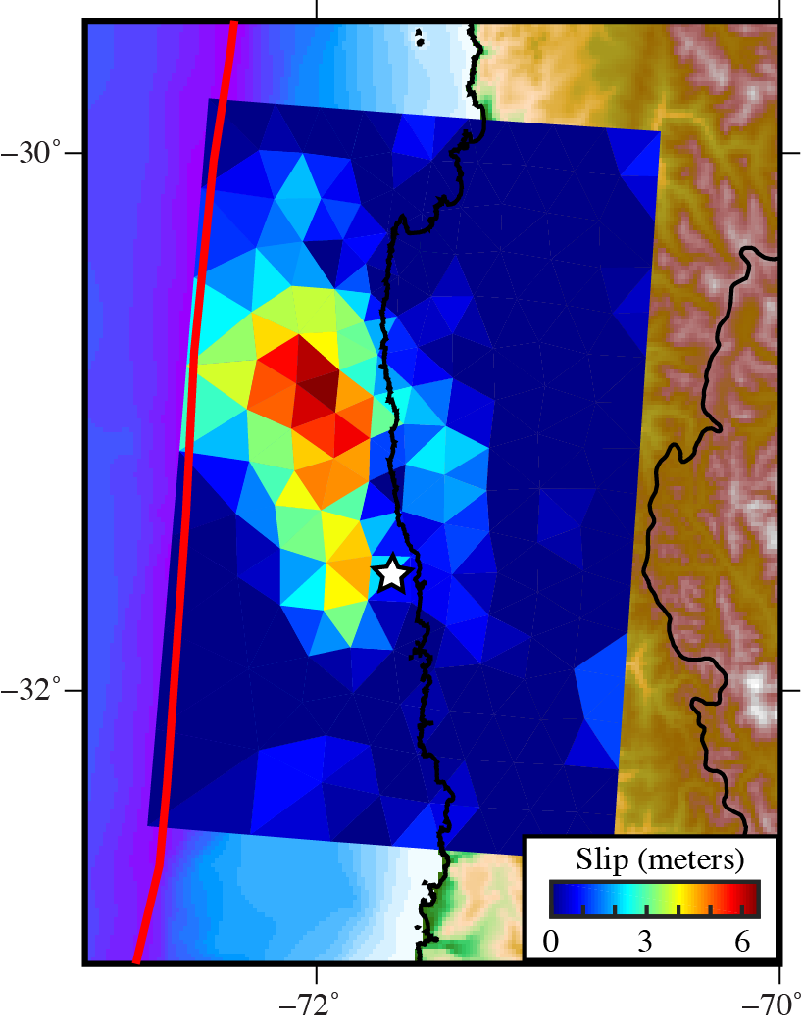
Geodetic Finite Fault Modeling
Joint InSAR/GPS inversion
Notes:
The finite fault slip distribution inverted jointly from InSAR and GPS static displacements. One image is shown in map view, the other in plan-view (depth is showing in kilometers). The star shows the NEIC epicenter. The slip distribution clearly resolves a northward propagating rupture, with the majority of of moment released ~90 km north of the epicenter, and almost entirely offshore. Some slip is imaged down-dip of the coastline. We are conducting a suite of tests to determine if this deeper slip is robust, and so far it appears to be robustly constrained. The slip distribution entails a constant slip direction (83 degrees from strike) and we impose a spatial smoothing constraint.
We have tested a range of fault geometries and regularization constraints to derive a suite of slip distributions in addition to those shown. In all cases, we are unable to recover the full earthquake magnitude (typically about M8.15). This strongly implies that, while we image some slip out to the trench, we are largely insensitive to near-trench slip that is imaged seismologically and evidenced by the tsunami. It should also be pointed out that the magnitude and extent of near-trench slip we do recover is highly dependent on the degree of regularization we impose.

Slide 35
Geodetic Finite Fault Modeling
Joint InSAR/GPS inversion
Shallow vs. deep peak slip
Magnitude
Seismic: 8.3
Geodetic: 8.1
2 meter seismic
FFM slip contours
Notes:
The finite fault slip distribution inverted jointly from InSAR and GPS static displacements. One image is shown in map view, the other in plan-view (depth is showing in kilometers). The star shows the NEIC epicenter. The slip distribution clearly resolves a northward propagating rupture, with the majority of of moment released ~90 km north of the epicenter, and almost entirely offshore. Some slip is imaged down-dip of the coastline. We are conducting a suite of tests to determine if this deeper slip is robust, and so far it appears to be robustly constrained. The slip distribution entails a constant slip direction (83 degrees from strike) and we impose a spatial smoothing constraint.
We have tested a range of fault geometries and regularization constraints to derive a suite of slip distributions in addition to those shown. In all cases, we are unable to recover the full earthquake magnitude (typically about M8.15). This strongly implies that, while we image some slip out to the trench, we are largely insensitive to near-trench slip that is imaged seismologically and evidenced by the tsunami. It should also be pointed out that the magnitude and extent of near-trench slip we do recover is highly dependent on the degree of regularization we impose.

Slide 36
Static Stress Change

Slide 37
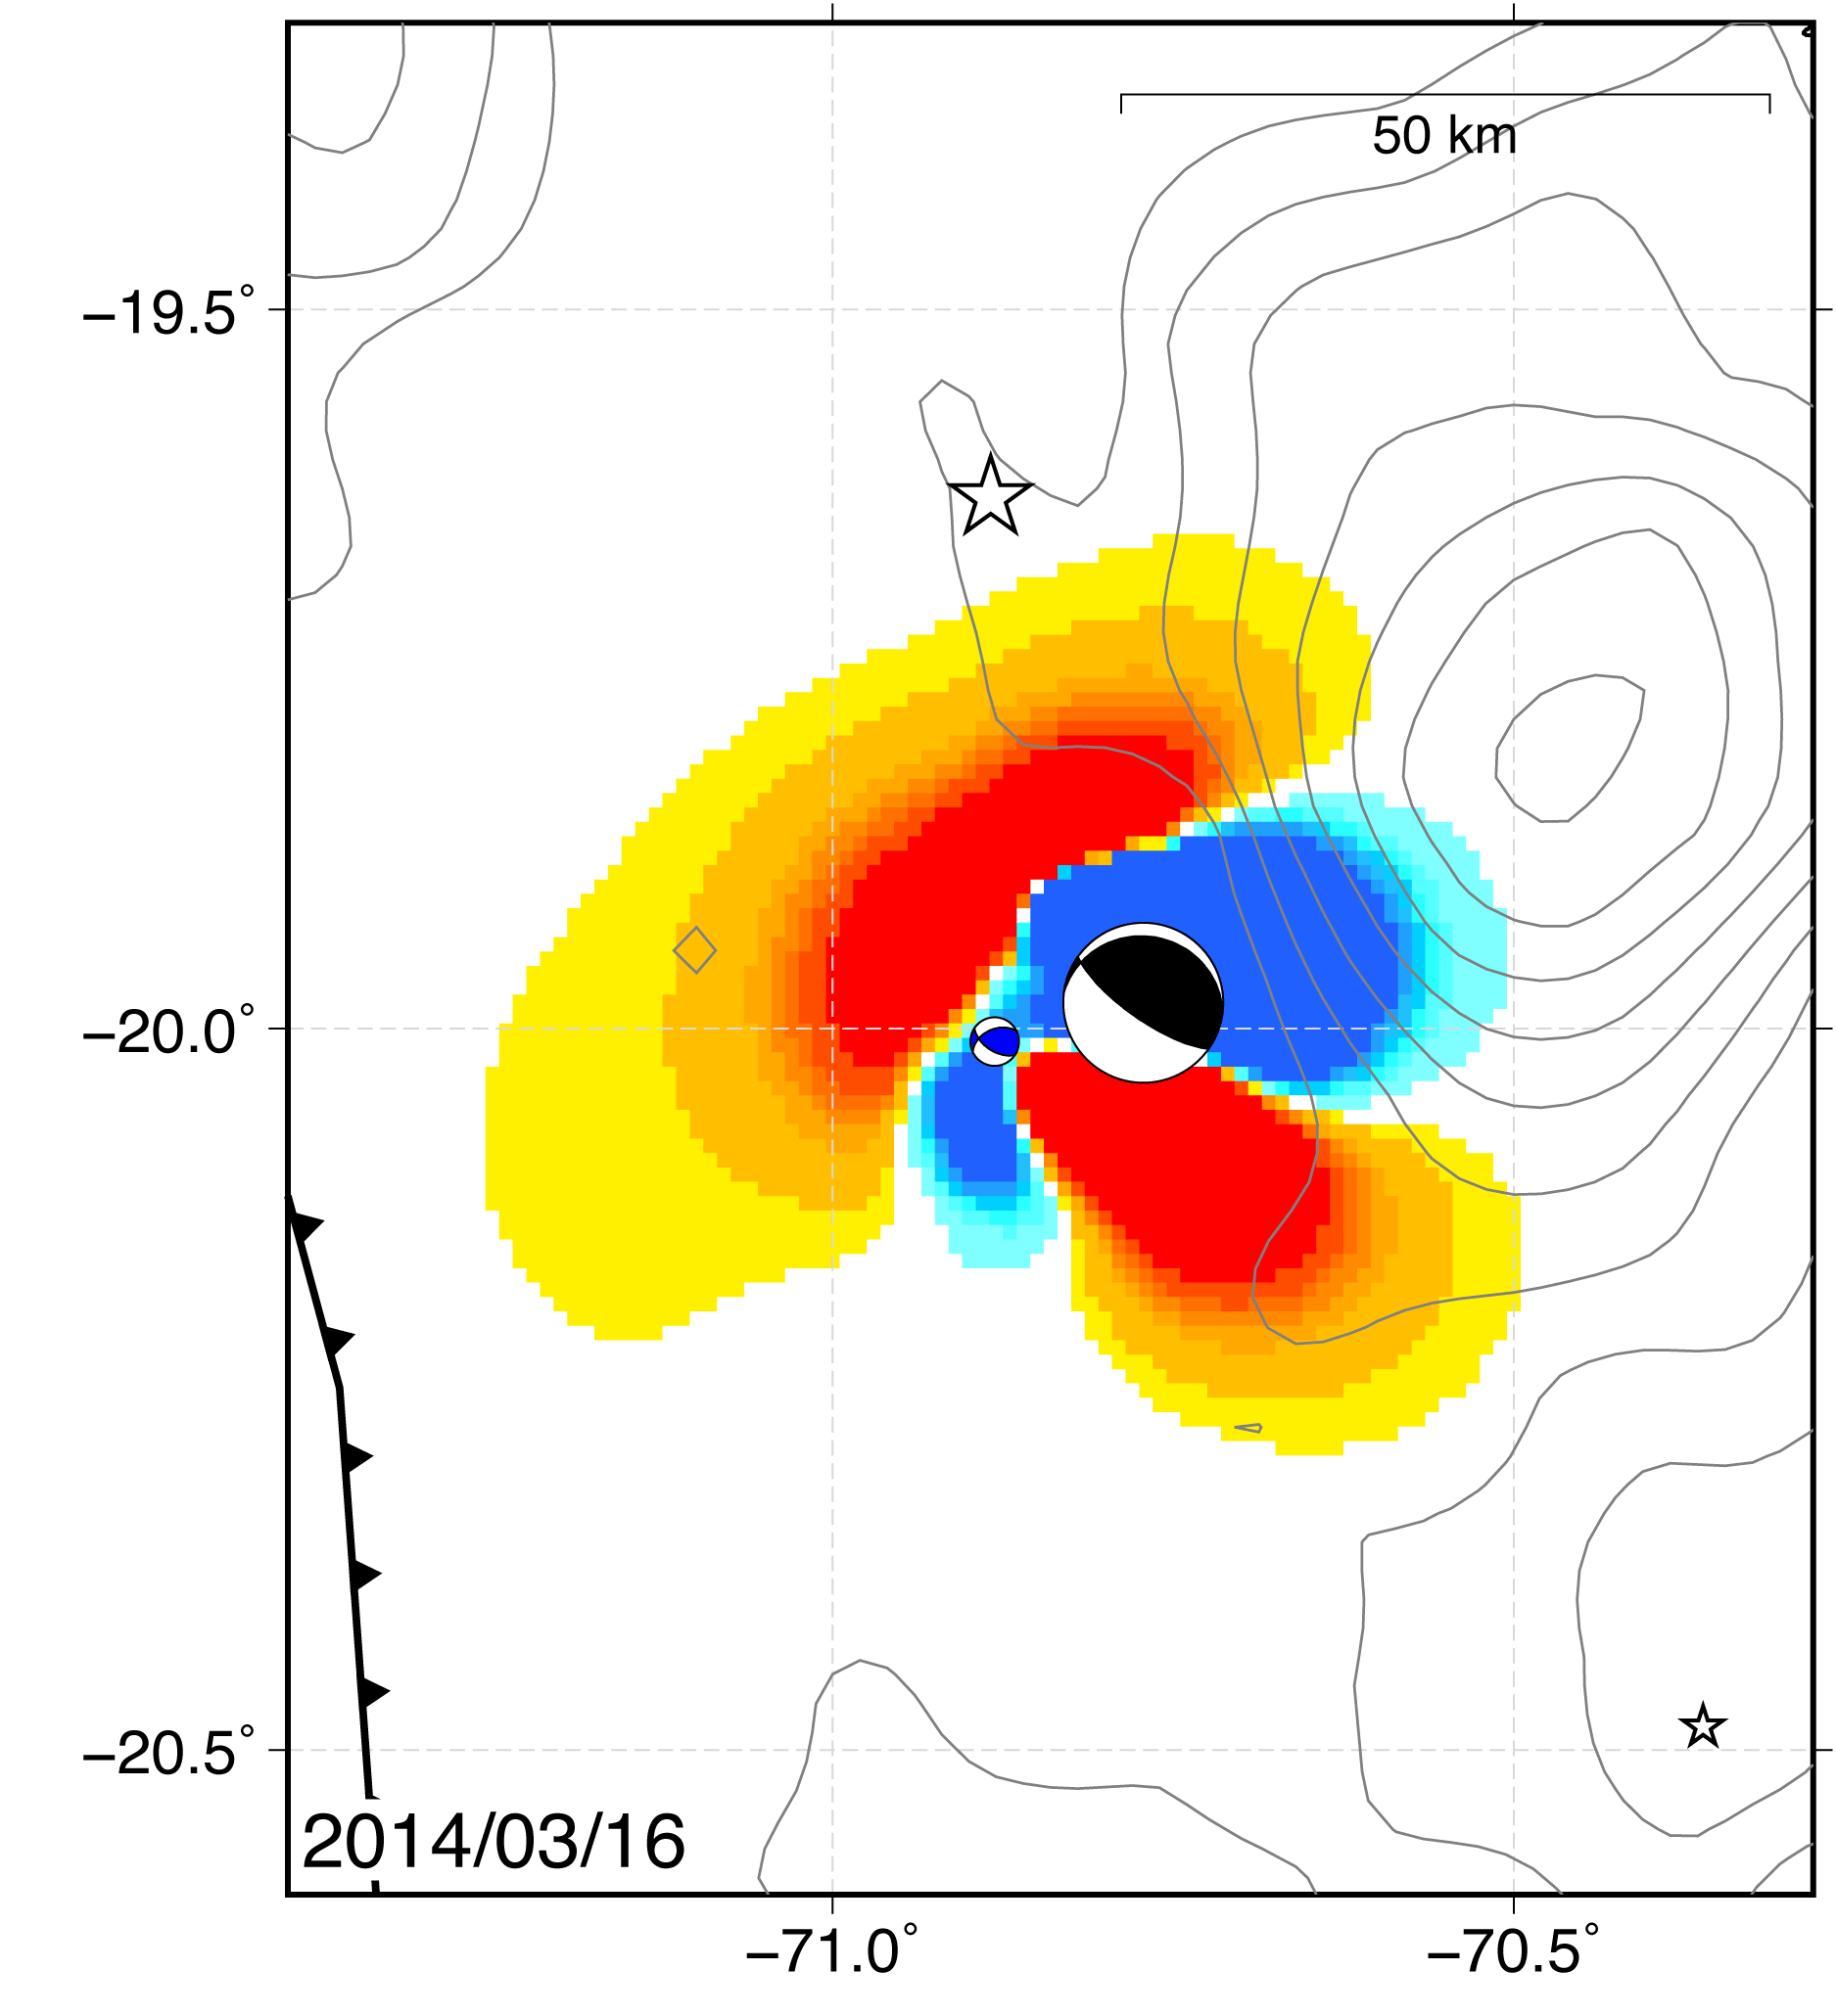
Static Stress Change
Coulomb stress change
τ shear stress
σ_{n} normal stress
μ friction (0.4)
Generated by slip in elastic half-space (Okada, 1992)
Resolved onto aftershock fault planes
Notes:
The basic idea of triggering is that an event can make an future earthquake more likely to occur. During this talk, when I say the word “trigger” I don’t necessarily imply a direct link to an earthquake in any predictive sense, but rather that an event enhances the possibility of a subsequent earthquake. We use the concept of Coulomb stress change as the physical mechanism linking these earthquakes. The idea here is simple: slip on a fault changes the stress field in the surrounding medium. If a nearby fault has an increase in shear stress or decrease in frictional resistance, it is brought closer to failure. Coulomb stress combines these into a single quantity. So if it is positive, the target structure is more likely to fail in an earthquake and if it is negative, the structure is less likely to fail.

Slide 38
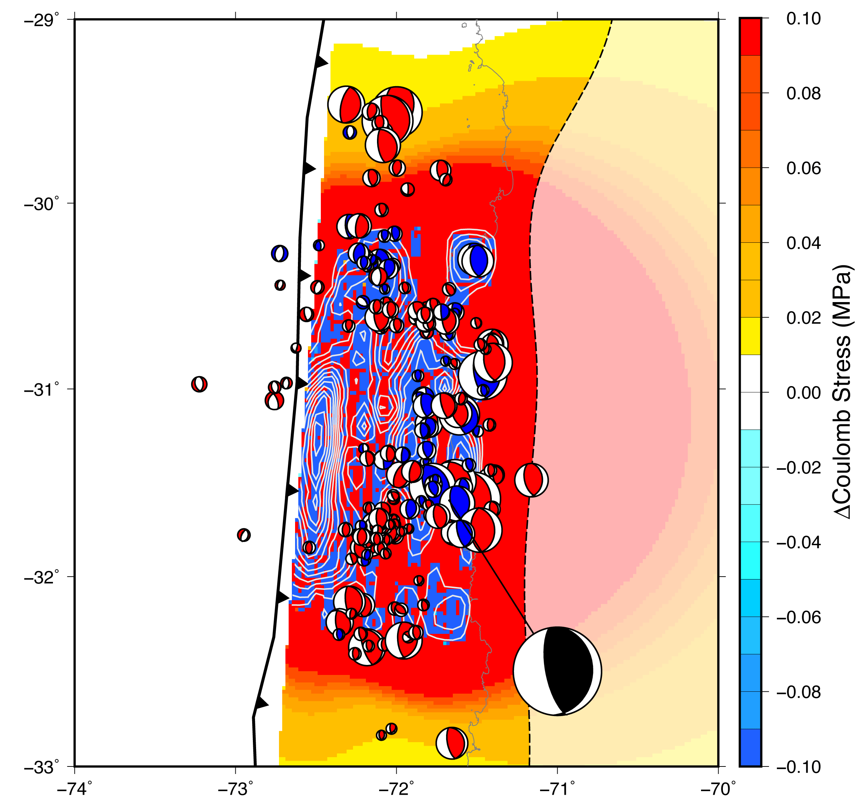
Coulomb
Stress Change
Complicated stress distribution
Generally reduced within slip zone, increased outside
Outside rupture area, aftershocks all have positive stress

Slide 39
Conclusions
Complex rupture with distinct pulses of moment release
Large shallow slip in seismological FFM consistent with 10 meter local tsunami
Many aftershocks in zone of deeper slip, few in shallow high-slip zone
Geodesy and seismology yield different locations and magnitudes of slip
Coulomb stress useful for anticipating aftershocks outside rupture area

