Slide 1
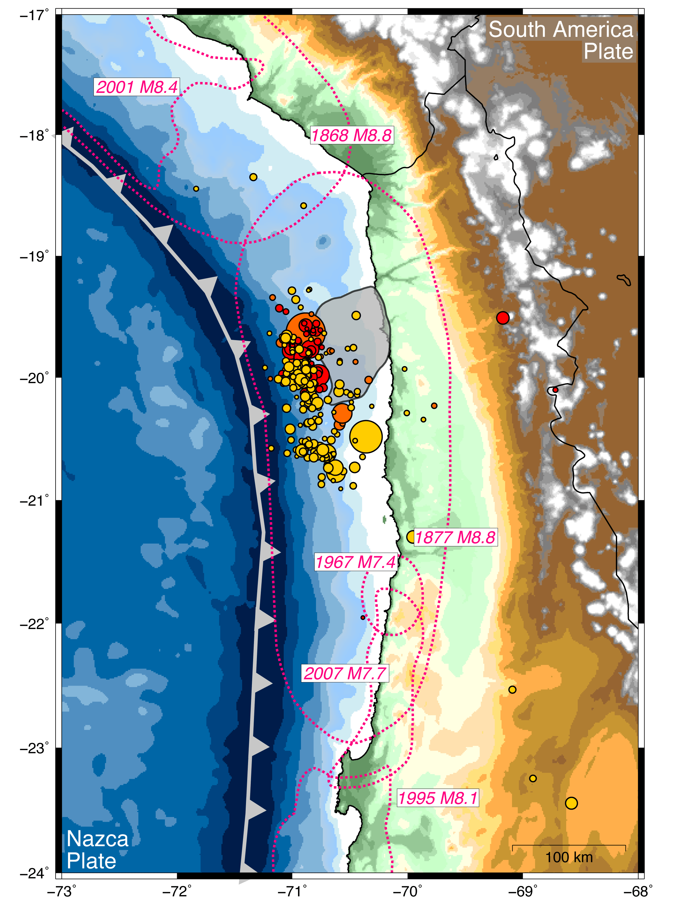


Foreshock (and Slow Slip?) Triggering of the 1 April 2014, Iquique Earthquake
Peru
Bolivia
Matthew Herman
Kevin Furlong
Gavin Hayes
Harley Benz
Chile
Notes:
Good morning everyone. Thank you for making it to the first presentation. Today I would like to talk to you about some of the work we have done utilizing multiple geophysical datasets to determine whether seismicity in March 2014 triggered the April 1st 2014 magnitude 8.2 Iquique earthquake.

Slide 2
Why Subduction Zone Observatories?
Integrating geophysical techniques yields unique insights into earthquake processes
Notes:
Since this is a session on subduction zone observatories, I want to briefly highlight that the insights we gained in this study required the combination of multiple geophysical approaches. In particular, the geophysical observations collected in Chile near the earthquakes were essential for constraining the earthquake and deformation processes.

Slide 3
Why Subduction Zone Observatories?
Integrating geophysical techniques yields unique insights into earthquake processes
This study:
  Seismology: earthquake locations, source parameters
Hayes et al. (2014), Nature
Notes:
These observations allowed us to precisely locate and constrain the earthquake sources,...

Slide 4
Why Subduction Zone Observatories?
Integrating geophysical techniques yields unique insights into earthquake processes
This study:
  Seismology: earthquake locations, source parameters
  Geodesy: surface displacements
Ruiz et al. (2014), Science; Schurr et al. (2014), Nature
Notes:
They provided a record of upper plate deformation leading up to the main shock,...

Slide 5
Why Subduction Zone Observatories?
Integrating geophysical techniques yields unique insights into earthquake processes
This study:
  Seismology: earthquake locations, source parameters
  Geodesy: surface displacements
  Deformation modeling: Coulomb stress change and surface displacements
Herman et al. (in review)
Notes:
And here we have used physical models to understand the links between events in space and time, and how the seismicity is related to the ground deformation.

Slide 6
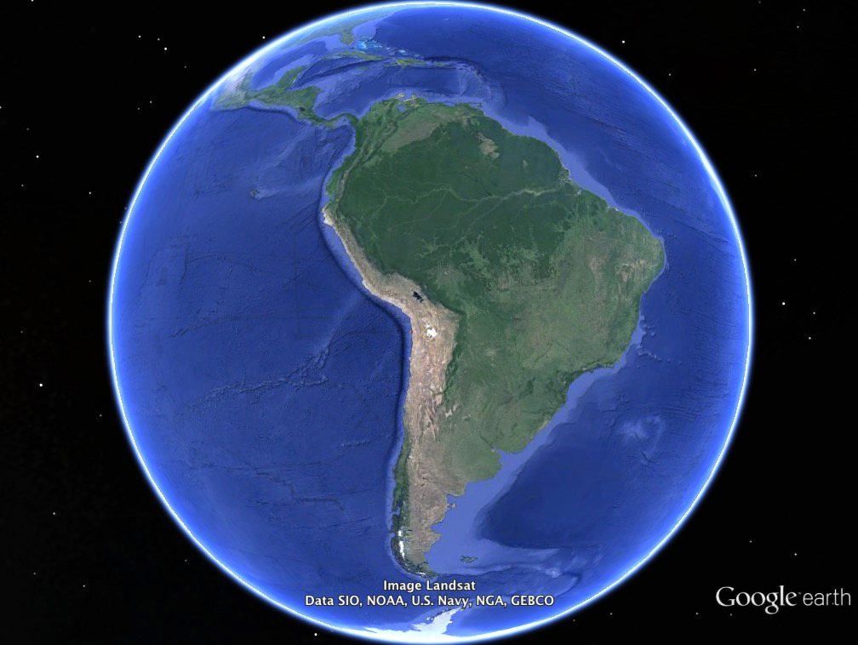
South America
Plate
Nazca
Plate
Notes:
With that said, let’s look at the the setting of this event. For those of you who are unfamiliar with the great Iquique earthquake, it occurred in the South America subduction zone where the oceanic Nazca plate descends eastward beneath South America. This subduction zone has a history of great earthquakes that generate strong shaking along the coast as well as large tsunamis. Zooming into the region outlined with the red box...

Slide 7
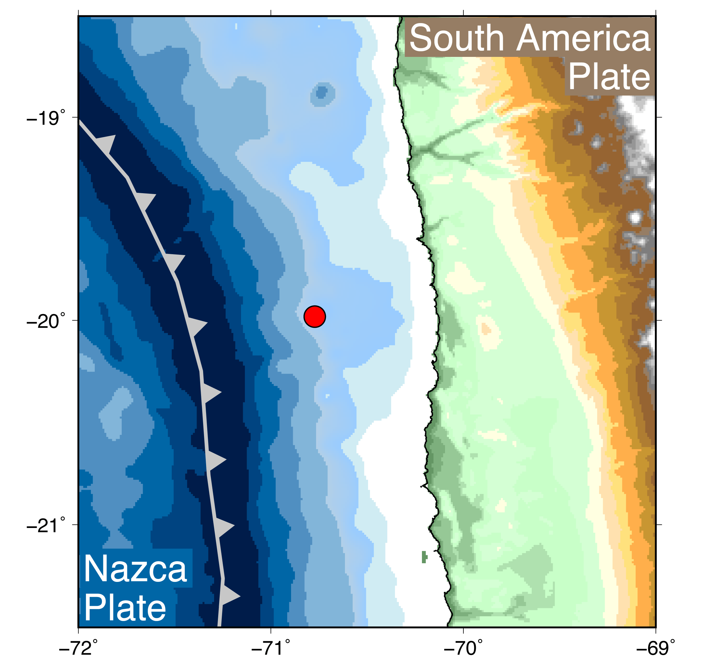
2014 Iquique Sequence
16 March Mw 6.7
Locations, source parameters
Hayes et al. (2014)
Notes:
You can see the subduction trench marked here by the plate boundary line. And on March 16, 2014, a magnitude 6.7 earthquake occurred offshore of northern Chile. This event by itself was not particularly exciting...

Slide 8
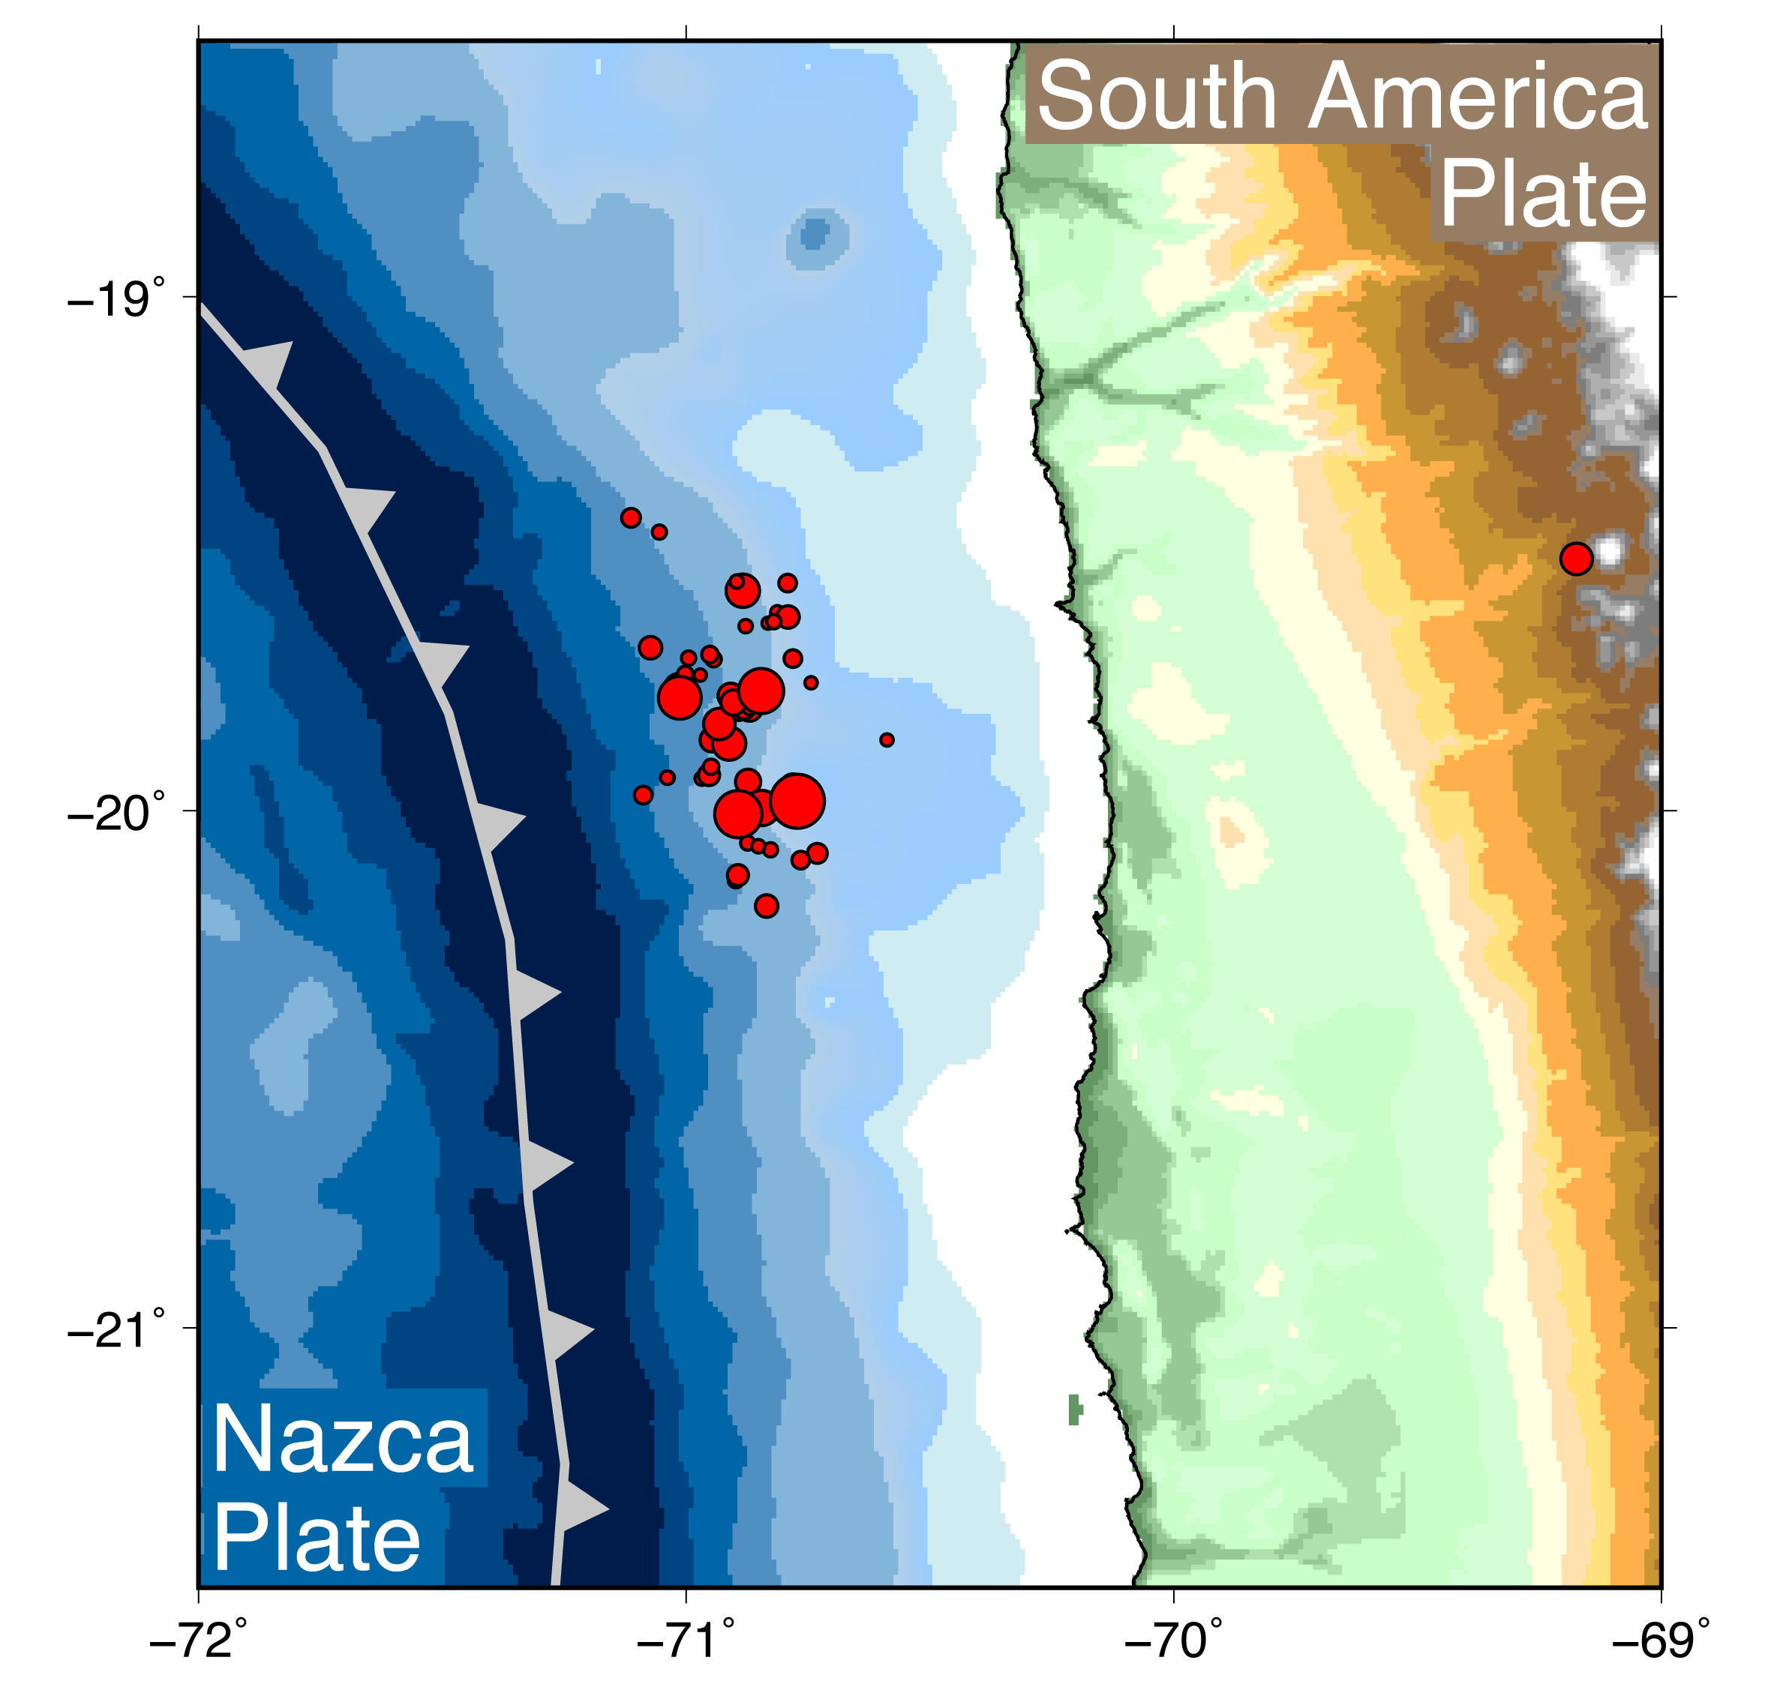
2014 Iquique Sequence
16 March Mw 6.7
17 March Mw 6.4
22 March Mw 6.2
23 March Mw 6.3
Locations, source parameters
Hayes et al. (2014)
Notes:
...but it initiated a sequence of earthquakes that included three more magnitude 6 and larger events over the following two weeks...

Slide 9
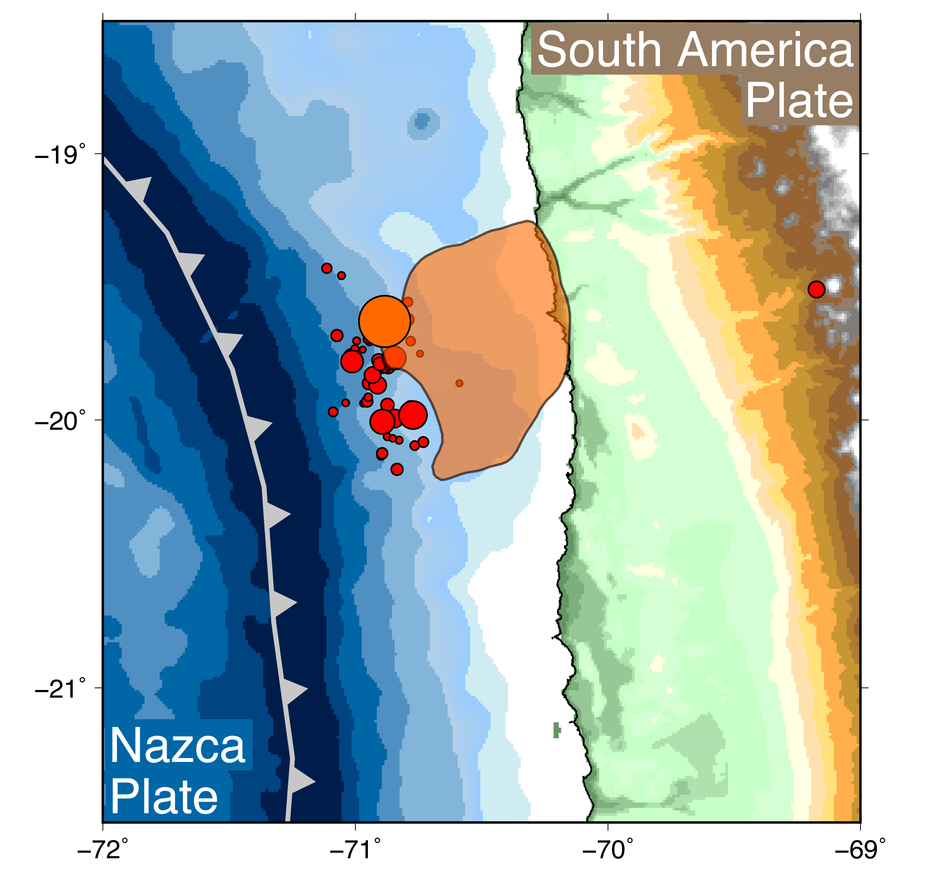
2014 Iquique Sequence
16 March Mw 6.7
17 March Mw 6.4
22 March Mw 6.2
23 March Mw 6.3
1 April Mw 8.2
Area of > 1 m slip
Locations, source parameters
Hayes et al. (2014)
Notes:
...before a magnitude 8.2 earthquake occurred on April 1st. This orange dot is the epicenter of the Iquique main shock, and the shaded area is the region with greater than 1 meter of slip, so you can see that the earthquake started at about the same depth as the foreshocks, but most of the slip happened down-dip of the foreshocks.

Slide 10
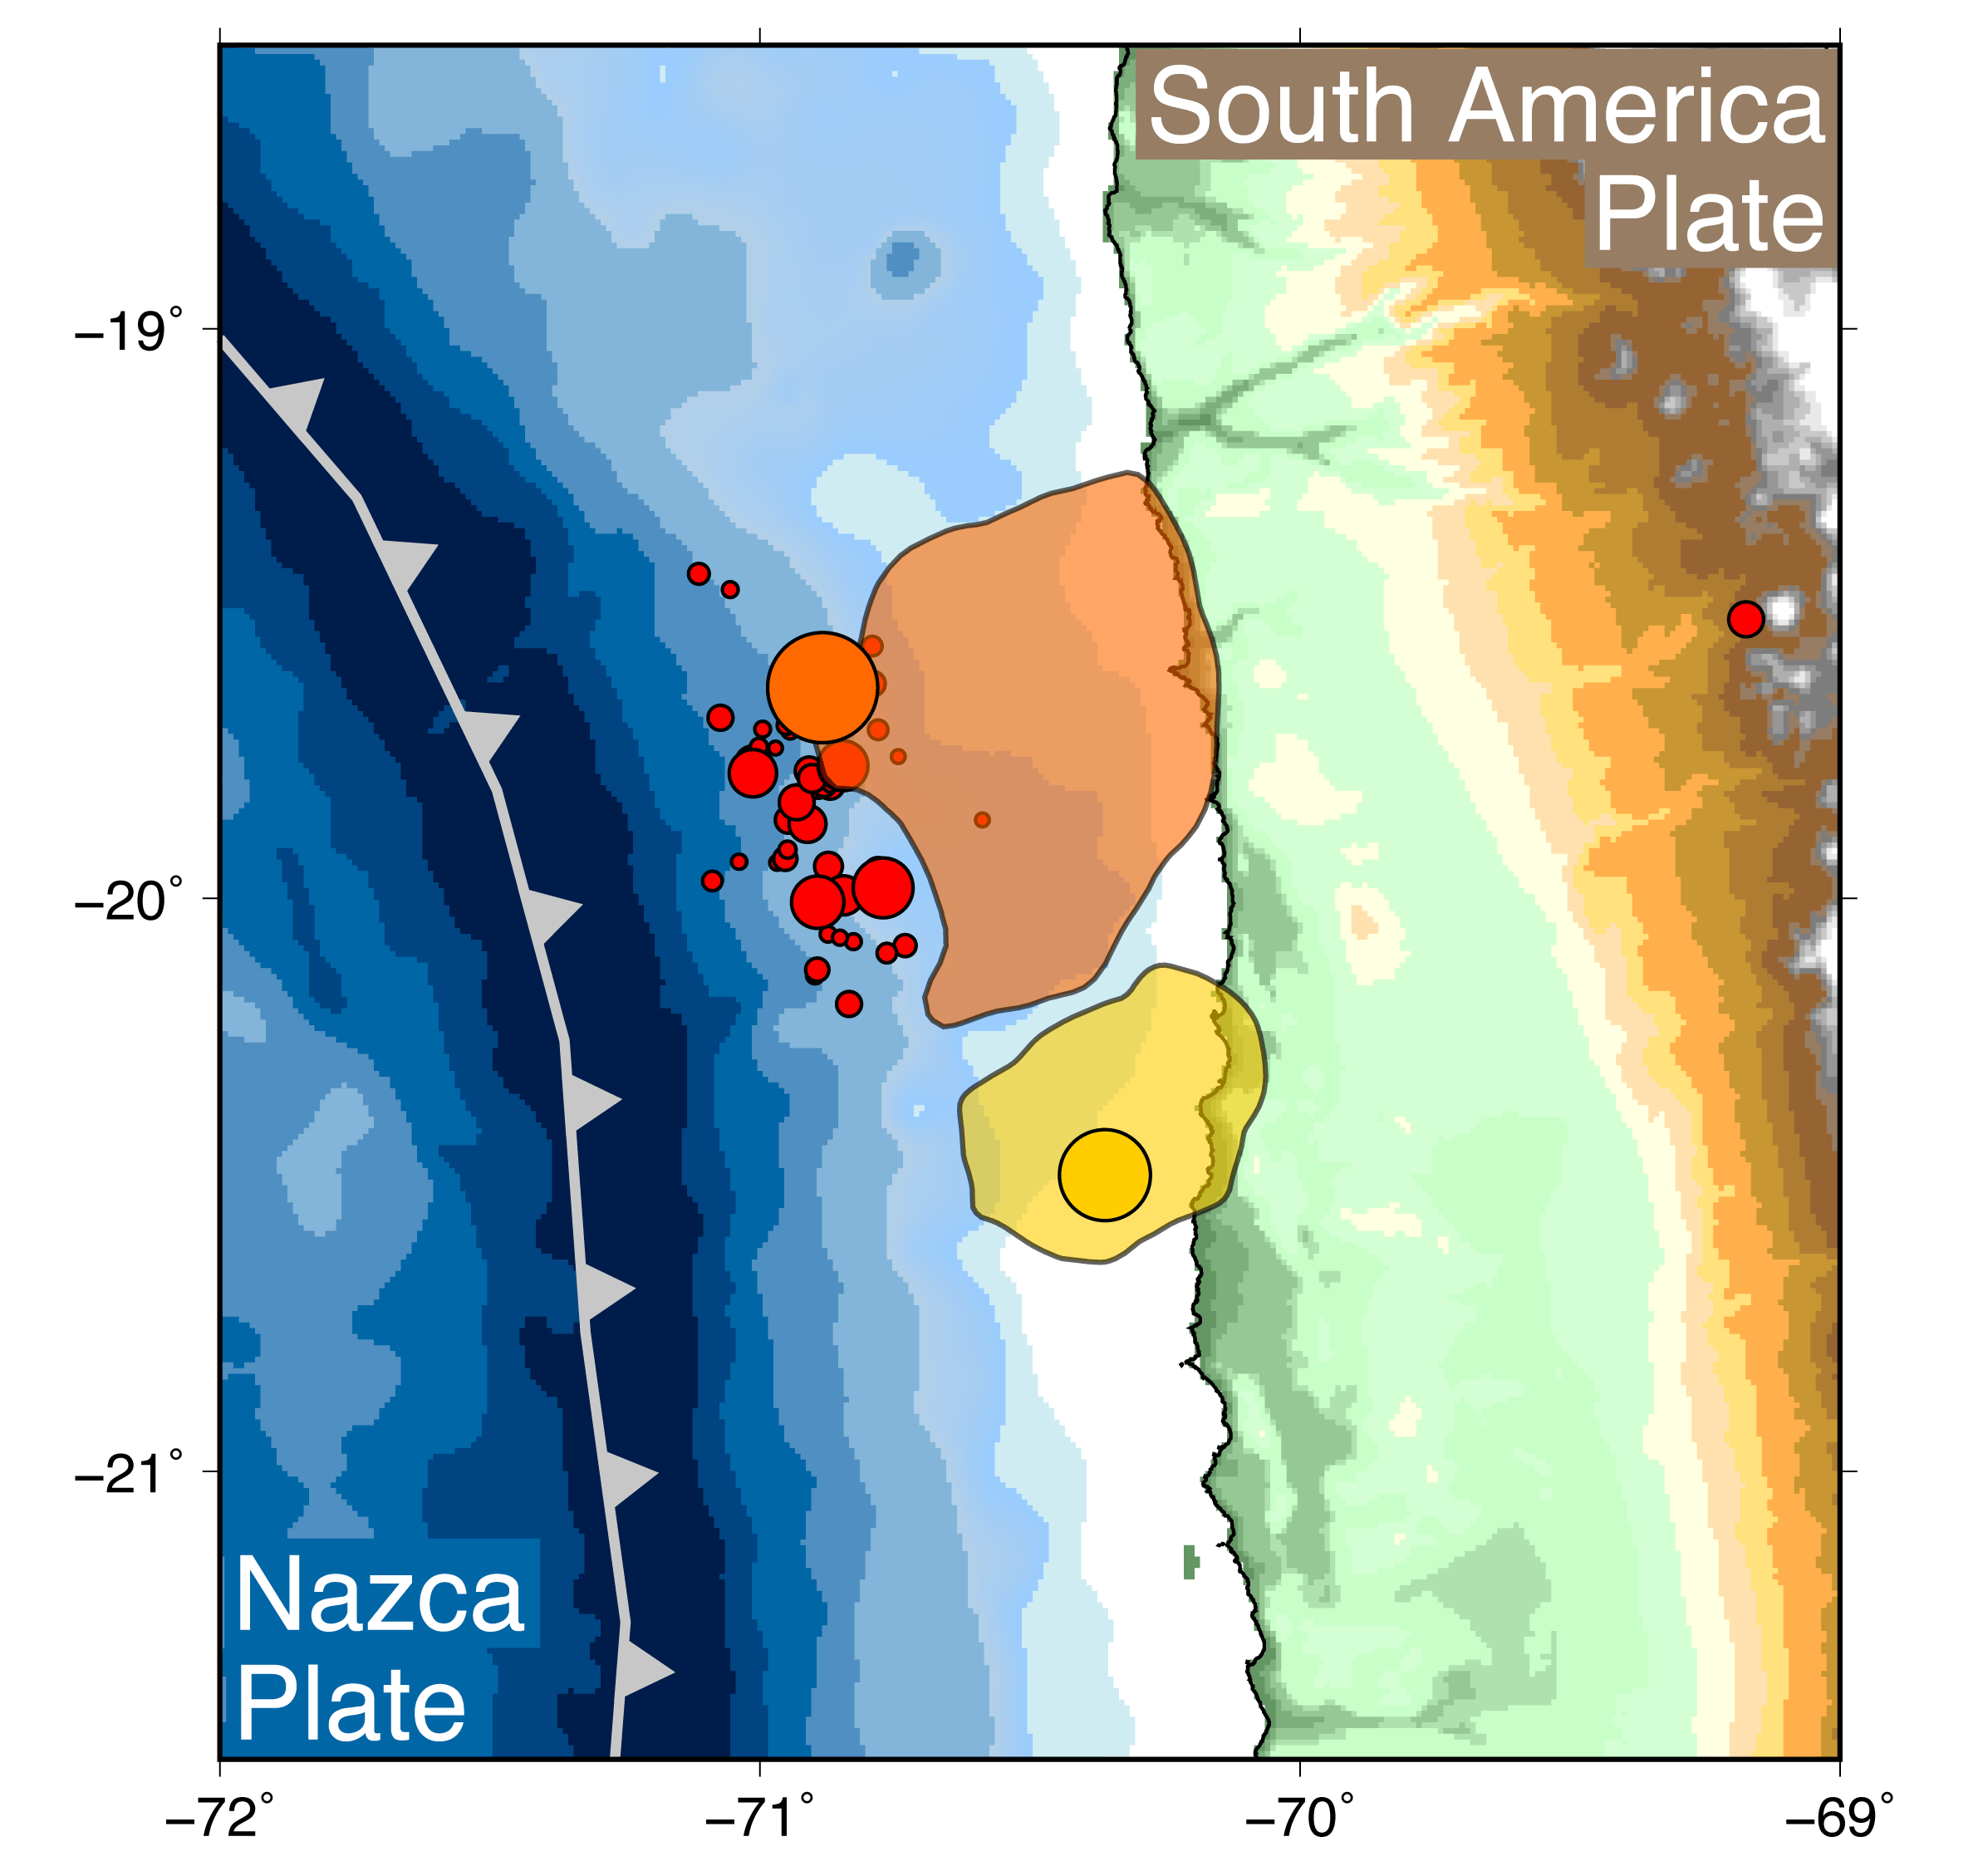
2014 Iquique Sequence
16 March Mw 6.7
17 March Mw 6.4
22 March Mw 6.2
23 March Mw 6.3
1 April Mw 8.2
3 April Mw 7.7
Area of > 1 m slip
Locations, source parameters
Hayes et al. (2014)
Notes:
Two days later, a magnitude 7.7 aftershock occurred to the south. Looking at the evolution of seismicity here, it’s very tempting to say that the March earthquakes shown in red are related to or somehow anticipated the big one, leading us to the question:

Slide 11
Did smaller earthquakes in the two weeks before April 1st trigger the Mw 8.2 Iquique earthquake?
Notes:
Did the smaller earthquakes trigger the big one?

Slide 12
Did smaller earthquakes in the two weeks before April 1st trigger the Mw 8.2 Iquique earthquake?
(And did slow slip aid this triggering?)
Notes:
And I’ll also address the possible role of slow slip in this triggering scenario a little later in the talk.

Slide 13
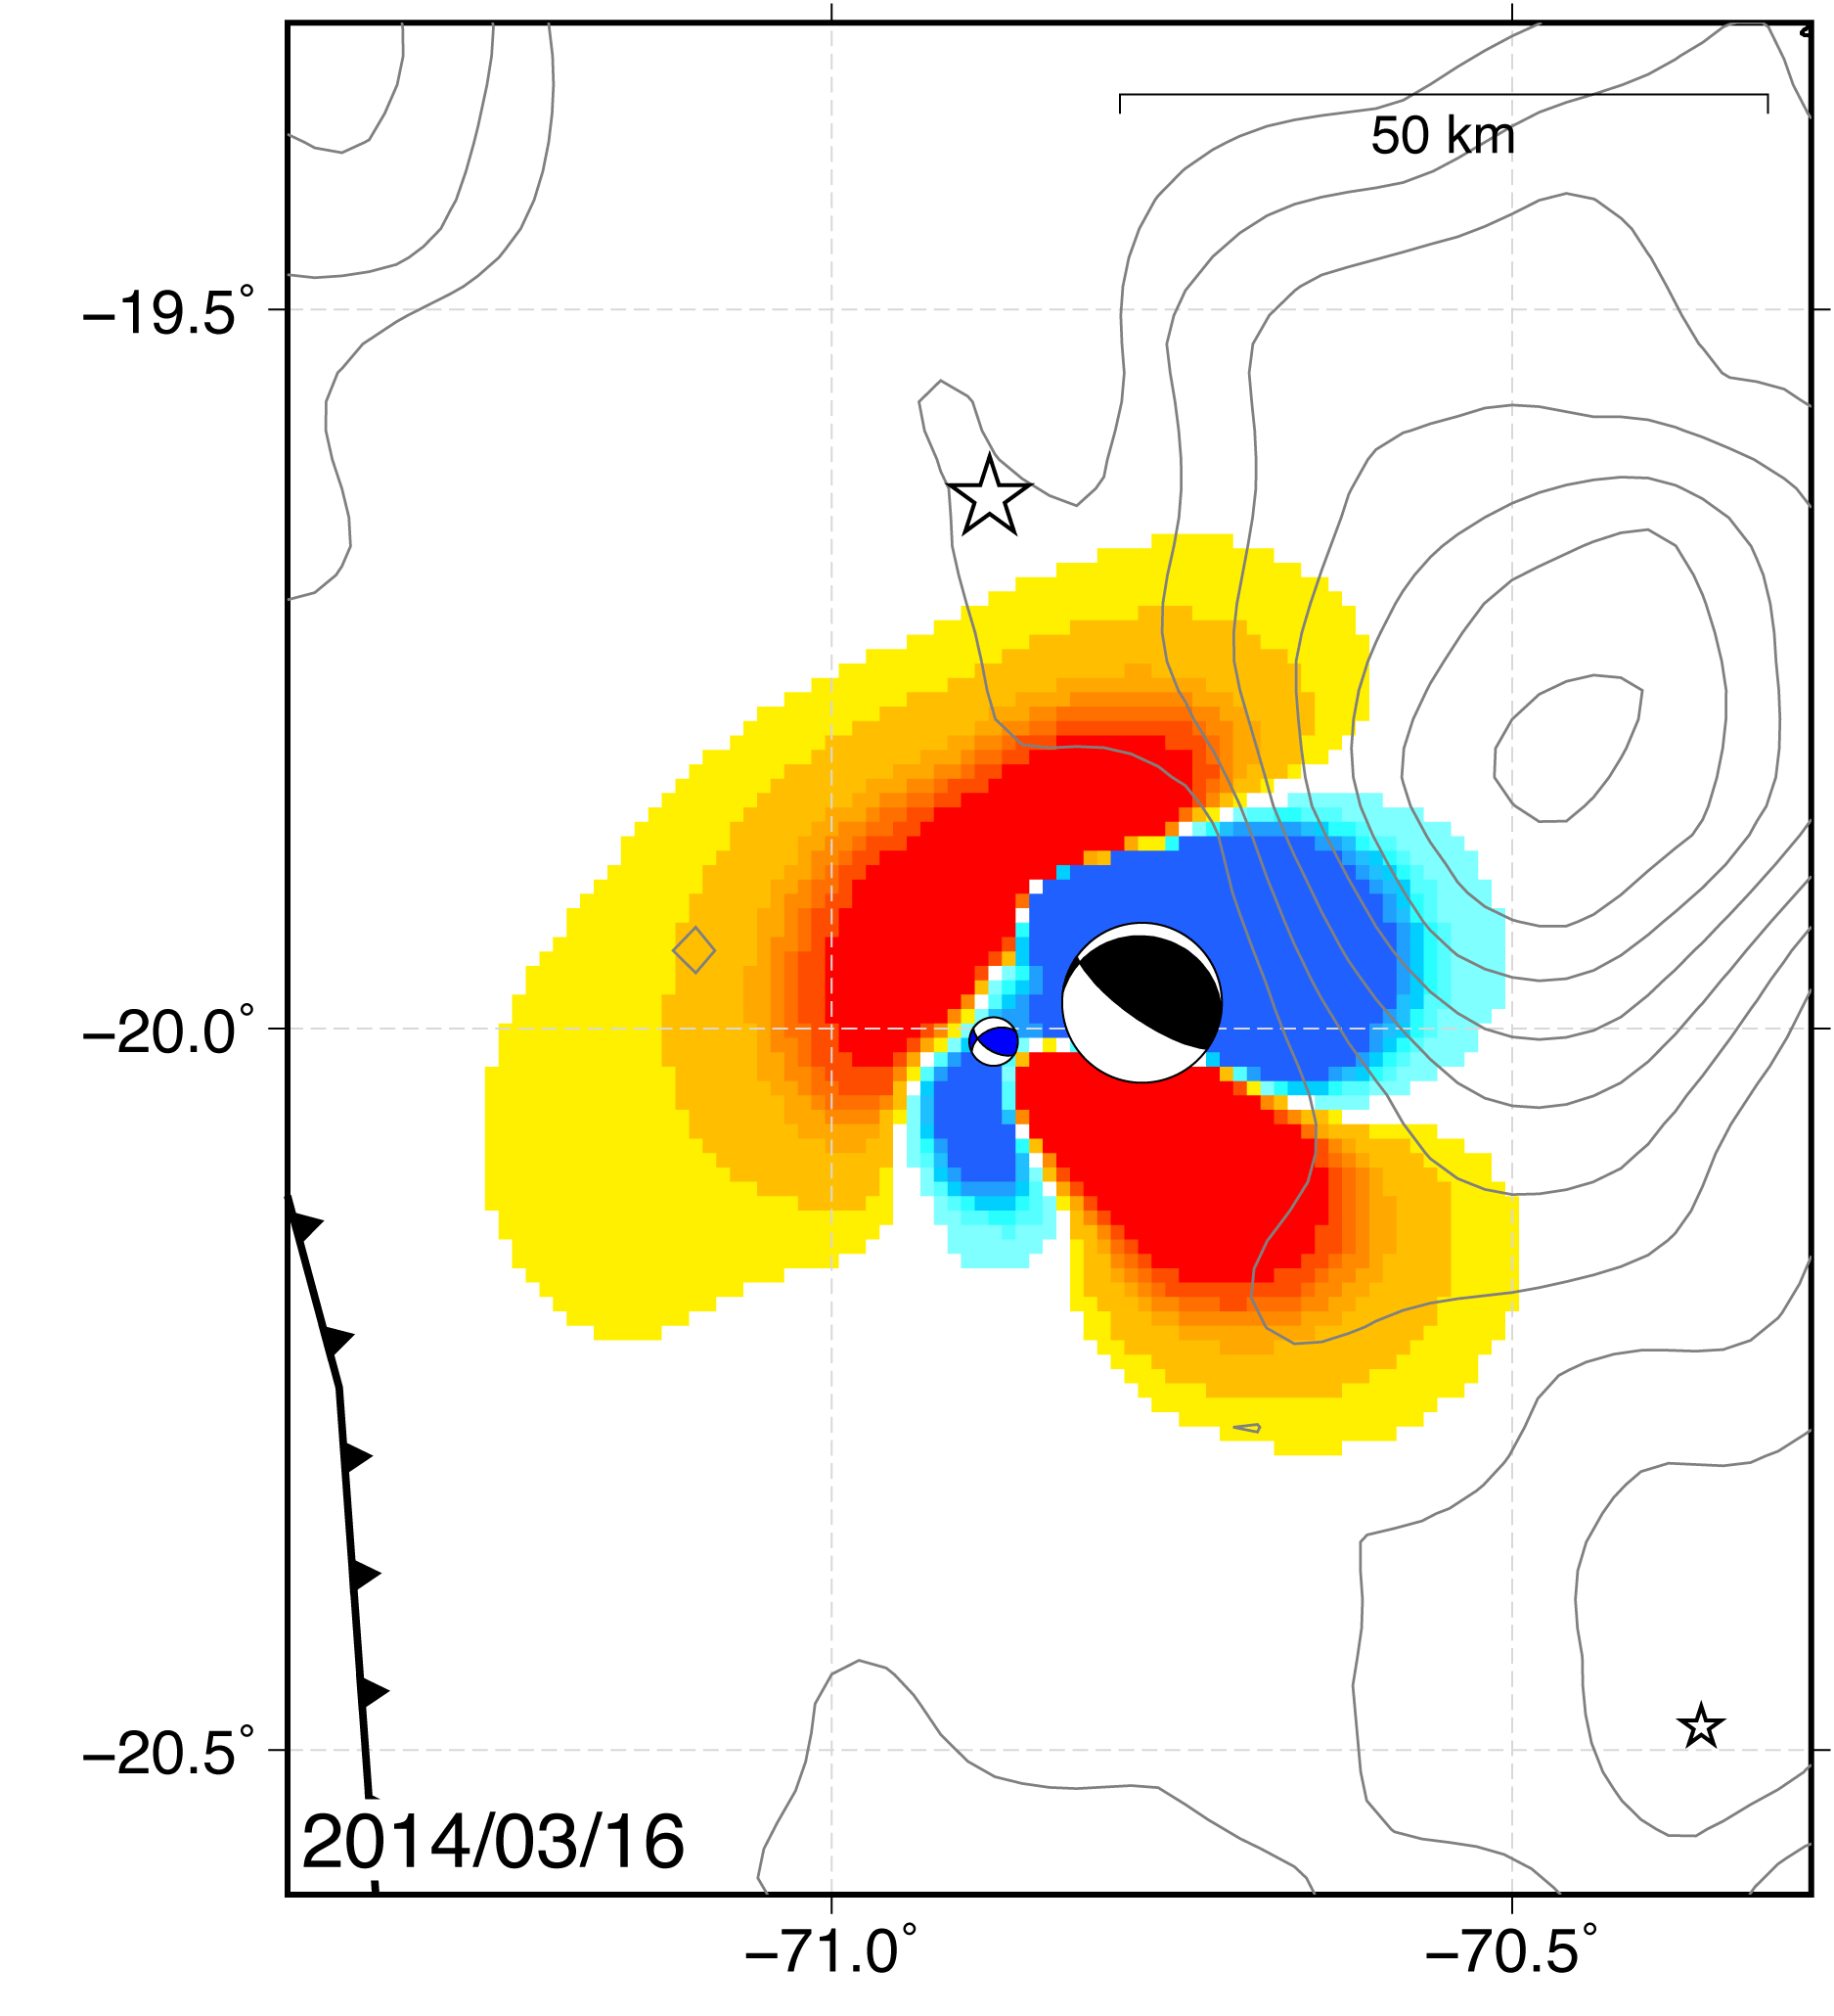
Static Stress Change
Coulomb stress change
τ shear stress
σ_{n} normal stress
μ friction
Generated by slip in elastic half-space (Okada, 1992)
Resolved onto fault geometry
Notes:
The basic idea of triggering is that an event can make an future earthquake more likely to occur. During this talk, when I say the word “trigger” I don’t necessarily imply a direct link to an earthquake in any predictive sense, but rather that an event enhances the possibility of a subsequent earthquake. We use the concept of Coulomb stress change as the physical mechanism linking these earthquakes. The idea here is simple: slip on a fault changes the stress field in the surrounding medium. If a nearby fault has an increase in shear stress or decrease in frictional resistance, it is brought closer to failure. Coulomb stress combines these into a single quantity. So if it is positive, the target structure is more likely to fail in an earthquake and if it is negative, the structure is less likely to fail.

Slide 14
Static Stress Change
Coulomb stress change
τ shear stress
σ_{n} normal stress
μ friction
Generated by slip in elastic half-space (Okada, 1992)
Resolved onto fault geometry
∆CS > 0: promotes slip
Notes:
I will show you several maps of Coulomb stress like this one here. Areas in red are where the Coulomb stress change is positive, and slip is promoted.

Slide 15
Static Stress Change
Coulomb stress change
τ shear stress
σ_{n} normal stress
μ friction
Generated by slip in elastic half-space (Okada, 1992)
Resolved onto fault geometry
∆CS > 0: promotes slip
∆CS < 0: inhibits slip
Notes:
And regions in blue are where the target structure is inhibited from failing. The colors are chosen so that anything in the yellow to red range has a stress change greater than a tenth of a bar, which seems to be the threshold for heightened seismicity in other earthquake sequences. So let's look at the stress change associated with the Iquique foreshocks.

Slide 16
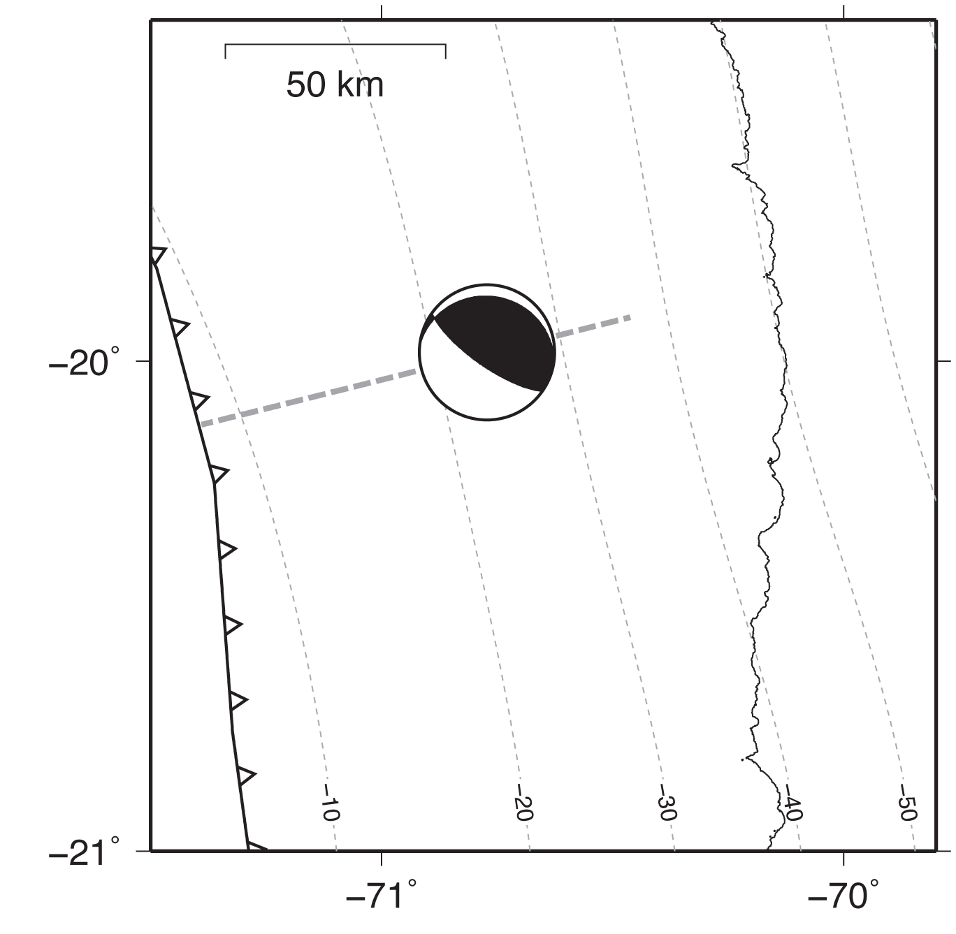
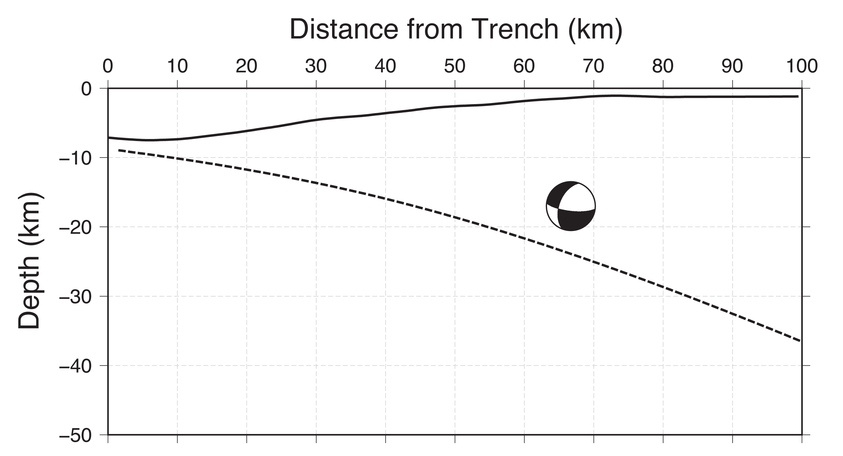
First Event: 16 March Mw 6.7
  Mechanism rotated 70º from plate boundary
  Located in upper plate
Location, source parameters
Hayes et al. (2014)
Slab 1.0; Hayes et al. (2012)
Notes:
As I mentioned before, the sequence began on March 16 with a magnitude 6.7 earthquake. This event is a little unusual in the context of the South America subduction zone. In the map view on the left, you can see that its focal mechanism is rotated about 70 degrees counter-clockwise from the plate boundary orientation. The right panel is a cross-section through the subduction zone, showing this event is 5-10 kilometers shallower than the interface. These suggest the earthquake occurred within the upper plate, not along the plate boundary. However, upper plate events still change the stress on the plate boundary.

Slide 17
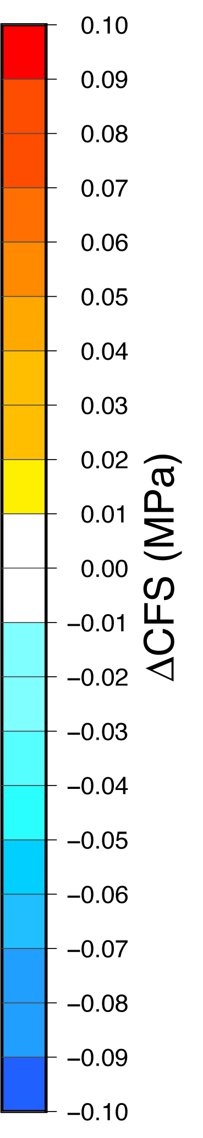
Foreshocks: 16 March Mw 6.7
Asymmetric stress pattern
Main shock mostly unaffected
Herman et al. (in review)
Notes:
On this map, I have computed the stress change around the event and resolved the Coulomb stress on the plate boundary, using Slab 1.0 geometry and assuming pure thrust motion. For context, I have added 1 meter slip contours from the main shock and largest aftershock, and showed the epicenter of the main shock as a star to the north. Remember, red means that a thrust faulting earthquake on the interface is more likely to occur, whereas blue means the likelihood of a thrust faulting earthquake is decreased. As we watch the foreshock sequence unfold, note that we will be adding together the Coulomb stress from all the events that have occurred up to that point. I want you to pay close attention to the color at the main shock hypocenter. You can see that on March 16, there is essentially zero stress change at the hypocenter, but there are lobes of increased Coulomb stress on the plate boundary.

Slide 18
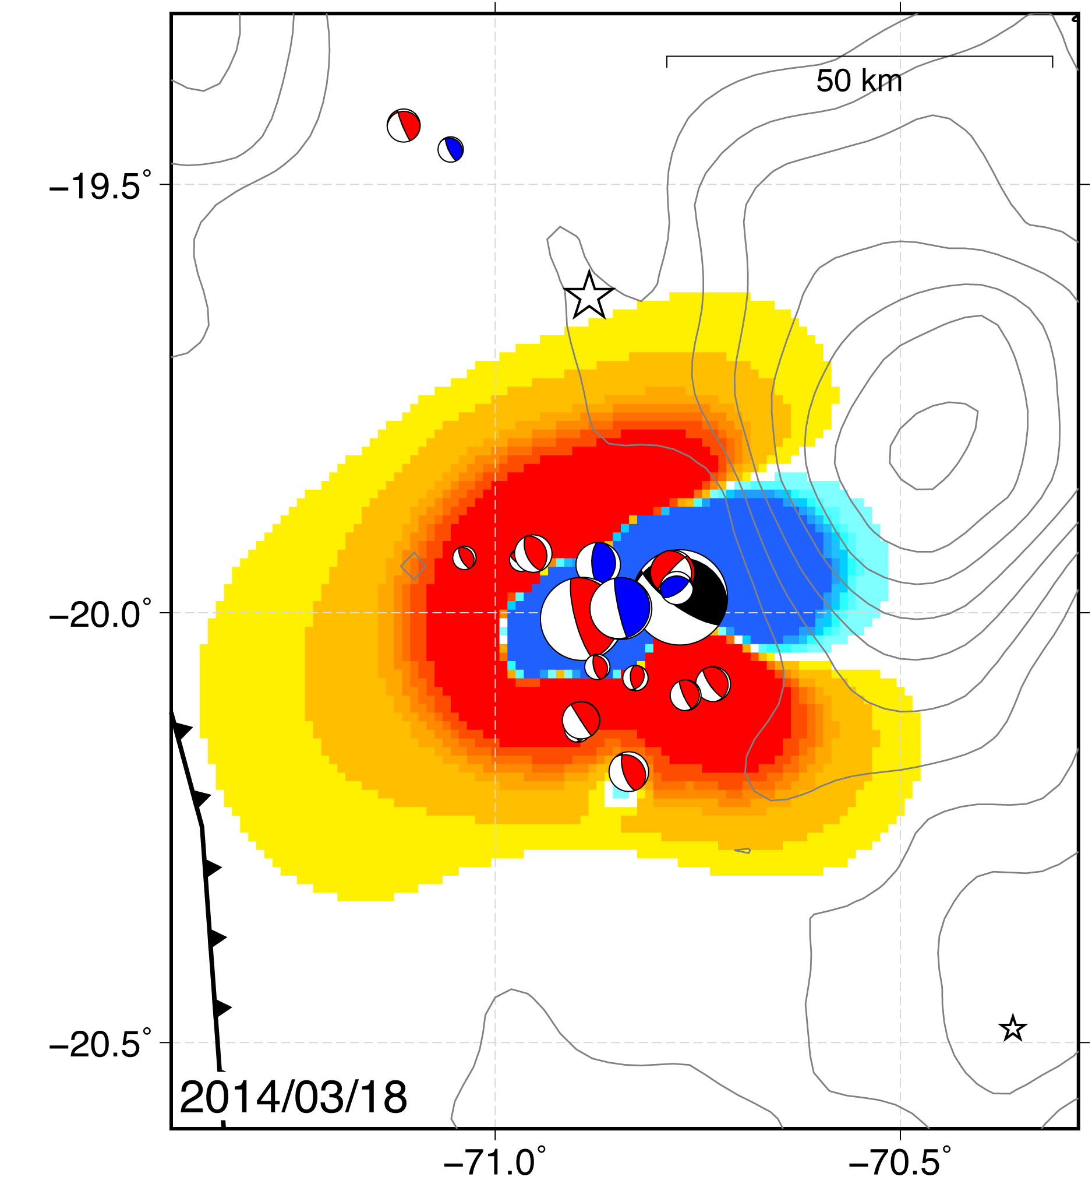
Foreshocks: 17 March Mw 6.4
Plate boundary earthquake
Up-dip of Mw 6.7
Enhances loading
Herman et al. (in review)
Notes:
The next day, on March 17, a magnitude 6.4 earthquake occurred just up-dip of the initial event. This earthquake was located on the interface, in the red region, so we say it was probably triggered by the magnitude 6.7. Notice that the stress at the main shock hypocenter is not changed much, but the new earthquake does enhance the positive stress footprint.

Slide 19
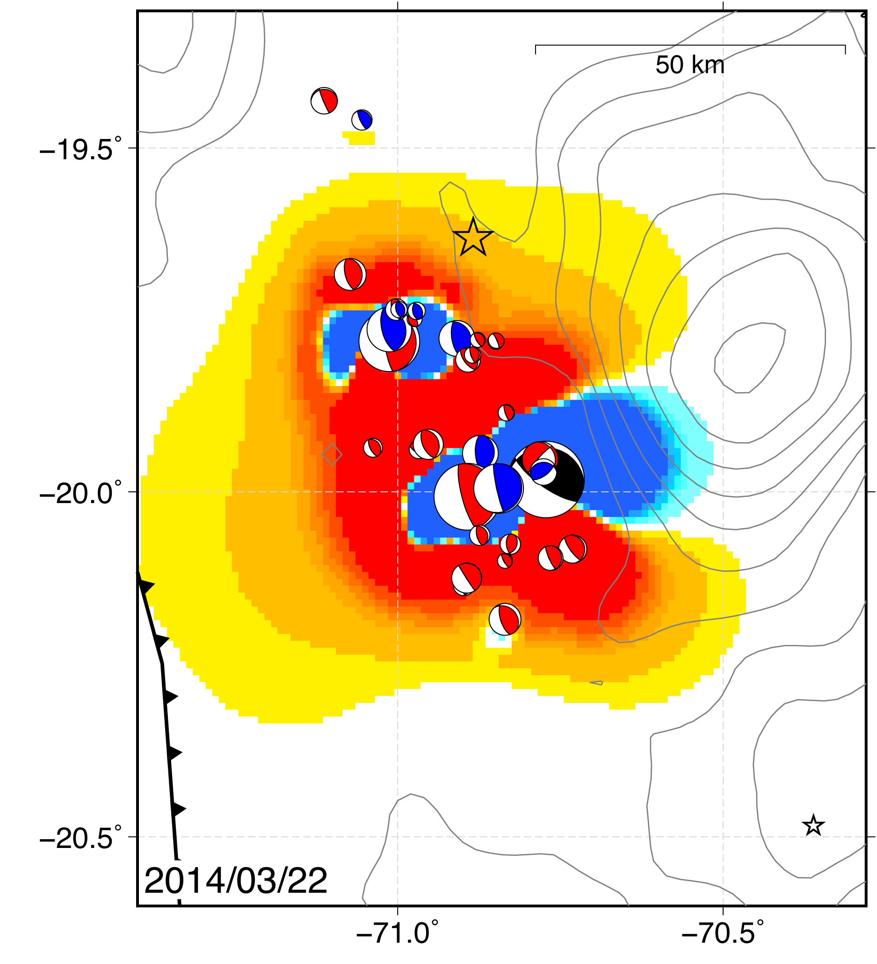
Foreshocks: 22 March Mw 6.2
Seismicity propagates northward
Pushes positive ∆CS region to hypocenter
Herman et al. (in review)
Notes:
And right in that enhanced region to the north, a magnitude 6.2 earthquake occurred on March 22, likely triggered by the previous events. You can see that this earthquake starts to load the hypocentral region.

Slide 20
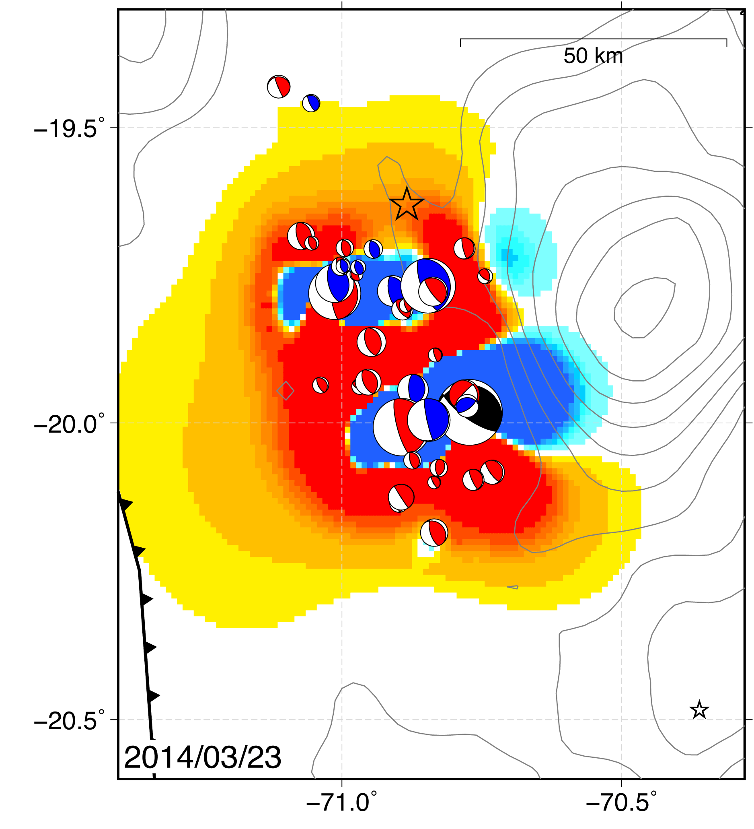
Foreshocks: 23 March Mw 6.3
Last Mw 6+ foreshock
Adds to loading at main shock hypocenter
No loading down-dip
Herman et al. (in review)
Notes:
The last foreshock larger than magnitude 6 occurred just south of the main shock epicenter, pushing the red region to the hypocenter.

Slide 21
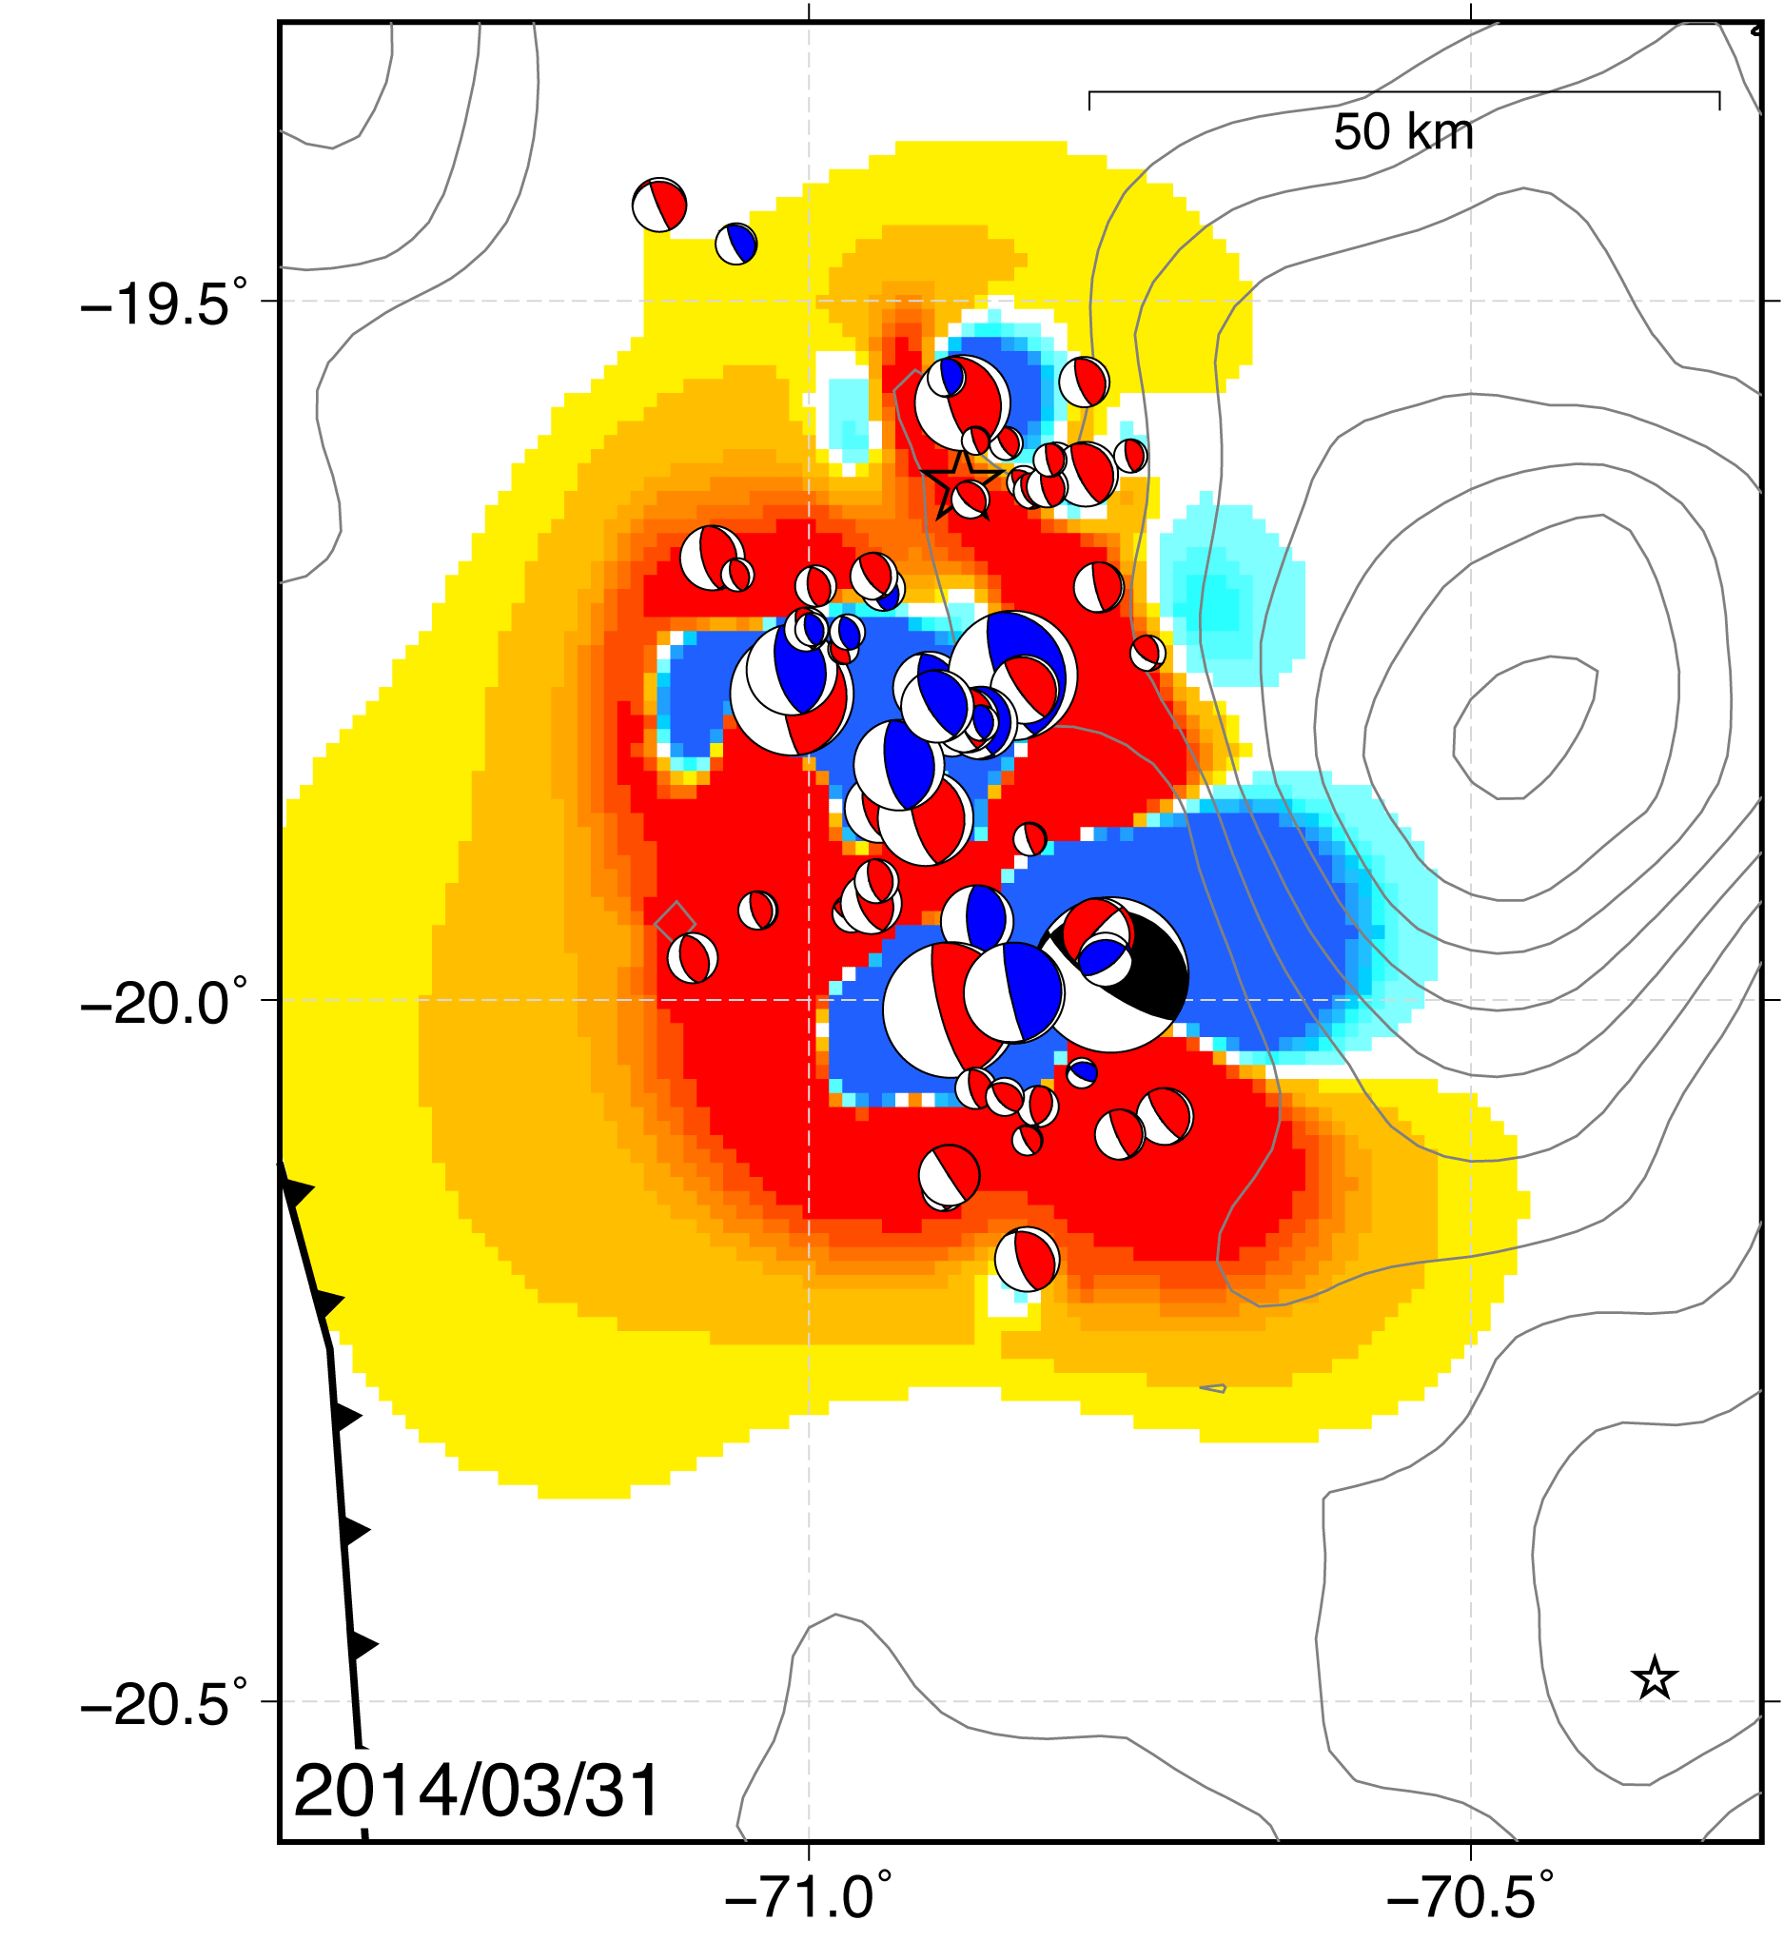
Foreshocks: 31 March
Mw < 5.5 earthquakes surrounding hypocenter
Herman et al. (in review)
Notes:
Leading up to the Iquique earthquake, you can see a few small foreshocks occurred near the hypocenter, loading it even more. This figure is a snapshot of the cumulative stress change from all the foreshocks between March 16 and April 1. They combined to substantially increase the Coulomb stress at the Iquique hypocenter, but you can see that they did not perturb the stress significantly down-dip, in the area that eventually had the largest slip.

Slide 22
Foreshock Stress Summary
Mw 6.7 earthquake initiates loading on plate boundary
Each subsequent M6+ occurs in a positively loaded area on the megathrust
Main shock hypocenter loaded by cumulative stress change of foreshocks
Down-dip area not loaded
Herman et al. (in review)
Notes:
To summarize, the magnitude 6.7 earthquake started perturbing the stress on the plate boundary. Each subsequent magnitude 6 earthquake occurred in a positively loaded area, so each one seems to have been triggered by the seismicity before it. As a consequence of the foreshock deformation, the Iquique hypocenter was loaded by the foreshocks, but the area of peak slip was not significantly affected. Interestingly, the moment-rate function for the Iquique earthquake is consistent with it starting as a small earthquake with magnitude less than 7. This means it started out looking a lot like the other sixes in the foreshock sequence, but some aspect of its rupture allowed it to penetrate down-dip and grow into a great earthquake.

Slide 23
Foreshock Stress Summary
Mw 6.7 earthquake initiates loading on plate boundary
Each subsequent M6+ occurs in a positively loaded area on the megathrust
Main shock hypocenter loaded by cumulative stress change of foreshocks
Down-dip area not loaded
Each Mw 6+ foreshock was triggered by the preceding earthquakes.
The Iquique main shock began as a similarly triggered earthquake.
Herman et al. (in review)
Notes:
So the main take-away points are that each of the biggest foreshocks was triggered by the preceding events, and that the beginning of the Iquique main shock was also triggered in apparently the same way. What we want to ask ourselves now is whether there are any observations that can help us understand how the last event was able to grow into a great earthquake.

Slide 24
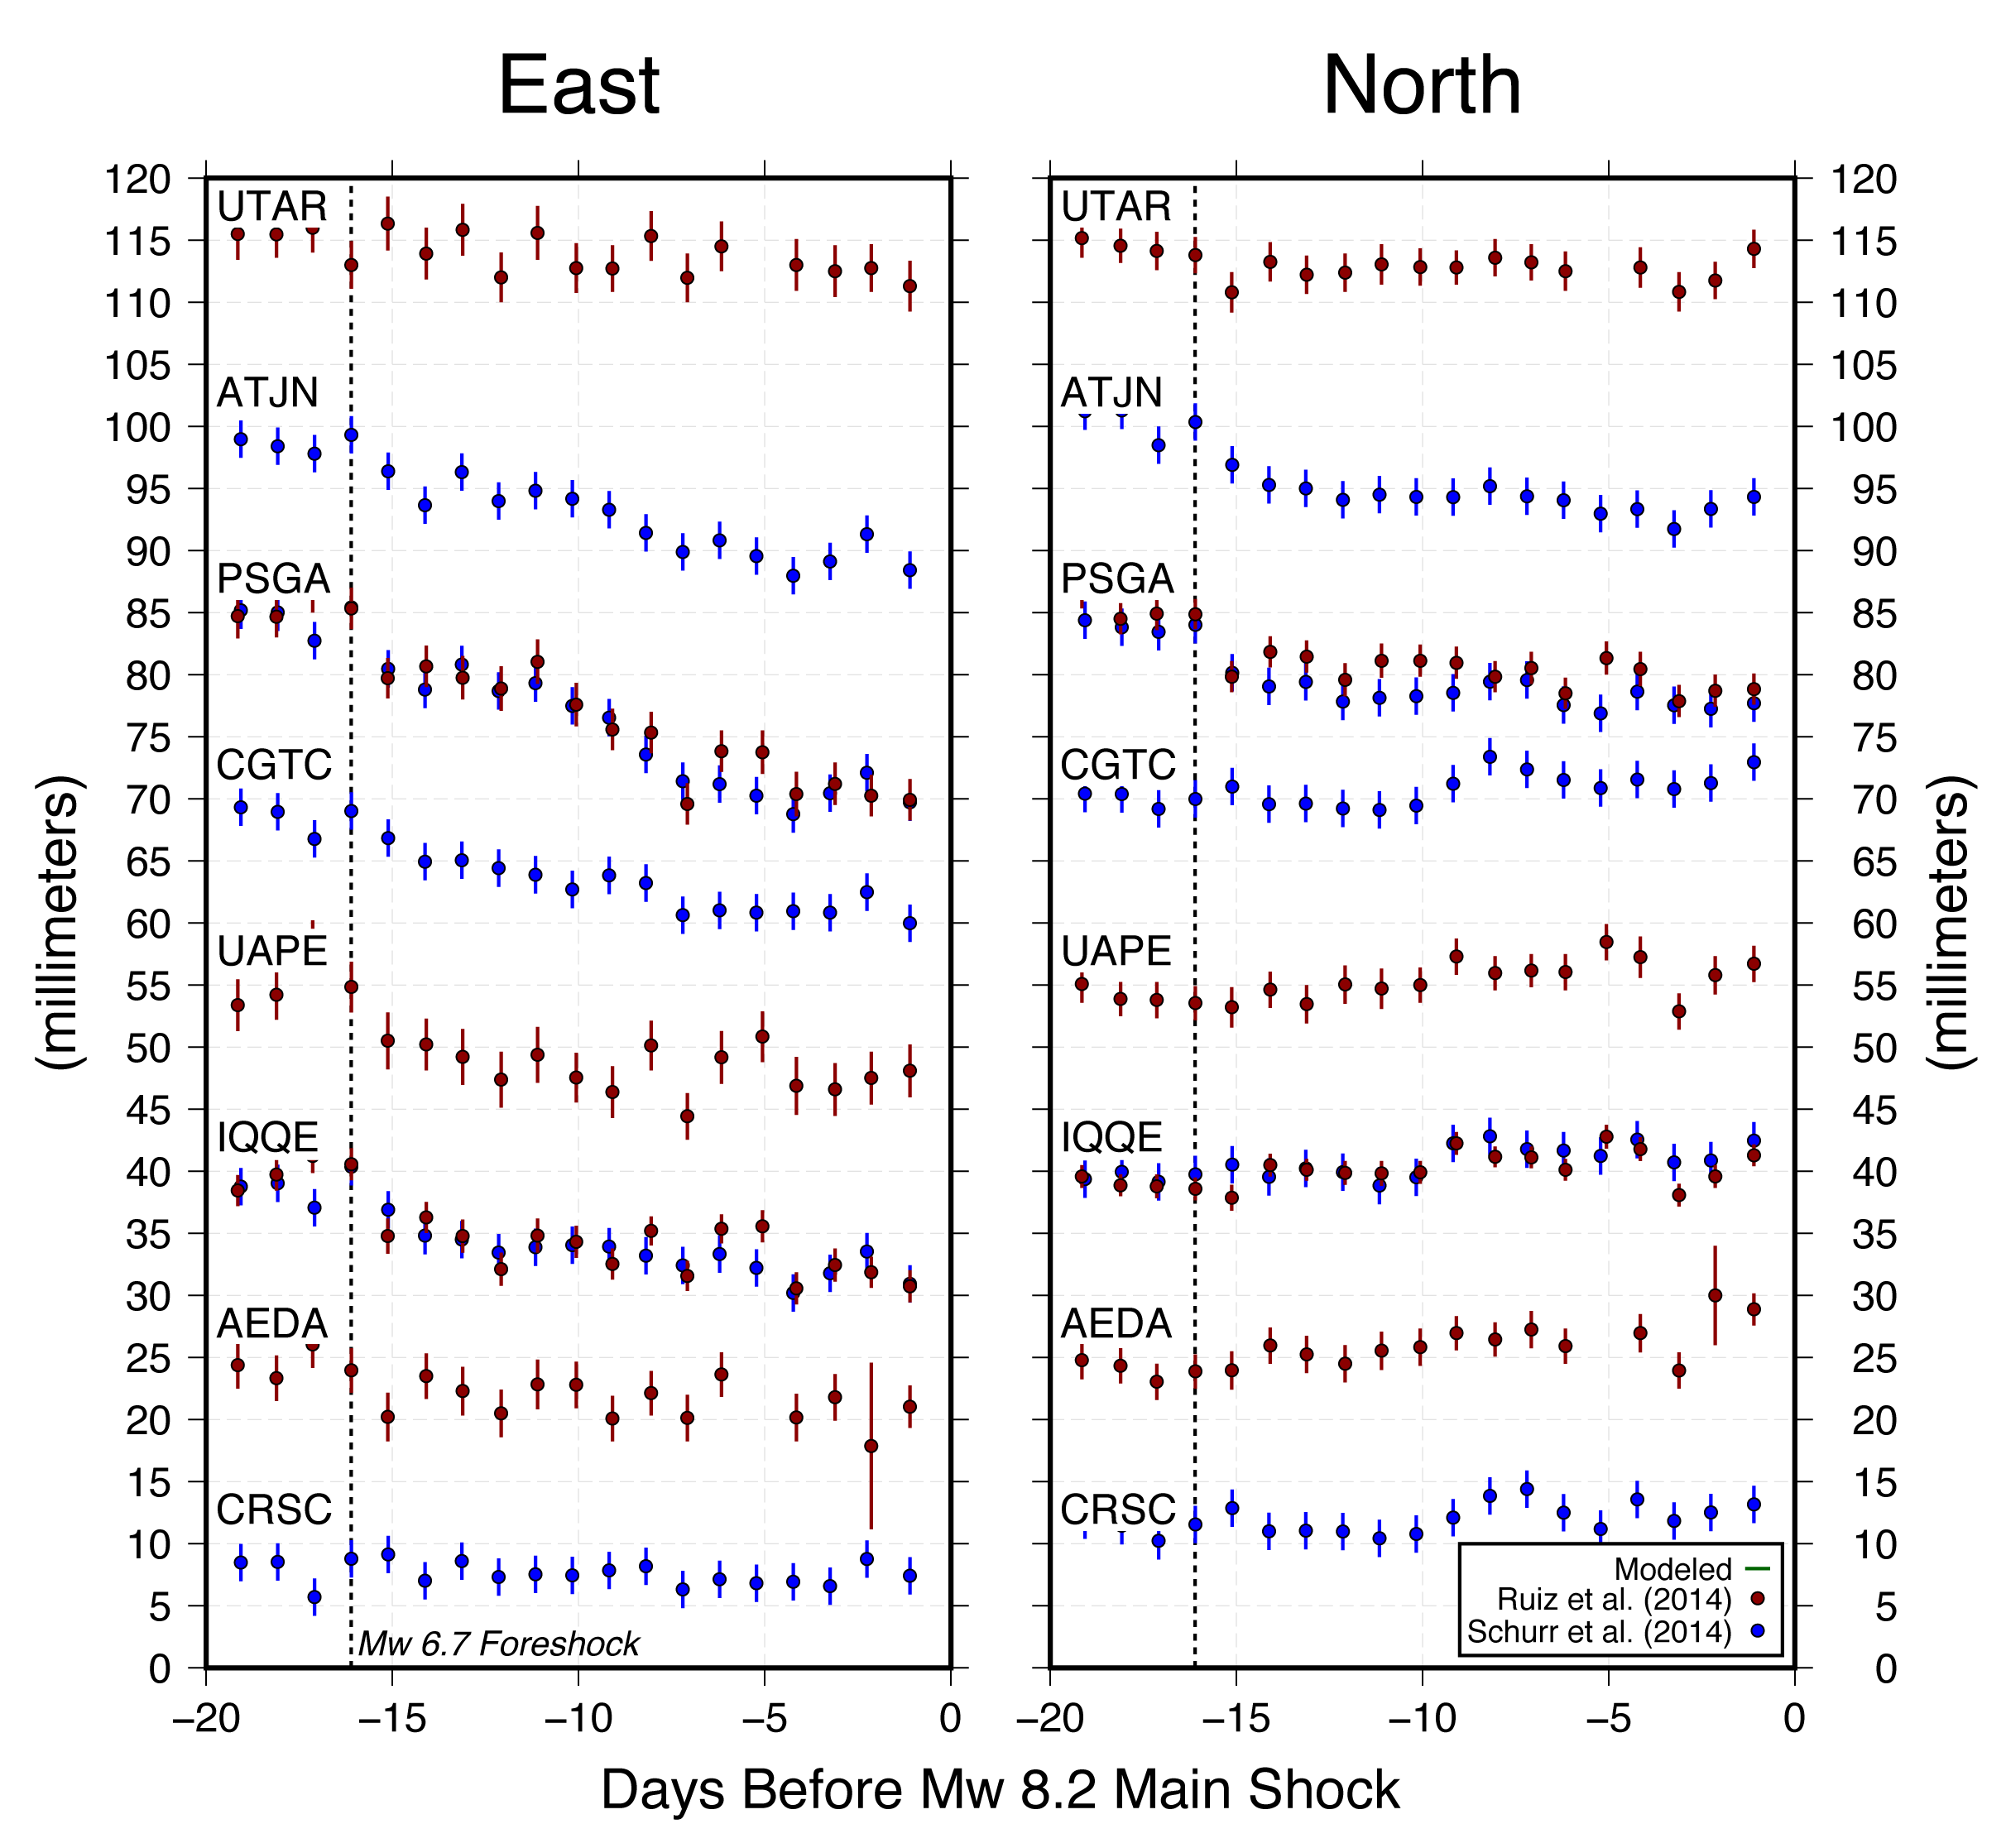
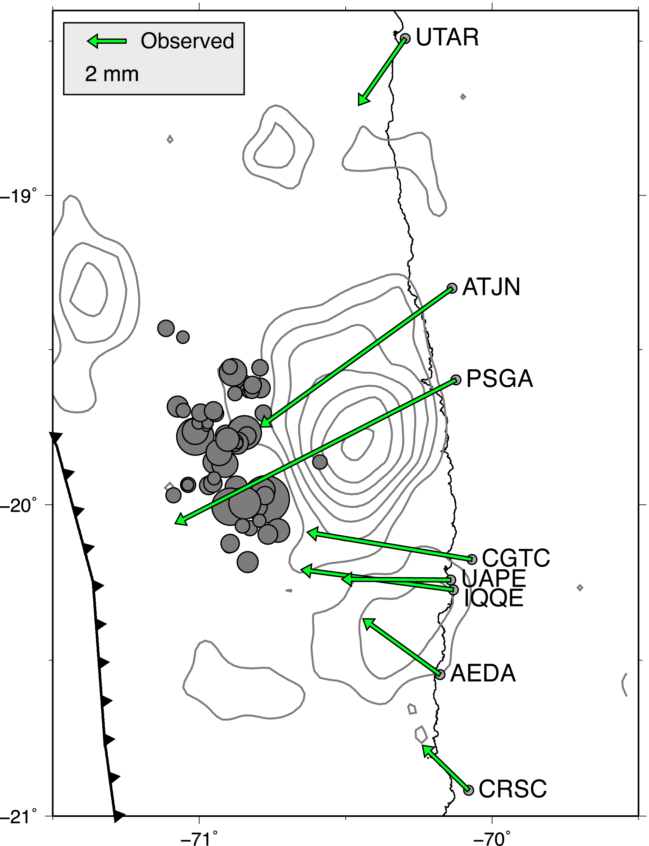
Continuous GPS
Daily GPS Time Series
GPS data: Ruiz et al. (2014); Schurr et al. (2014)
Notes:
One possible dataset that might help us here are the GPS measurements of surface displacement along the coast throughout the foreshock sequence. The reason is that, in addition to the stress modeling of the seismicity, we can generate surface displacements, and compare these to the observed values to see whether everything is accounted for. On the left are the displacement vectors at each station right before the Iquique main shock, and as expected, they all point towards these thrust faulting earthquakes. On the right are the GPS time series corresponding to the stations shown on the map. You can see the growth of the displacement throughout the foreshock sequence, especially in the east-west component.

Slide 25
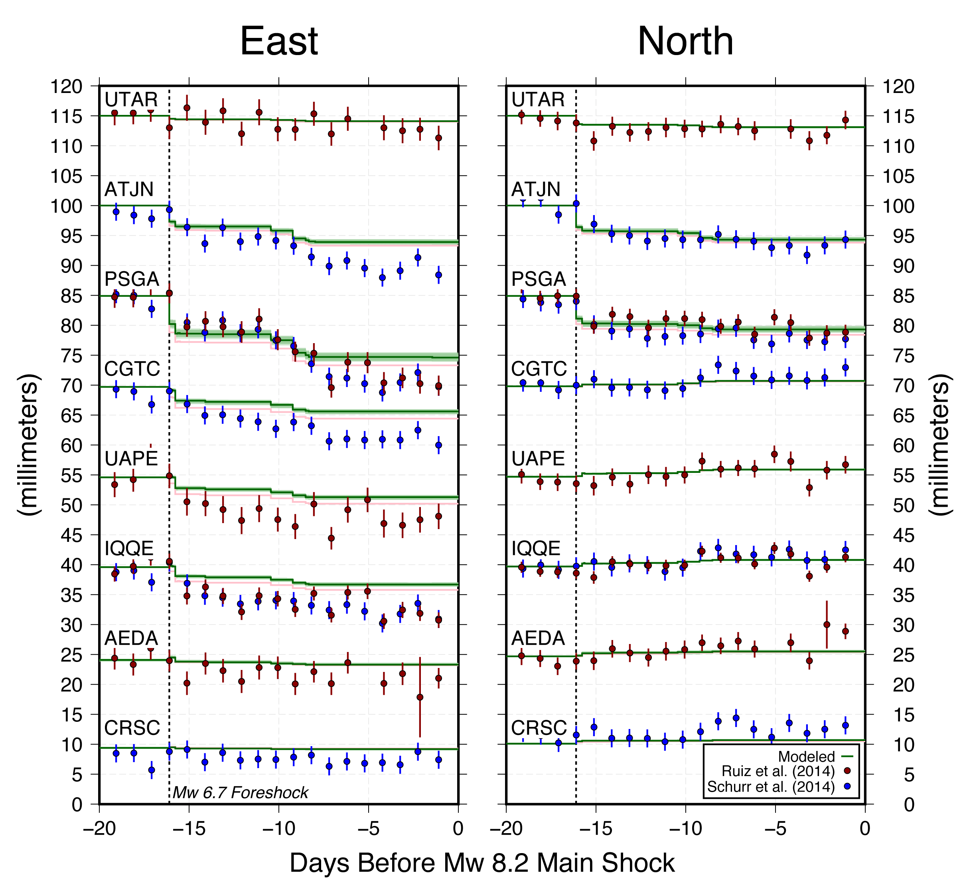
Synthetic displacements from seismicity at GPS stations
Notes:
Here I have added the surface displacements predicted by the seismicity to the time series. As each event occurs, it generates a step offset at each station, and by combining these steps, we can produce a synthetic GPS time series at each station, shown here in green.

Slide 26
Notes:
What I really want you to notice is that the synthetic displacements systematically underpredict the observed westward displacement. You might point out here that earthquake location or subduction zone modeling uncertainty might account for the difference. In this figure, the thickness of the green line reflects the effect of earthquake location uncertainty on the displacements. As you can tell, it is essentially negligible. We could reduce the half-space shear modulus in our model to increase the slip on each fault and this would increase the predicted surface displacement. But we would need a shear modulus of 20 GPa to fit the observations, which is on the low side of realistic. This suggests that there is some extra process generating deformation at these stations.

Slide 27
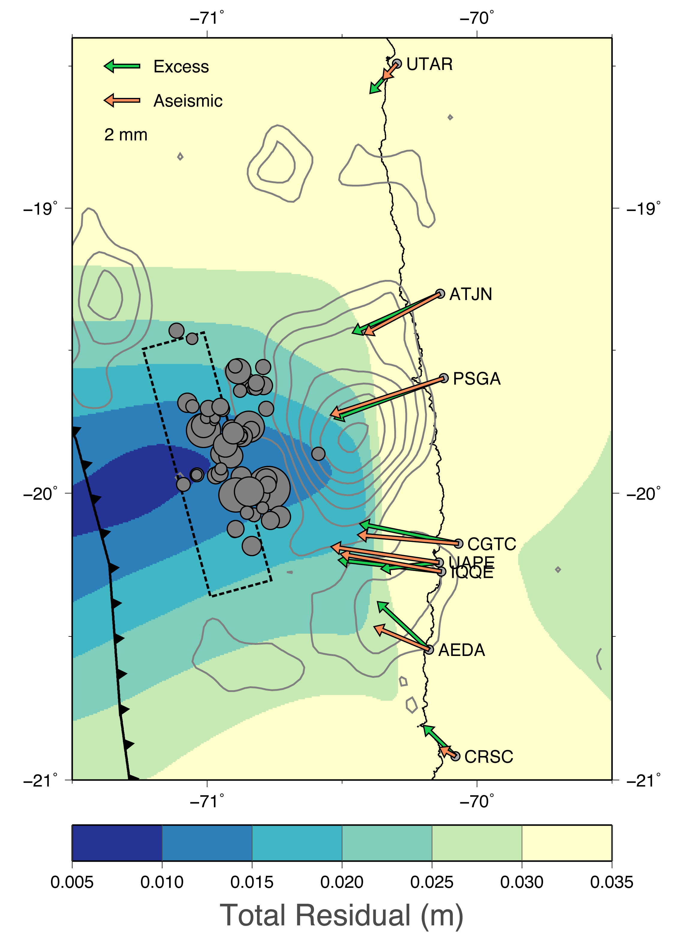
Slow Slip Search
Grid search for location and size of rectangular patch that fits excess displacements
Shear Modulus | 35 GPa
Poisson’s Ratio | 0.25
Maximum Excess Displacement | ~ 5 mm
~20 cm slip (Mw ~6.7)
Note: a smaller shear modulus yields larger synthetic displacements, hence less modeled slow slip.
Notes:
If we assume the extra displacement is a consequence of aseismic slip on the plate boundary, then we can look for the location and amount of slip required to produce the excess. On this map, I show a result of a grid search for the location and dimensions of a rectangular slip patch that fits the extra displacement. The slip patch is constrained to lie on the plate boundary and have dip-slip only. This search suggests that the inferred aseismic slip is most likely coincident with or up-dip of the foreshock seismicity. So now let's see what that does to the stress.

Slide 28
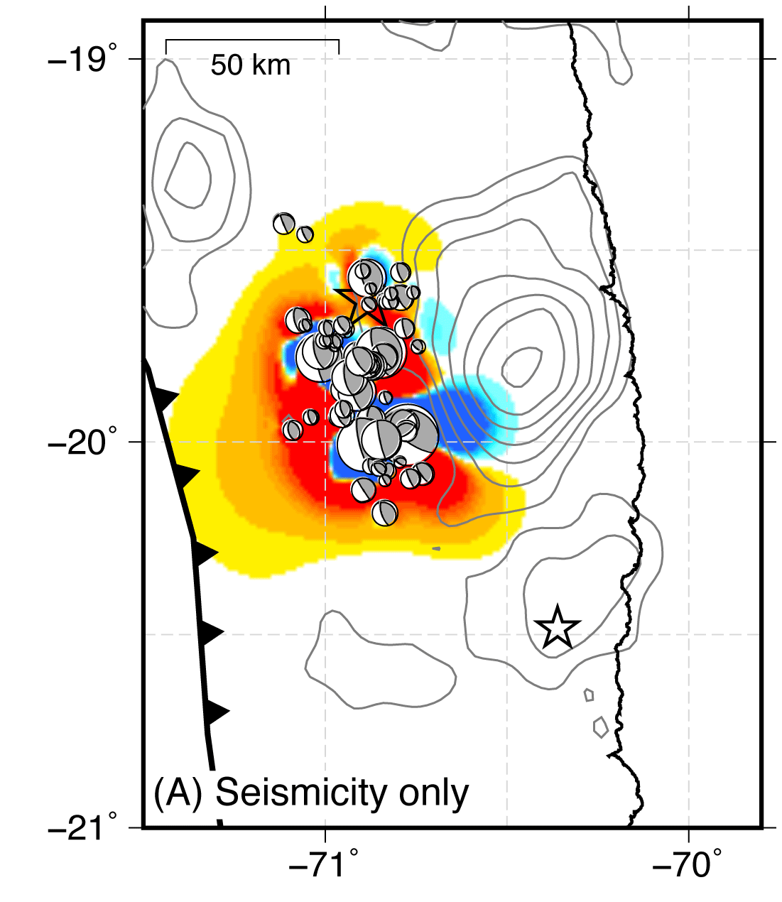
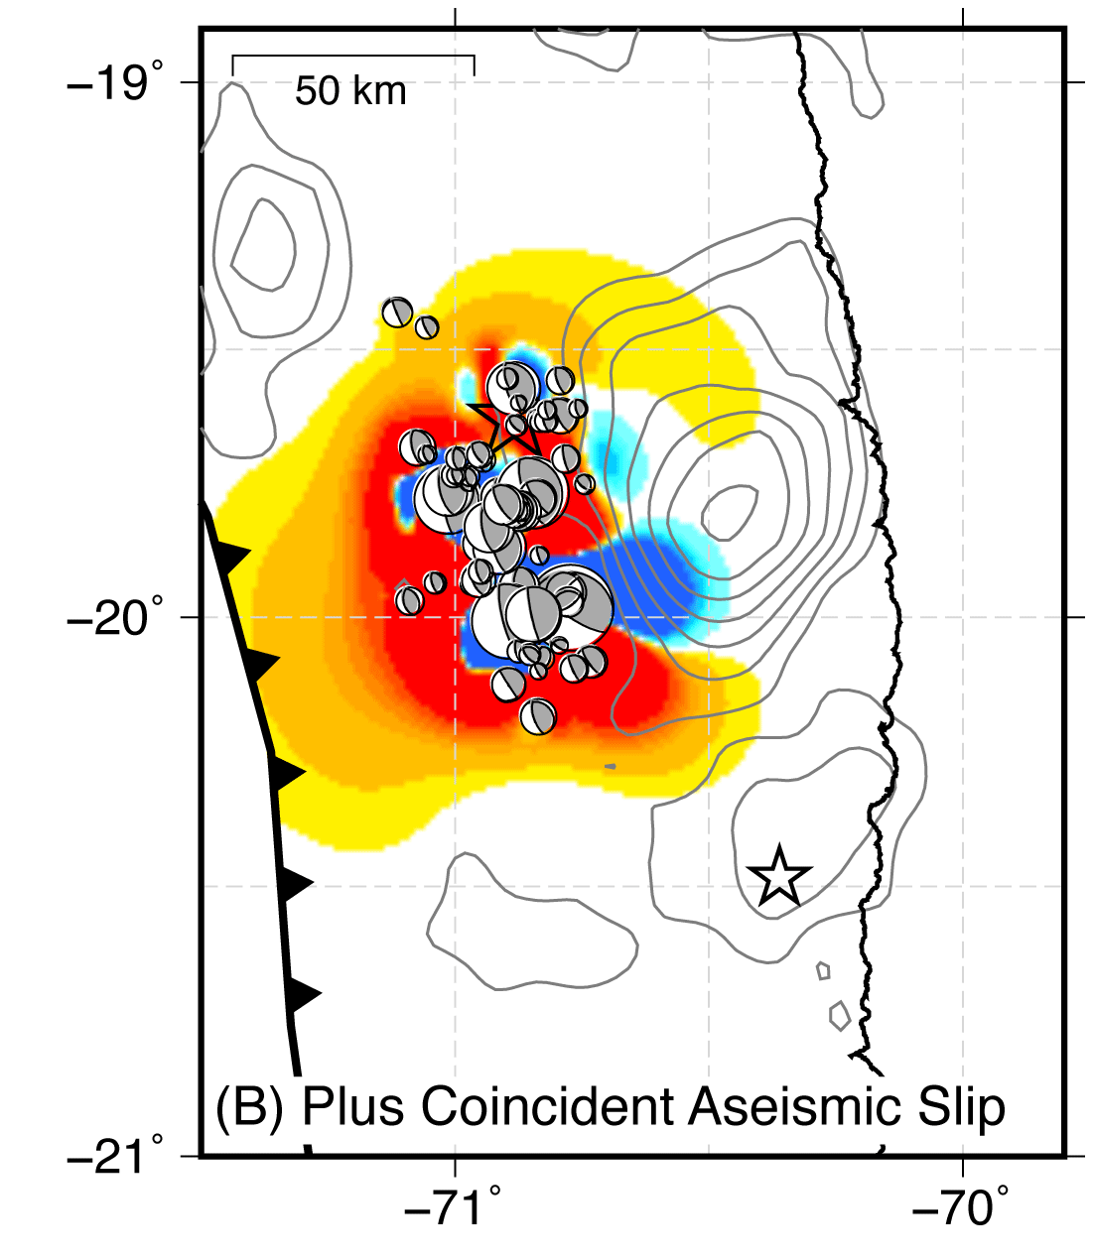
Effect of Slow Slip on Stress
Notes:
If the slow slip is coincident with the foreshocks, it seems likely that it is related to the seismicity, and we model it by simply adding slip at each foreshock location. This does not change the distribution of stress, but enhances the magnitude of the stress change.

Slide 29
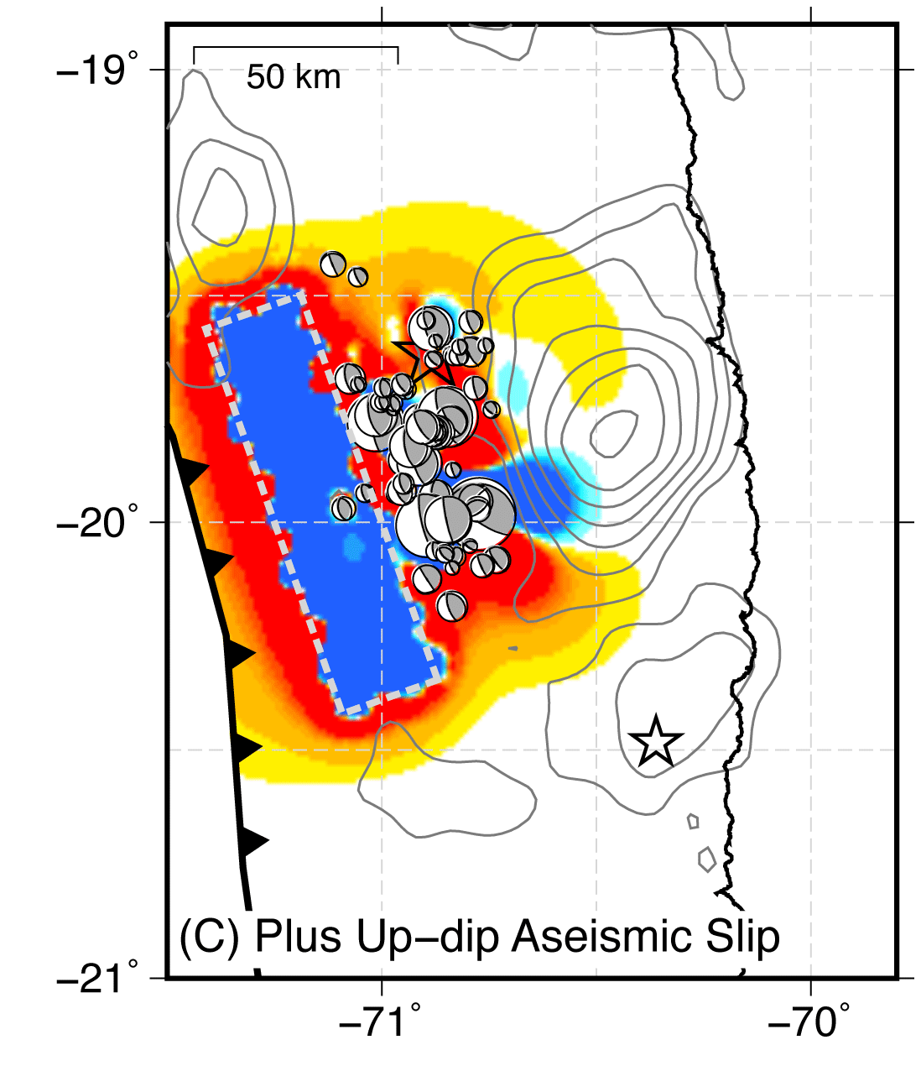
Effect of Slow Slip on Stress
Notes:
In contrast, if the slow slip occurs up-dip of the foreshocks, then we see that the entire foreshock region becomes loaded, and the up-dip region experiences a significant stress reduction. In both cases, extra aseismic slip adds a small amount of positive loading down-dip of the foreshocks, in the area that slipped a lot during the Iquique main shock. So although slow slip is not necessary to conclude that the foreshocks were sequentially triggered leading to the Iquique main shock, it does appear to enhance this triggering argument, and is consistent with the Iquique earthquake growing into the down-dip region of the plate boundary.

Slide 30
Conclusions
Seismicity alone sufficient to trigger start of 2014 Iquique earthquake
Seismicity systematically underpredicts GPS displacements => aseismic slip
Aseismic slip, located coincident with or up-dip of seismicity, enhances loading at hypocenter
Seismicity + slow slip triggered beginning of April 1st Iquique earthquake

