Slide 1
Installing LAPACK
Matt Herman

Slide 2
LAPACK
Linear Algebra Package
Contains lots of optimized matrix algebra subroutines.
Useful for small-ish matrix computations, not for bigger problems.

Slide 3
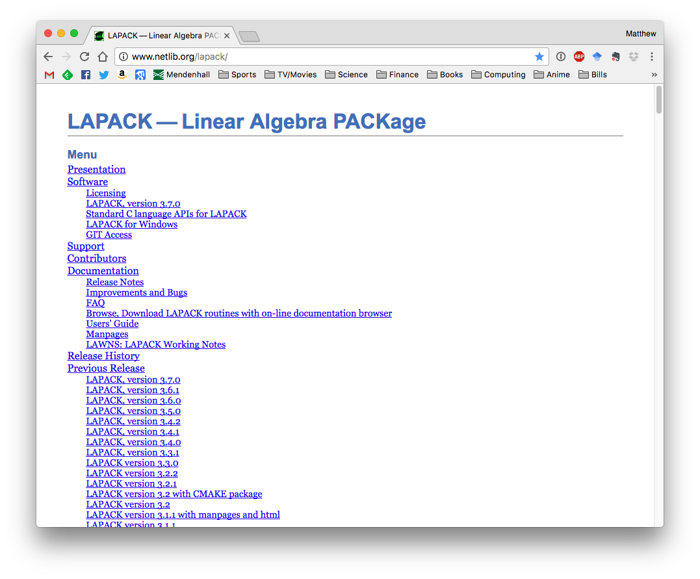
www.netlib.org/lapack

Slide 4
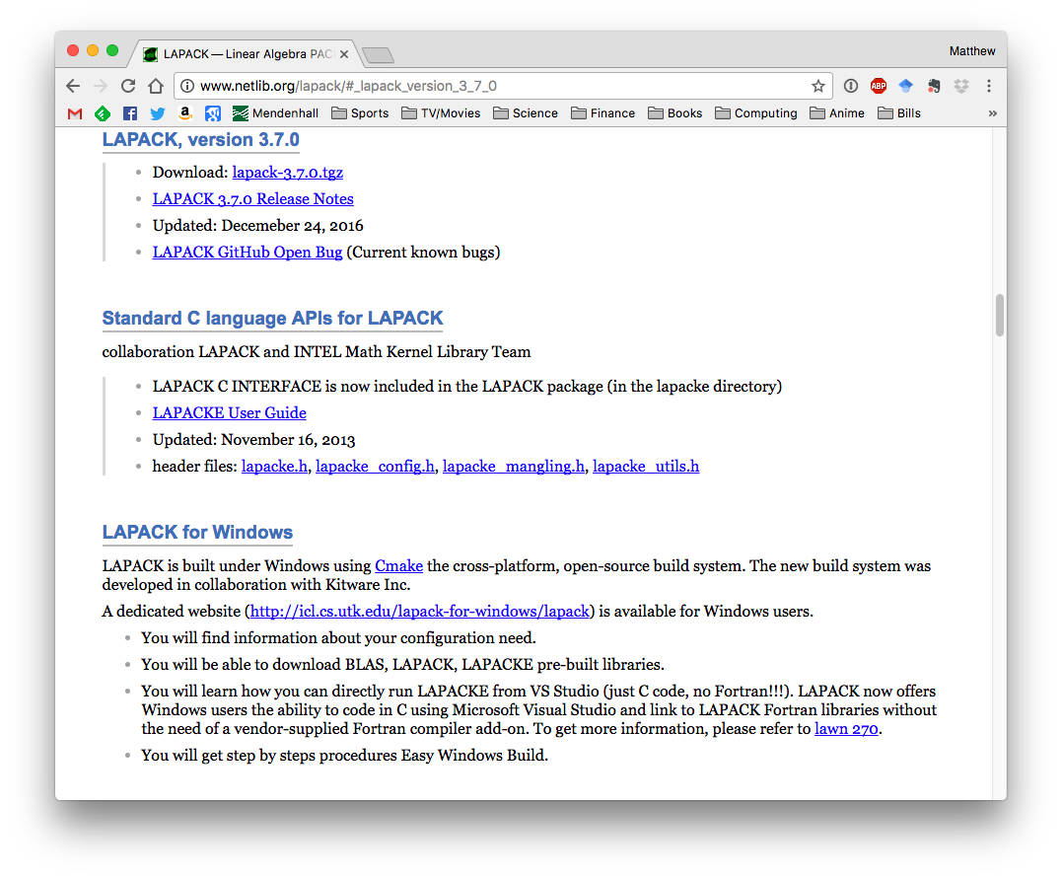
Download the tarred, zipped LAPACK source code.

Slide 5
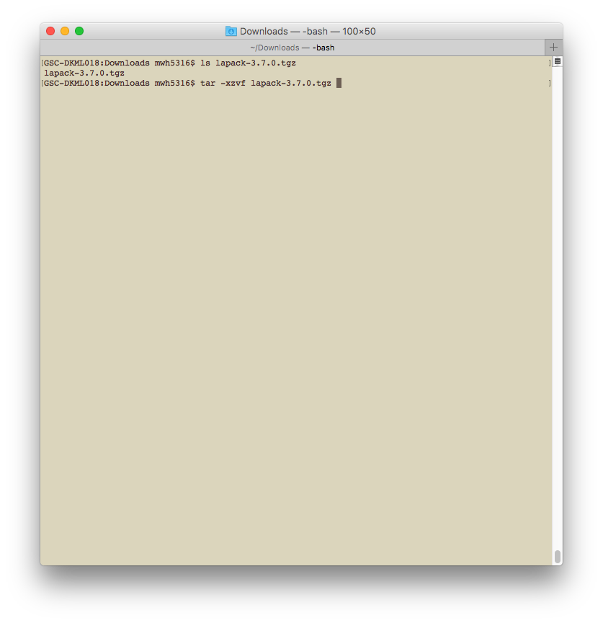
In a terminal, navigate to the location where you saved the LAPACK tarball and type:
tar -xzvf lapack-3.7.0.tgz
to unzip the tarball and extract the archive. If the name of your file is different, that is okay. Use the name of your downloaded file.
NOTE: LAPACK 3.7.1 is distributed with Hdef. It is in the ext/ directory.

Slide 6
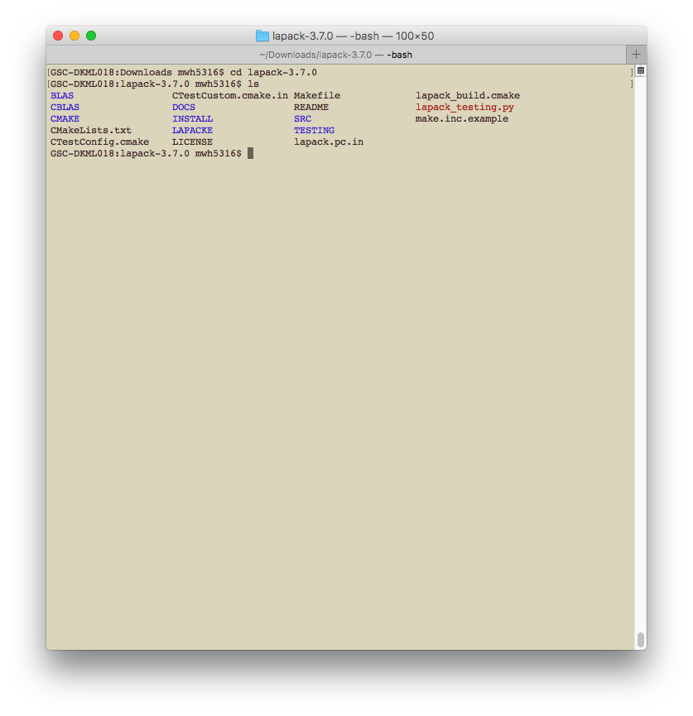
LAPACK compilation requires an include file called make.inc. An example of this file is distributed with the source code (make.inc.example). This include file usually works fine for me, since I use GFortran.
Copy the example include file with the command:
cp make.inc.example make.inc

Slide 7
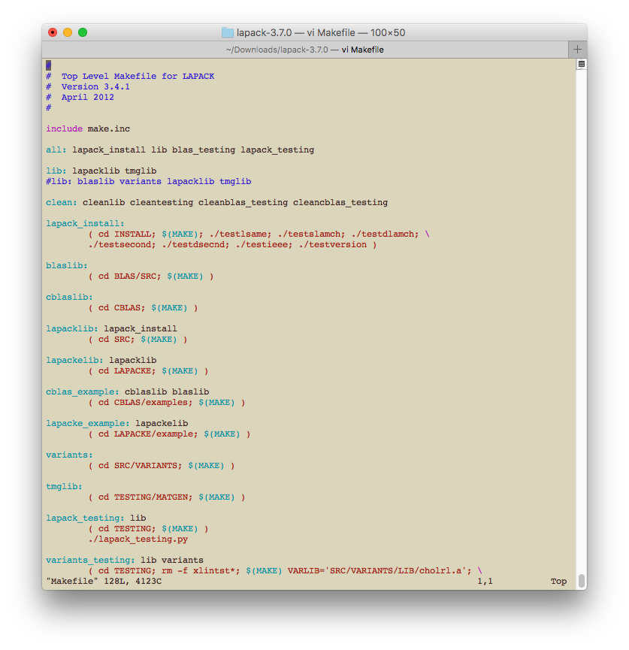
One more (annoying) little thing: the default Makefile does not compile the BLAS (Basic Linear Algebra Subroutines – the precursor to LAPACK) library. To compile BLAS, edit the Makefile.

Slide 8
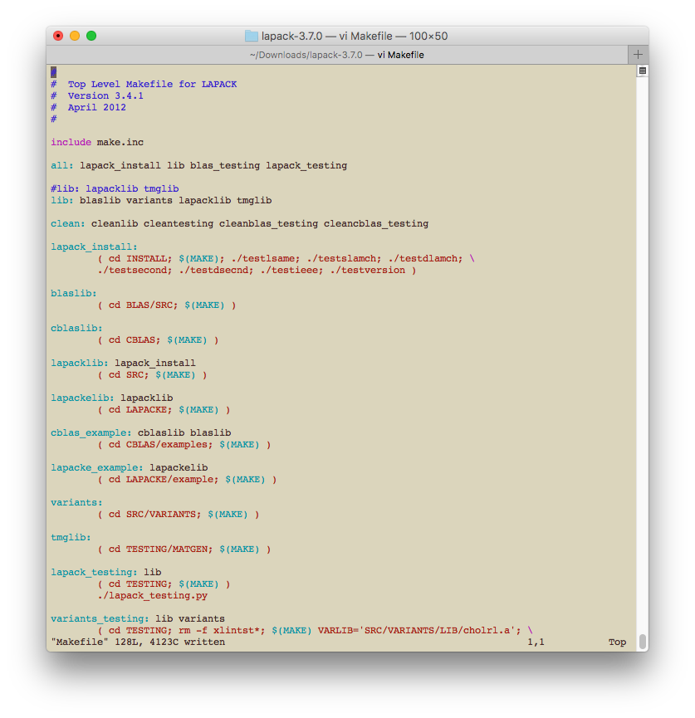
Move the “#” to be in front of the line that reads:
lib: lapacklib tmglib

Slide 9
Type “make,” hit the return key, and wait….

Slide 10
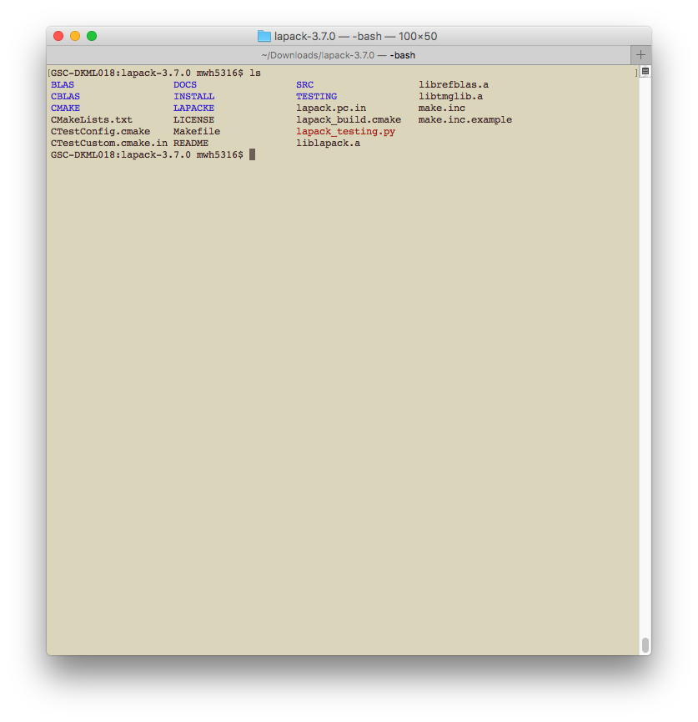
Congratulations!
You have compiled the LAPACK libraries.

