Slide 1
Installing GFortran
Matt Herman

Slide 2
Requirements
Fortran compilers are available for every type of operating system, including Mac OS, Linux, and Windows
Some are free (GFortran)
Some are not (PGFortran, Intel Fortran)
GFortran is good enough for me

Slide 3
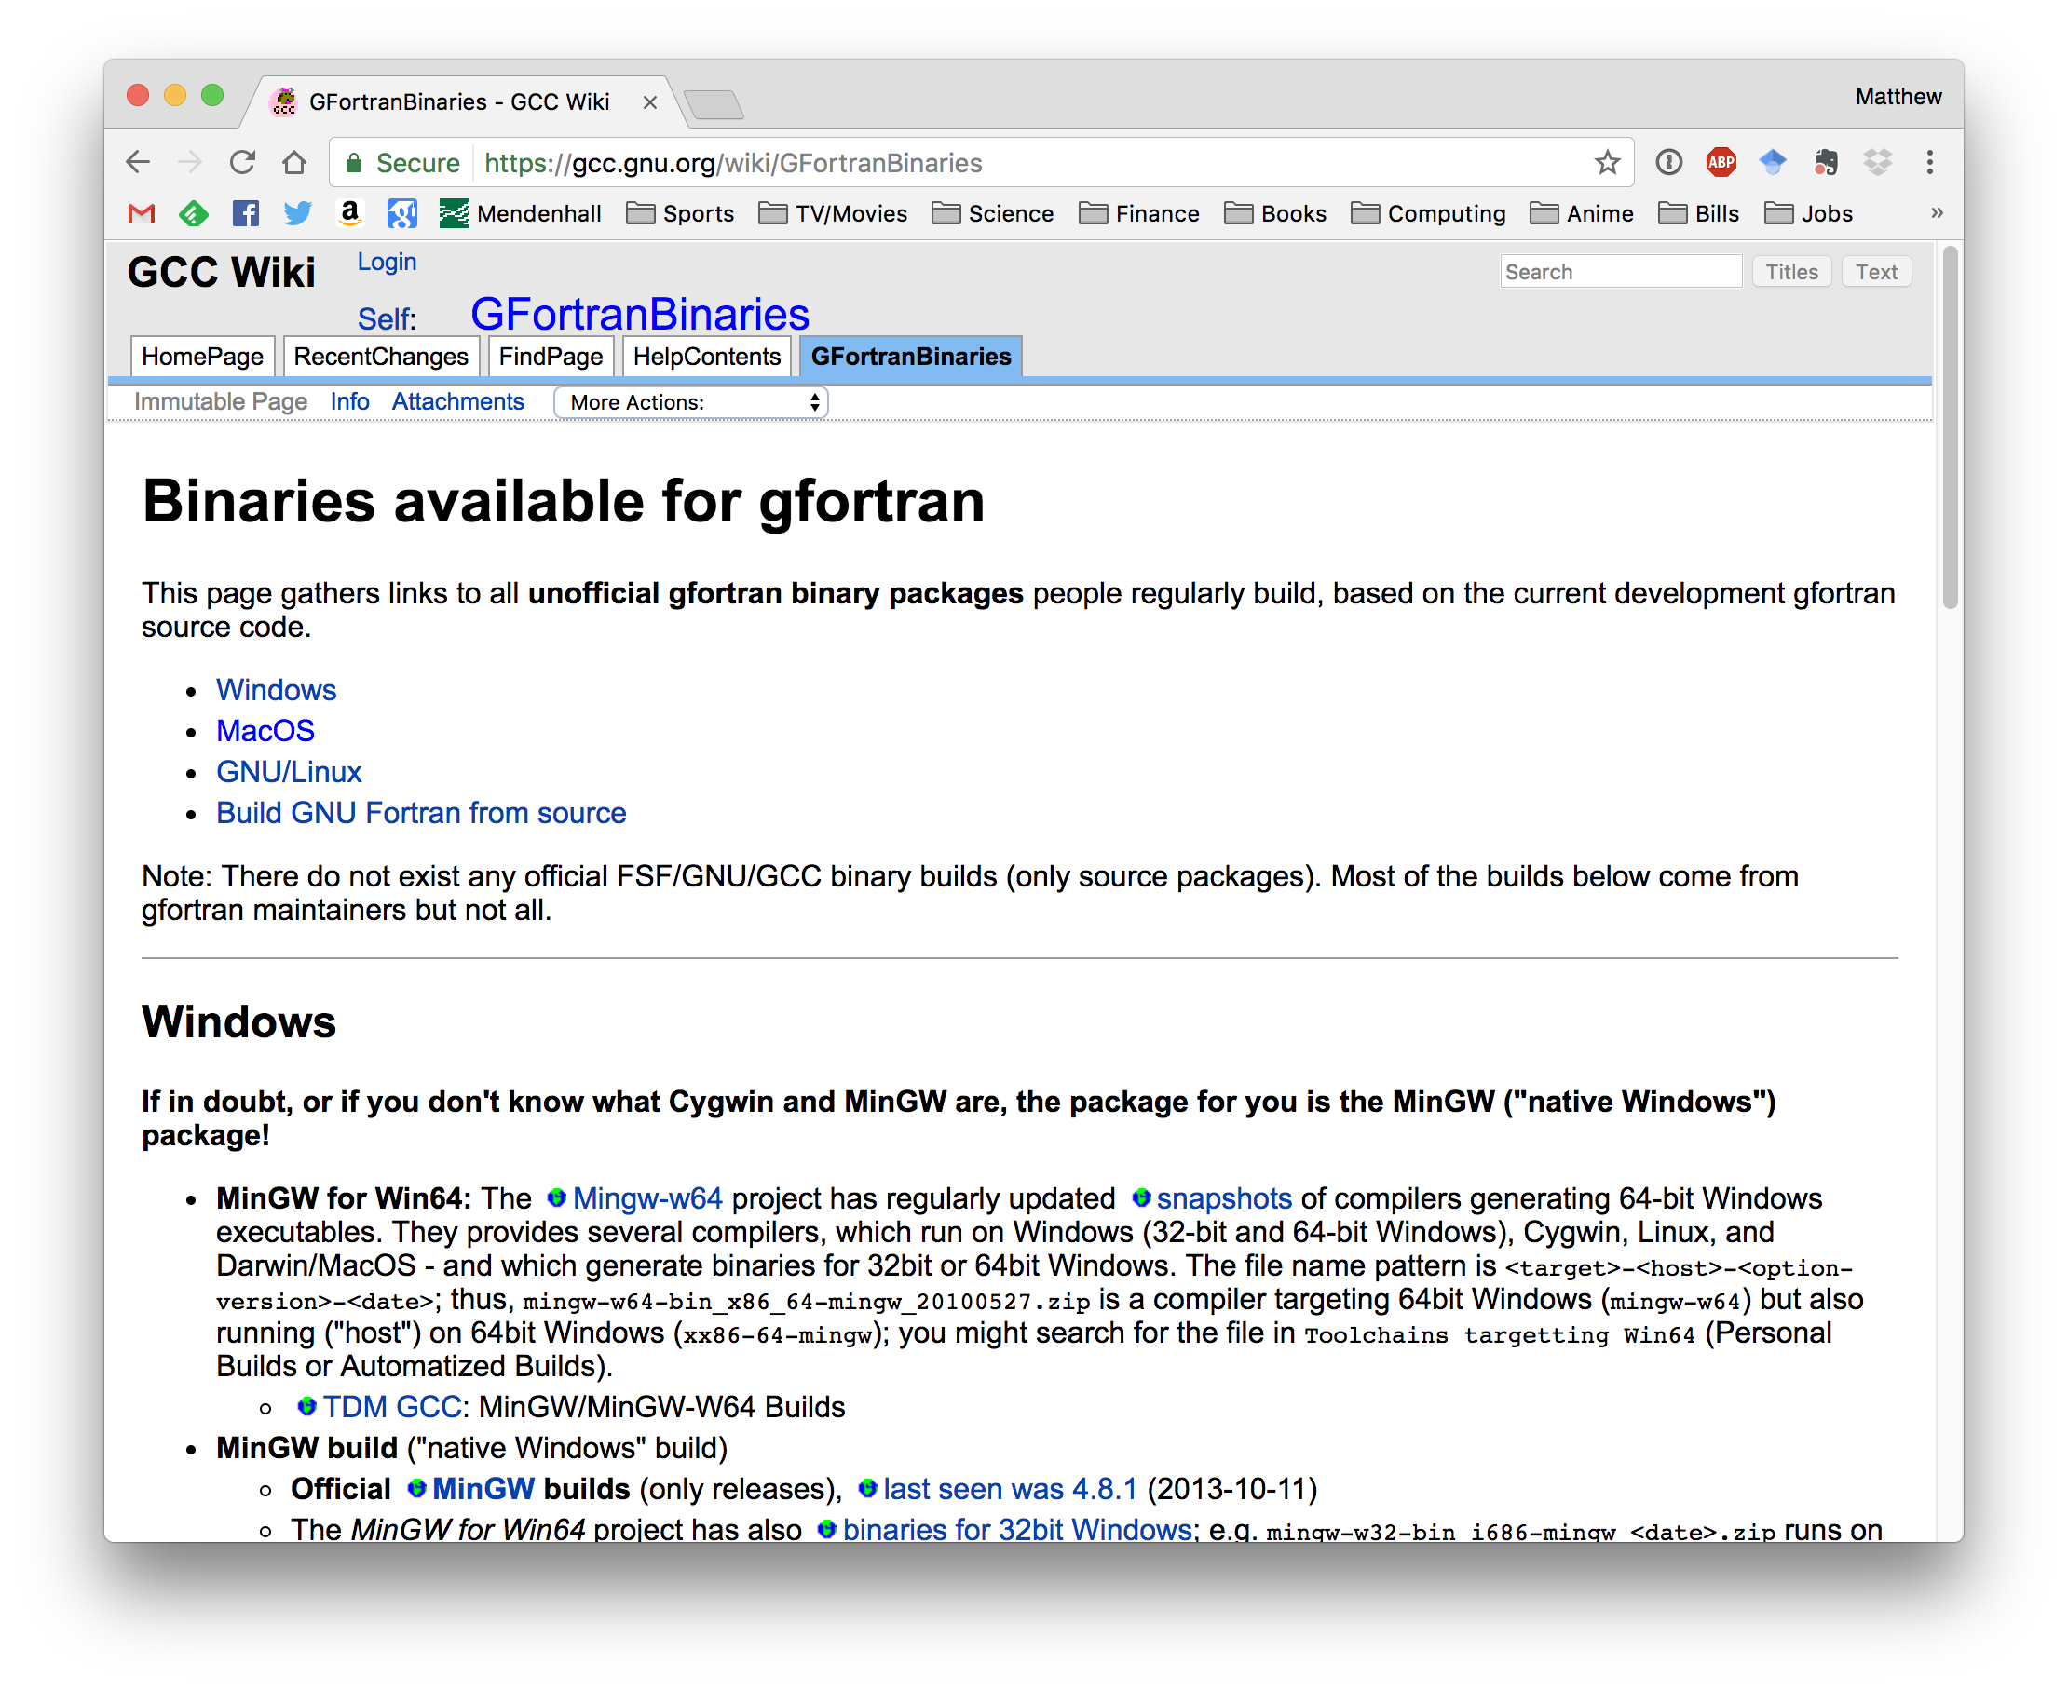
Downloading & Installing
The easiest way is to install a pre-compiled version
https://gcc.gnu.org/wiki/GFortranBinaries

Slide 4
Downloading & Installing
I use Mac OS
The easiest way is to install a pre-compiled version
https://gcc.gnu.org/wiki/GFortranBinaries

Slide 5
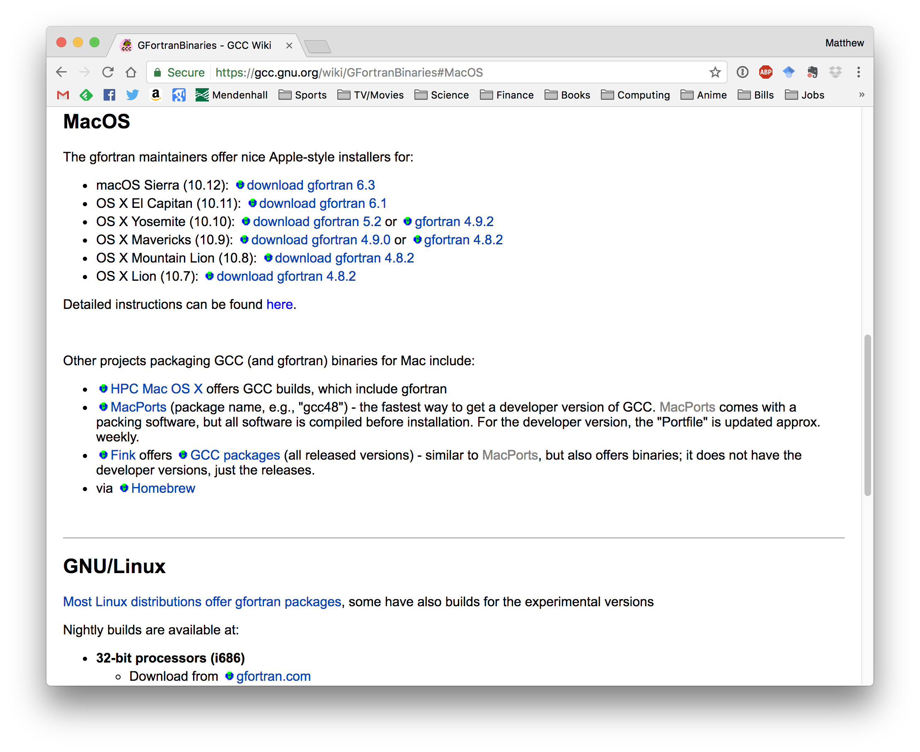
Downloading & Installing
On a Mac, just follow the instructions and install as you would a normal application.
Then open a new terminal and you are all set!
https://gcc.gnu.org/wiki/GFortranBinaries

Slide 6
Installing on Linux
I am going to operate under the assumption that Linux users know how to install packages
Buuuut, if not, try opening a terminal and typing:
  sudo apt-get install gfortran

